Slide 1
Chapter 4: Building Healthy Relationships and Communicating Effectively

Slide 2
Did You PREPARE and Did You LEARN?
Discuss the purpose and common types of intimate relationships.
Identify the characteristics of successful relationships, including how to maintain them and overcome common barriers.
Discuss ways to improve communication skills and interpersonal interactions.

Slide 3
Did You PREPARE and Did You LEARN?
Compare and contrast the different types of committed relationships.
Describe the demographic trends related to remaining single.
Examine the factors that affect decisions related to whether or when to have children.
Discuss why relationships end and how to cope when they do.

Slide 4
Intimate Relationships
Characteristics of intimate relationships include:
Behavioral interdependence
Need fulfillment
Emotional attachment
Emotional availability
Intimate relationships are a means of need fulfillment. They include:
Intimacy
Social integration
Nurturance
Assistance
Affirmation
Notes:
Behavioral interdependence refers to the impact that people have on each other as their lives and daily activities intertwine.
Intimate relationships also fulfill psychological needs and are therefore a means of need fulfillment:
Intimacy: someone with whom we can share our feelings freely
Social integration: someone with whom we can share worries and concerns
Nurturance: someone we can take care of and who will take care of us
Assistance: someone to help us in times of need
Affirmation: someone who will reassure us of our own worth and tell us that we matter
In addition, intimate relationships involve emotional attachment, feelings of love, emotional availability, or the ability to give to others emotionally and receive from them in return without fear of being hurt or rejected

Slide 5
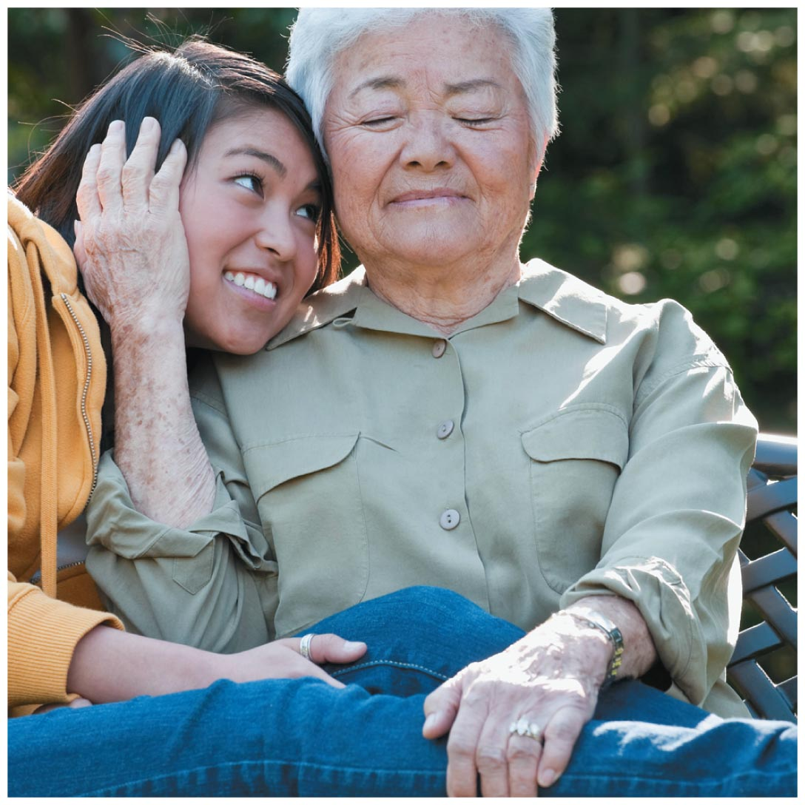
Does an Intimate Relationship Have to Be Sexual?
We may be used to hearing intimacy used to describe romantic or sexual relationships, but intimate relationships can take many forms.
Notes:
Men and women tend to view the relationship between sex and love differently. Studies show that men can generally separate love from sex, whereas women tend to view sex in the context of a relationship.

Slide 6
Relating to Yourself
Being accountable means recognizing that you are responsible for your own decisions, choices, and actions.
Self-nurturance means developing your potential through a balanced and realistic appreciation of your worth and ability.
Notes:
Students usually believe themselves to be responsible and accountable, but often this is not the case.
Ask your students if they have ever forgotten to do an assignment or prepare for a test but then come up with an excuse for the professor. This shows lack of responsibility and accountability. Would they prefer to associate themselves with someone who is responsible and accountable or with a person who lacks these qualities?

Slide 7
Self-Esteem and Self-Acceptance
The way you define yourself is your self-concept.
The way you evaluate yourself is your self-esteem.
Your acceptance of yourself influences your relationship choices.
Notes:
Invite your students to write out their self-concepts and then to evaluate themselves based on these statements

Slide 8
Family Relationships
A family is a recognizable group of people with shared roles, tasks, boundaries, and personalities.
Healthy families foster a sense of security and feelings of belonging.
Healthy families nurture and support.
It is from our family of origin, the people present in our household during our first years of life, that we initially learn about feelings, problem solving, love, intimacy, and gender roles.
Notes:
Ask students to volunteer how their families nurture and support them. Find out if the family is traditional in gender roles and boundaries or if changes are evident. Determine if further changes, such as a marriage and the introduction of a new family member, enhances or undermines the family structure.

Slide 9
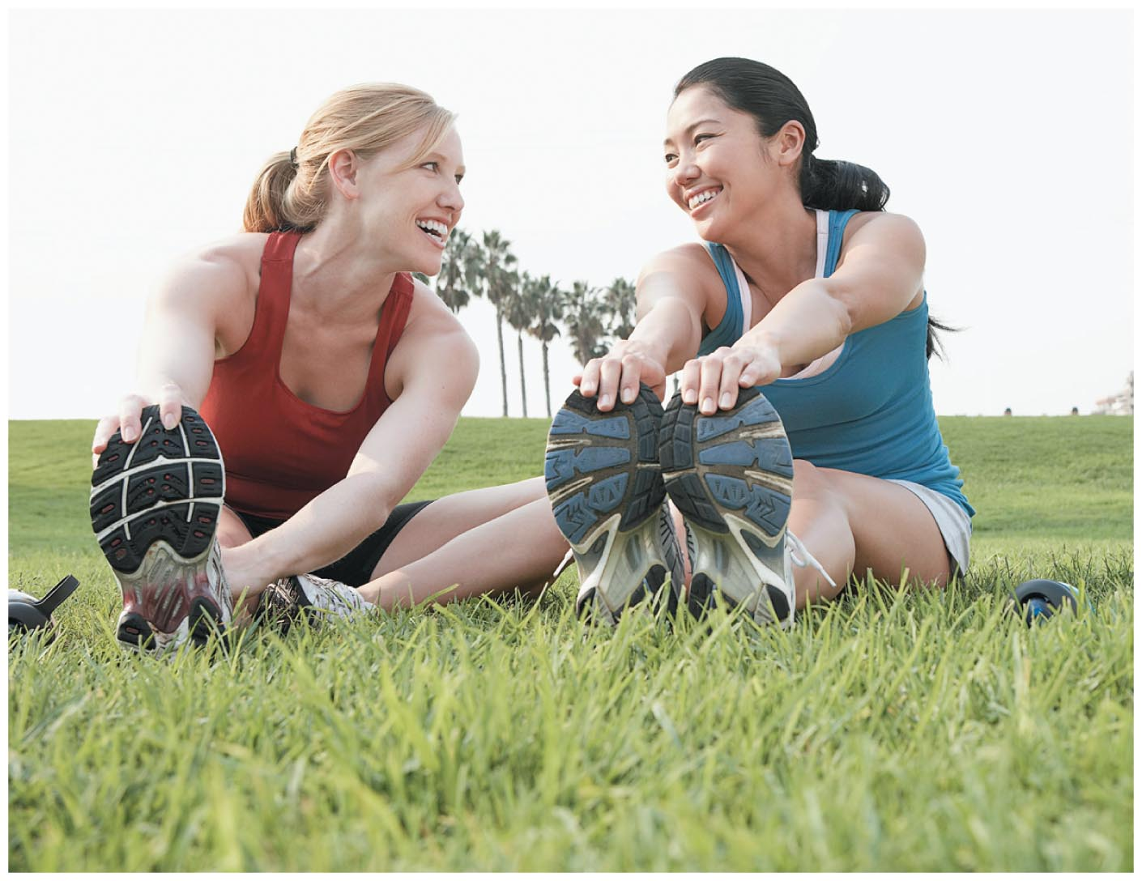
Friendships
Friendships are unique because they are voluntary relationships.
Friends provide emotional stability, and having strong friendships may predict success in loving relationships.
Notes:
Friendship differs from an intimate relationship because it does not involve passion or sexual desire. Friendships offer companionship, mutual respect, acceptance, trust, and loyalty; they also usually provide help and reciprocity.

Slide 10
Romantic Relationships
Romantic relationships typically include all the characteristics of friendships as well as the following characteristics related to passion and caring:
Fascination
Exclusiveness
Sexual desire
Giving the utmost
Being a champion or advocate
Notes:
How many among the students in your room are involved romantically?
Of that number, ask if any of them are married, and see if any married people neglected to consider themselves as in a romantic relationship.
Women and men often differ on the issue of romantic relationships, with women often needing more romance and more courtship than men.

Slide 11
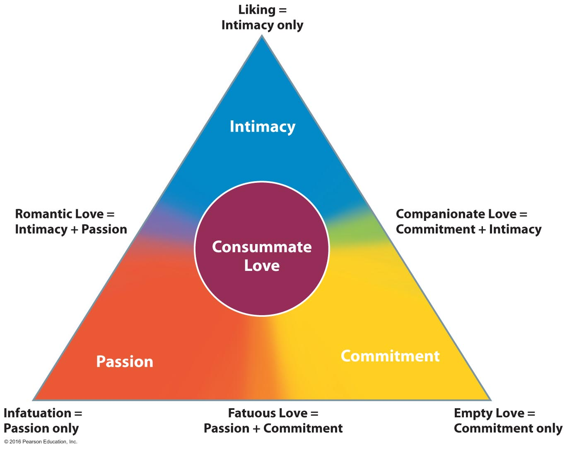
Sternberg's Triangular Theory of Love
Notes:
Love begins with high levels of passion and rapidly increasing intimacy. Passion decreases as we become more comfortable and habits are established. Passion can be revived, but lack of passion in a relationship is often viewed as a crisis. With commitment, partners usually experience a more enduring love. The key to a successful relationship is to transform passion into an intimate and committed love for one another.

Slide 12
Strategies for Success in Relationships
Characteristics of healthy relationships:
Predictability means that you can predict your partner's behavior because he or she acts in consistently positive ways.
Dependability means that you can rely on your partner to provide support in all situations.
Faith means that you feel absolutely certain about your partner's intentions and behavior.

Slide 13
Strategies for Success in Relationships
Choosing a romantic partner:
Choosing a relationship partner is influenced by more than just the chemical and psychological processes described in researchers' theories of love.
One important factor is proximity, or being in the same place at the same time.
You also choose a partner based on similarities.
A final factor that plays a significant role in selecting a partner is physical attraction.

Slide 14
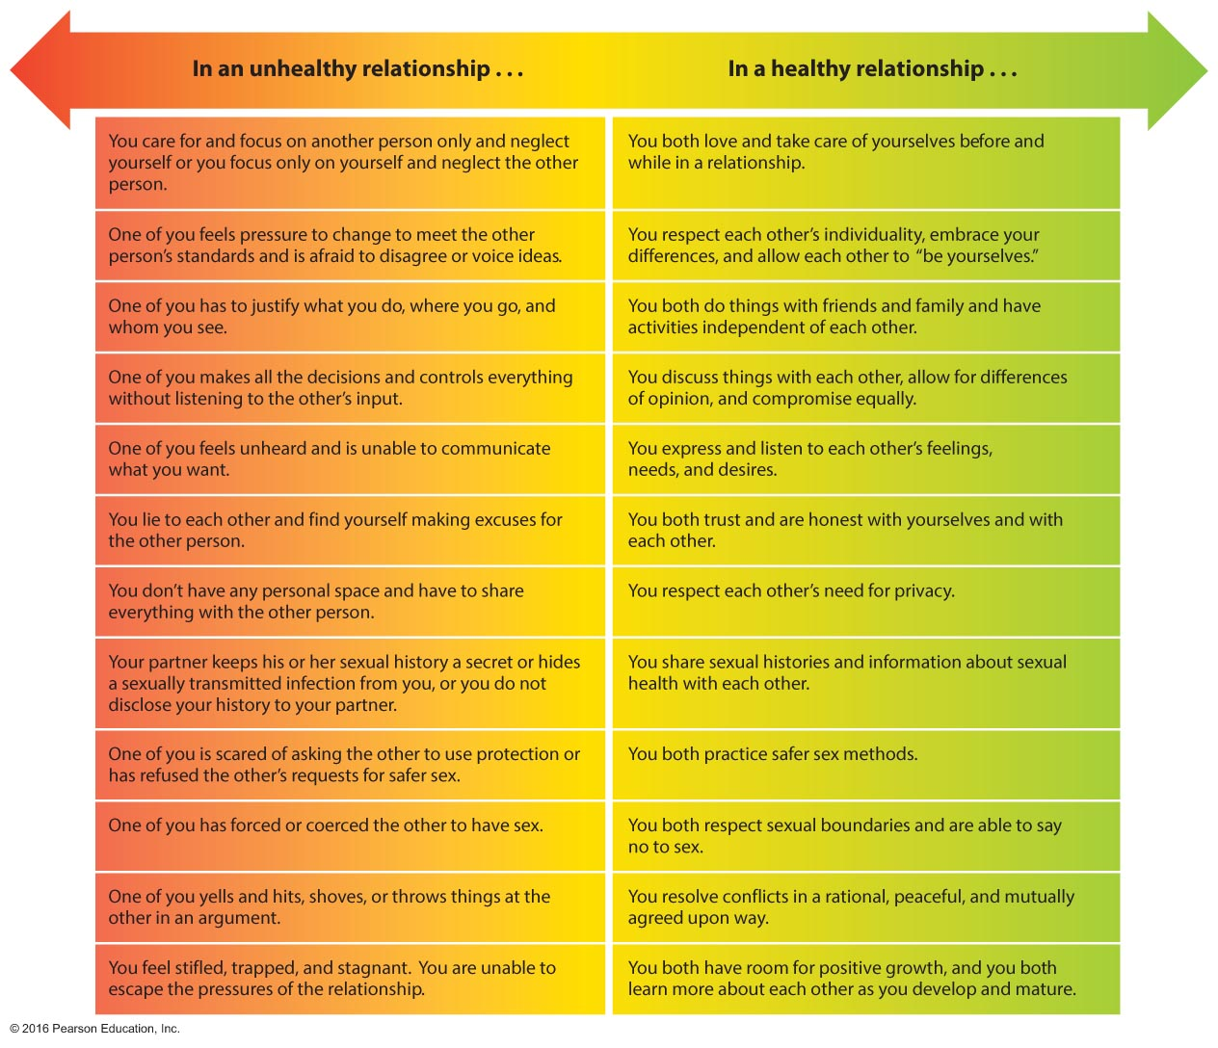
Healthy versus Unhealthy Relationships
Notes:
Students generally like to assess themselves, and this chart provides the opportunity for them to assess their relationships. It may be valuable to follow up with strategies for improving the health of a relationship and asking students to identify ways in which this can be done.

Slide 15
Communicating: A Key to Good Relationships
Learning appropriate self-disclosure
Get to know yourself.
Become more accepting of yourself.
Be willing to discuss your sexual history with your partner.
Choose a safe context for self-disclosure.
Be thoughtful about self-disclosure via social media.
Notes:
The key to any relationship—whether an intimate one with family or friends or with an acquaintance—is communication.
Before you express your feelings and thoughts, you need to understand yourself, especially with respect to your relationship with a partner.
Use "I" messages; for example, "I feel that you are not spending enough time with me."

Slide 16
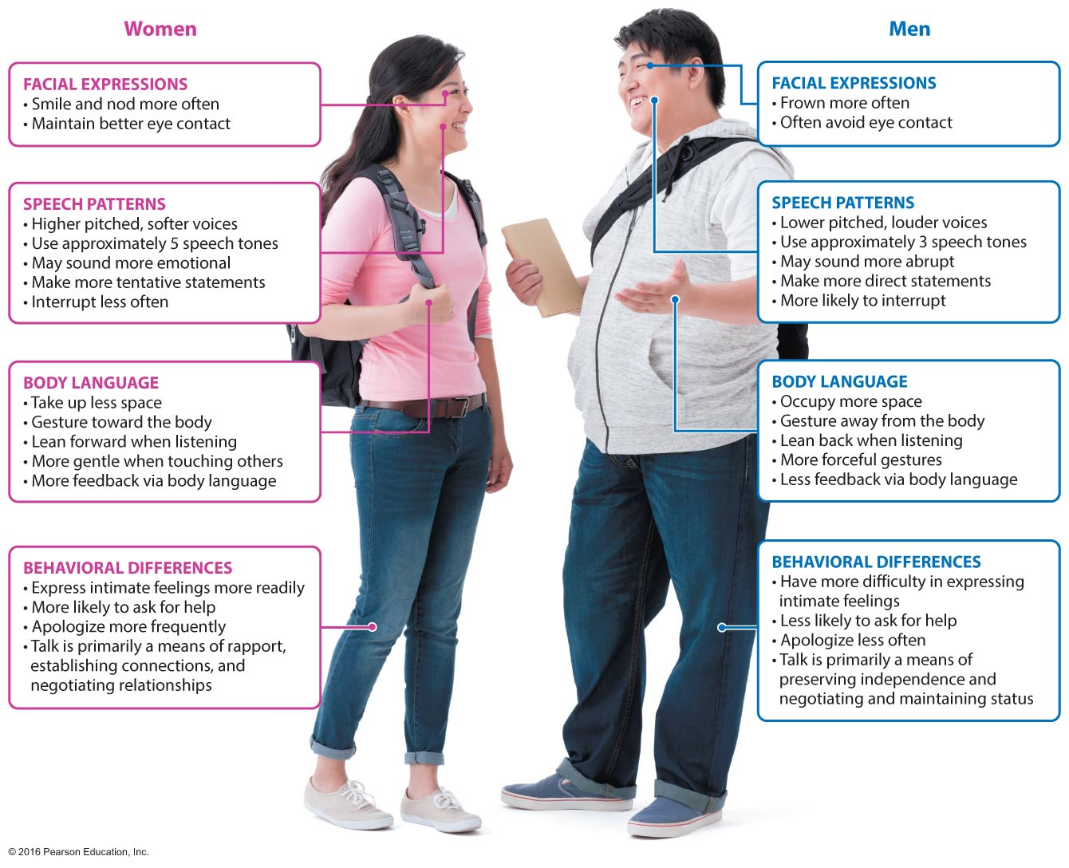
He Says/She Says
Notes:
Ask students to view the communication styles of their male and female professors. Determine if they find the females to be more nurturing than the males and if they find the males to be more competitive.

Slide 17
Becoming a Better Listener
The three basic listening modes
Competitive, or combative, listening happens when we are more interested in promoting our own point of view.
Passive, or attentive, listening occurs when we are genuinely interested in hearing and understanding the other person's point of view.
Active, or reflective, listening is active in confirming our understanding before responding with our own new message.
Notes:
We listen best when (1) we believe that the message is somehow important and relevant to us; (2) the speaker holds our attention through humor, dramatic effect, use of the media, or other techniques; and (3) we are in the mood to listen (free of distractions and worries).
Competitive, or combative, listening happens when we are more interested in promoting our own point of view than in understanding or exploring someone else's.
Passive, or attentive, listening occurs when we are genuinely interested in hearing and understanding the other person's point of view We assume that we hear and understand correctly, but we stay passive and don't verify it.
Active, or reflective, listening is the single most useful and important listening skill We are active in confirming our understanding before we respond with our own new message by restating or paraphrasing what we think the person means, reflecting it back to the sender for verification.
If you were speaking with your instructor, what type of listening would you want him or her to use? And what type of listening would your instructor want from you?

Slide 18
Using Nonverbal Communication
Nonverbal communication includes all unwritten and unspoken messages, both intentional and unintentional. Nonverbal communication can include the following:
Touch
Gestures
Interpersonal space
Body language
Tone of voice
Facial expressions
Notes:
Ask the students "What percentage of communication is nonverbal?" (Answer: on average, 90 percent!) Point out that they are all communicating with you right now, and remark on their body language: sleepy, bored, interested, etc.
Ideally, our nonverbal communication matches and supports our verbal communication. This is not always the case, though. Research shows that when verbal and nonverbal communication don't match, we are more likely to believe the nonverbal cue.s

Slide 19
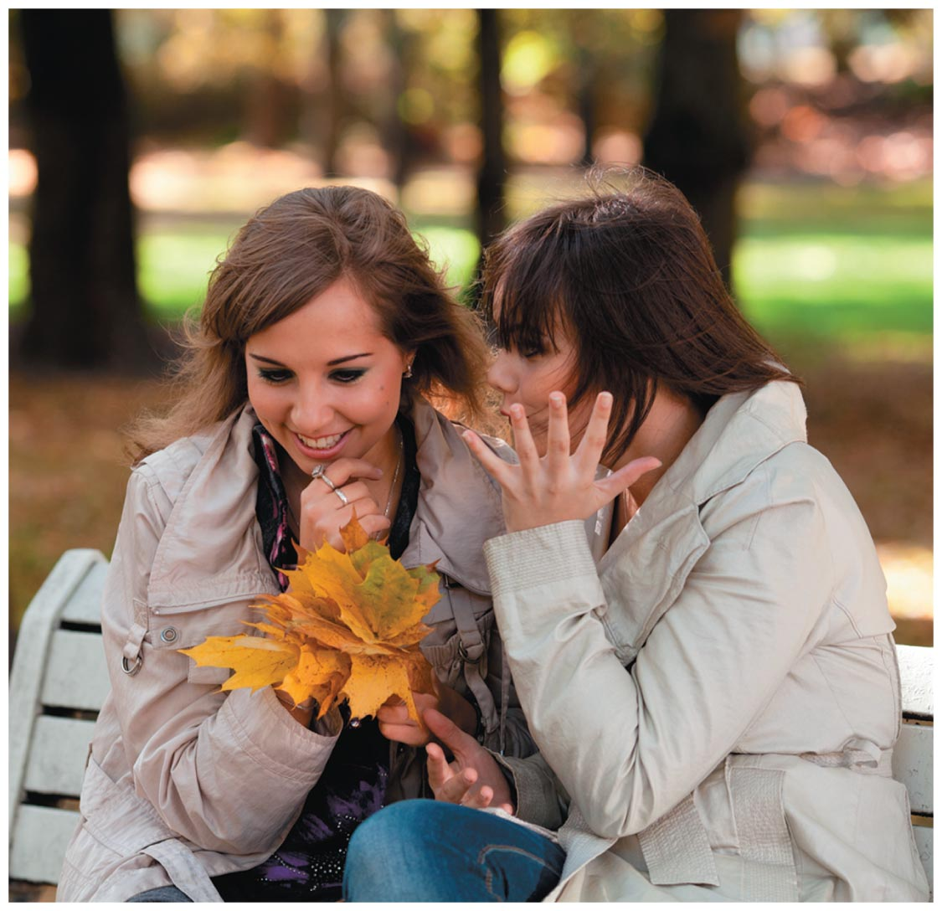
How Can I Communicate Better?
Notes:
Have students work in pairs. One of each pair will provide information on their goals, ambitions, and two or three problems they currently face. Once this is said, the second person will respond.
Now ask the couples how much of what was said was addressed in follow-up statements. Was advice offered, was empathy shown, and did the listener use body language to express interest? During the response, did the first speaker interrupt to make corrections or use "yes, but…" statements?

Slide 20
Managing Conflict Through Communication
Some strategies for conflict resolution include:
Identifying the problem or issues
Generating several possible solutions
Evaluating the alternative solutions
Deciding on the best solution
Implementing the solution
Following up
Notes:
In viewing possible solutions, consider the potential positive and negative consequences of each.

Slide 21
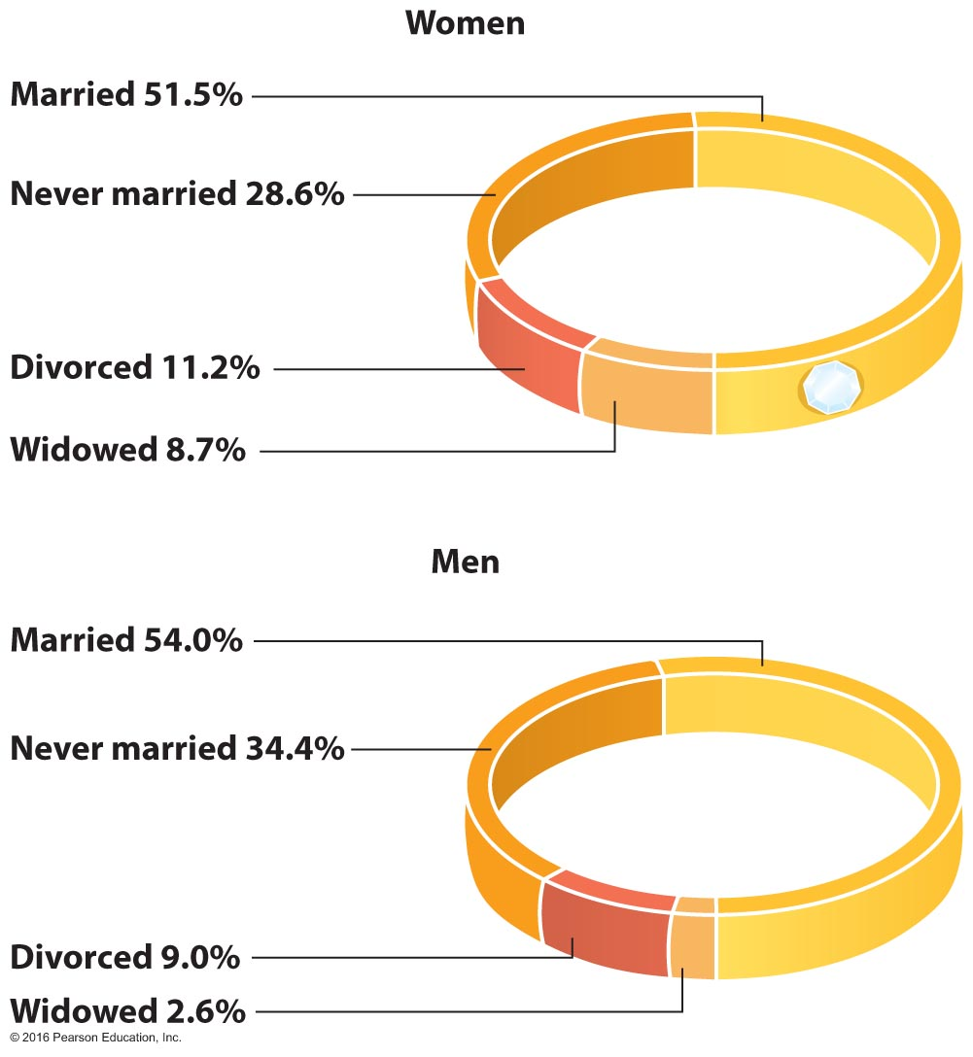
Committed Relationships
Commitment in a relationship means that there is an intent to act over time in a way that perpetuates the well-being of the other person, oneself, and the relationship.
Marriage
Cohabitation
Staying single
Choosing whether to have children
Notes:
Click to add notes

Slide 22
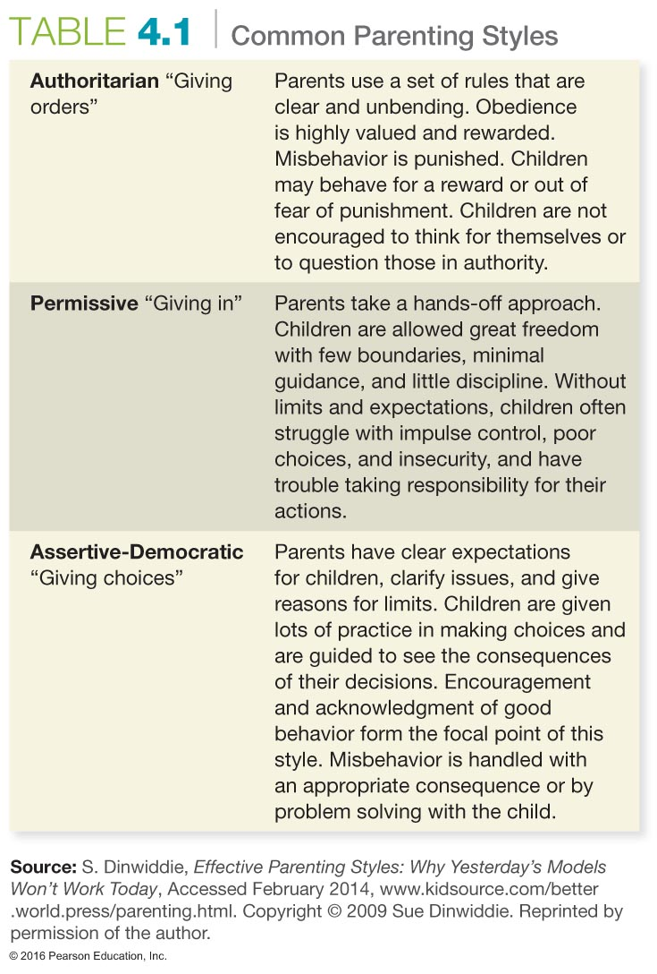
Common Parenting Styles
Notes:
Ask students what style their parents used and what styles they think they might adopt with their children.

Slide 23
When Relationships Falter
Relationship breakdown usually begins with a change in communication.
College students are particularly likely to remain in unhealthy relationships because they may feel socially isolated.
Honesty and verbal affection should not be abused to cover up irresponsible or hurtful behavior.
Notes:
Communication styles that include criticism, contempt, and withdrawal or defensiveness may lead to troubled relationships.

Slide 24
Confronting Couple Issues
Jealousy may be caused by:
Overdependence on the relationship
Severity of the threat
High value on sexual exclusivity
Low self-esteem
Fear of losing control
Notes:
Jealousy does not indicate love. It merely reflects a person who may be insecure or overly possessive. People with a high level of self-esteem are less likely to feel jealous. If jealousy does arise, it's important for the partners to communicate clearly about their feelings.

Slide 25
Confronting Couple Issues
Changing gender roles: Modern society has very few gender-specific roles.
Sharing power: The dynamics between men and women changed as women began enjoying their own financial success.
Unmet expectations: The failure to communicate our expectations can lead to disappointment and hurt.
Notes:
In today's society, we do not have traditional gender roles; men do not always make more money than women, and sometimes men stay home to be with the kids. Ask students the following: In your relationship, who is going to do the laundry, shop, do yard work, change diapers, and balance the checkbook? These are very important questions that you and your partner will have to answer.
Fairy-tale notions come back to haunt us in marriage. One partner might have unrealistic notions of what the other partner is supposed to be or do. One might think the other should help make dinner or clean up, when in reality the other person has never before done these tasks. If one tries to change the other to fit his or her notion of relationship roles, it will most likely become a set-up for disaster.

Slide 26
When and Why Relationships End
The divorce rate in the United States has never exceeded 40 percent.
Relationships may end because of illness, financial concerns, or career problems.
Unmet expectations, failure to communicate, and differences in sexual needs can all lead to the ending of a relationship.
Notes:
Discuss as a class why we generally view the divorce rate as at about 50 percent. Does knowing that it is actually lower than that change anyone's view of marriage? See what the divorce rate is in your classroom, either among the parents of your students or among students who have married.

Slide 27
Coping with Failed Relationships
Consider these tips for coping with a failed relationship:
Recognize and acknowledge your feelings.
Find healthful ways to express your emotions, rather than turning them inward.
Spend time with current friends or reconnect with old friends.
Don't rush into rebound relationships.
Notes:
Perhaps add to the list: Recognize how the relationship benefited you and consider what lessons you are taking with you.
Remind students that there can be life after love.

Slide 28
Assessing Yourself—A Personal Inventory
Go online to MasteringHealth to take the "How Well Do You Communicate?" assessment.
Evaluate your relationships, and identify one area in each that you would like to improve.

