Slide 1
Chapter 12: Avoiding Drug Misuse and Abuse

Slide 2
Did you PREPARE and did you LEARN?
Explain how drugs affect physical functions and activate the brain's pleasure circuit.
List and describe the six categories of drugs and their routes of administration.
Review problems relating to the misuse and abuse of prescription drugs, including the use of illicit drugs among college students.
Notes:
Ask students to write down any illicit drug they have ever used. Have them consider using tobacco or alcohol earlier than the legal ages. Ask them to leave their names off their papers. Pass around an envelope in which to collect the answers. As you move through the lecture, review their answers with the group.

Slide 3
Did you PREPARE and did you LEARN?
Discuss the use and abuse of controlled substances, including cocaine, amphetamines, marijuana, opioids, hallucinogens, club drugs, inhalants, and steroids.
Provide examples of treatment and recovery options for addicts and their effectiveness.
Profile illicit drug use in the United States, including who uses illicit drugs, financial impact, and impact on college campuses and the workplace.

Slide 4
Drug Dynamics
Drugs work because they are similar to chemicals produced naturally in the body.
According to the receptor site theory, drugs bind to specific receptors within the body.
Psychoactive drugs can alter mood or behavior by acting on neurotransmitters in the brain.

Slide 5
How Drugs Affect the Brain
Pleasure, or reward, is a powerful biological force for survival.
Life-sustaining activities stimulate specialized nerve cells devoted to producing and regulating pleasure.
A neurotransmitter is one of many chemical substances that transmit nerve impulses along nerve fibers.
Notes:
All addicting drugs can activate the brain's pleasure circuit. Drug addiction is a biological, pathological process that alters the way in which the pleasure center functions. Psychoactive drugs change the way the brain works by affecting chemical neurotransmission, either enhancing or suppressing it.
5

Slide 6
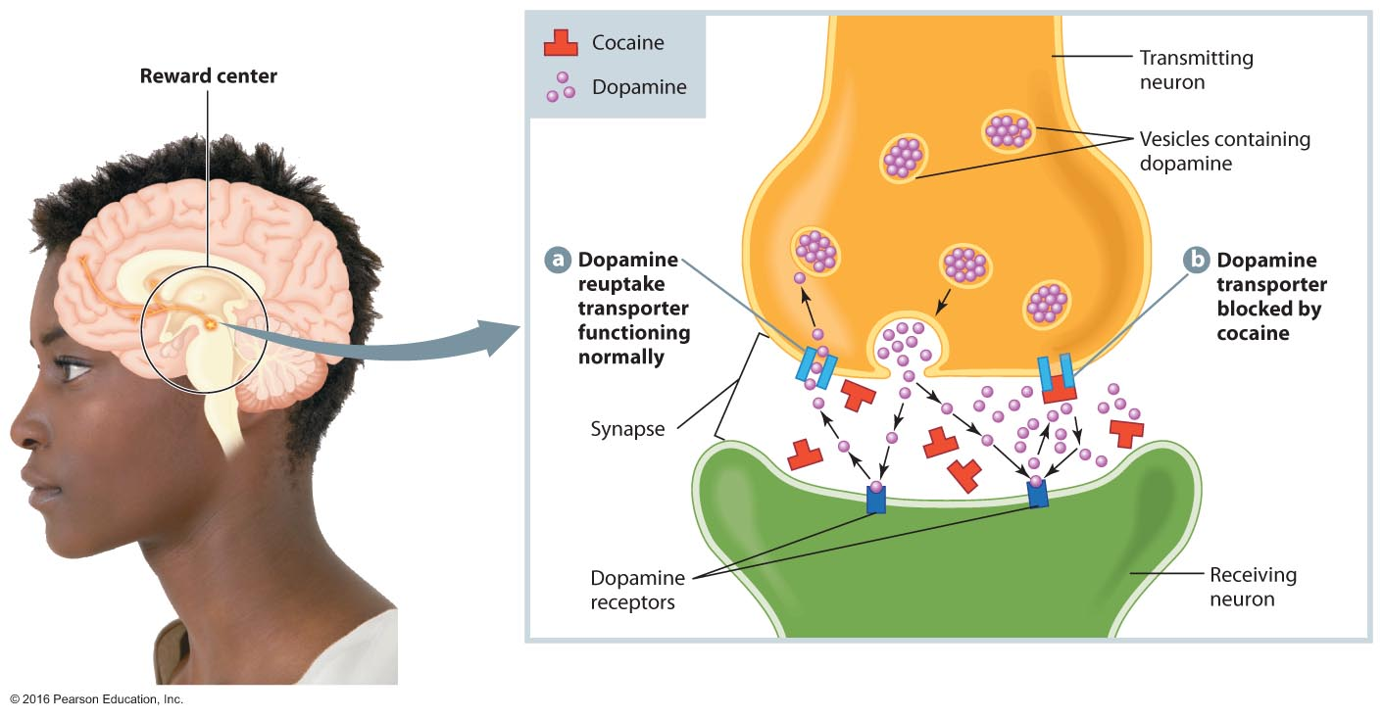
The Action of Cocaine at Dopamine Receptors in the Brain, an Example of Psychoactive Drug Action

Slide 7
Types of Drugs
Prescription drugs
Over-the-counter (OTC) drugs
Recreational drugs
Herbal preparations
Illicit (illegal) drugs
Commercial preparations
Notes:
More than 10,000 prescription drugs are sold in the United States.
More than 100,000 OTC drugs are available.
Recreational drugs are a vague category of drugs that contain chemicals to help people relax or socialize. Alcohol, tobacco, and caffeine products are in this category.
There are about 750 herbal preparations.
Illicit drugs are generally recognized as harmful.
Commercial preparations are universally used, yet they are not recognized as drugs. They include perfumes, cosmetics, household cleansers, paints, glues, dyes, inks, and pesticides.
7

Slide 8
Routes of Drug Administration
Oral ingestion: Taken by mouth
Inhalation: Sniffed, smoked, or inhaled
Injection: Administered either intravenously or subcutaneously
Transdermal: Absorbed through the skin, vagina, or anus (suppositories)
Notes:
Generally, inhalation causes the drug to reach the brain quicker, followed by intravenous injection.
8

Slide 9
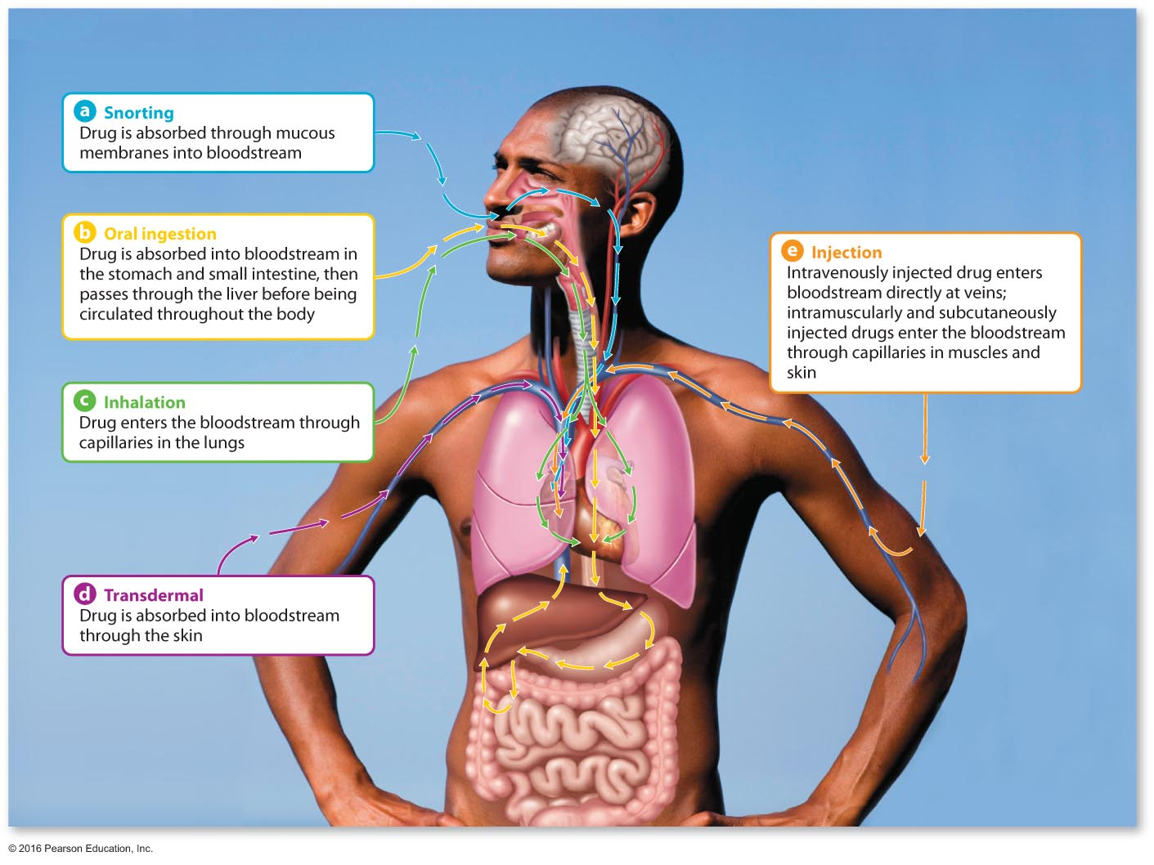
Routes of Drug Administration

Slide 10
Drug Interactions
Polydrug use: Where several substances are taken simultaneously
Synergism (potentiation): Where the effects of two or more drugs are multiplied beyond what is expected if each were taken alone
Antagonism: Where one drug blocks the action of another drug
Inhibition: Where the effects of one drug are eliminated or reduced by the presence of another drug
Intolerance: When drugs combine in the body to produce extremely uncomfortable reactions
Cross-tolerance: Where tolerance to one drug transfers to a second drug

Slide 11
Using, Misusing, and Abusing Drugs
Drug misuse involves using a drug for a purpose other than that for which it was intended.
Drug abuse, the excessive use of any drug, may cause serious harm.
Both misuse and abuse can lead to addiction.
Notes:
Ask students for examples of what might be considered drug misuse.
Examples are taking someone else's prescription, taking more than the recommended dose, not following the prescription label, taking a drug for a purpose for which it is not intended, and so on.
11

Slide 12
Abuse of Over-the-Counter (OTC) Drugs
OTC medications can be abused, with resultant health complications.
The most likely candidates for abuse are teens, young adults, and people over aged 65.
Examples of abused OTC drugs include sleep aids, cold medicines, and diet pills.

Slide 13
Nonmedical Use or Abuse of Prescription Drugs
Only marijuana is more widely abused than prescription drugs.
Over 6.1 million Americans over the age of 12 have used prescription drugs for nonmedical reasons in the last month.
The prescription drugs most likely to be abused include opioids/narcotics, depressants, and stimulants.

Slide 14
See It! Video: Government Crackdown on Painkillers
Discussion Questions
How have some medical doctors contributed to the prescription drug epidemic?
Will greater restrictions on Vicodin and other painkillers help reduce drug use and appeal or will people become more aggressive in searching for the drug(s)? Explain your answer.
Given the number of Americans hooked on Vicodin, how might restrictive measures decrease use? What are appropriate measures of restriction?

Slide 15
College Students and Prescription Drug Abuse
Prescription drugs can be as unsafe or even more unsafe that illegal drugs.
3 percent of teenagers age 12 to 17 and 5 percent of people 18 to 25 reported abusing prescription drugs in the past month.
Nearly 15 percent of twelfth-graders reporting abuse of prescription drugs by the time they graduate from high school.
Stimulant drugs used to treat attention deficit hyperactivity disorder (ADHD) are of particular concern.

Slide 16
Illicit Drugs
In the past month, approximately 6.1 million Americans age 12 and older used prescription drugs for nonmedical reasons.
In 2013, 14.9 percent of college students reported illegally using prescription drugs. Marijuana use is also on the rise.

Slide 17
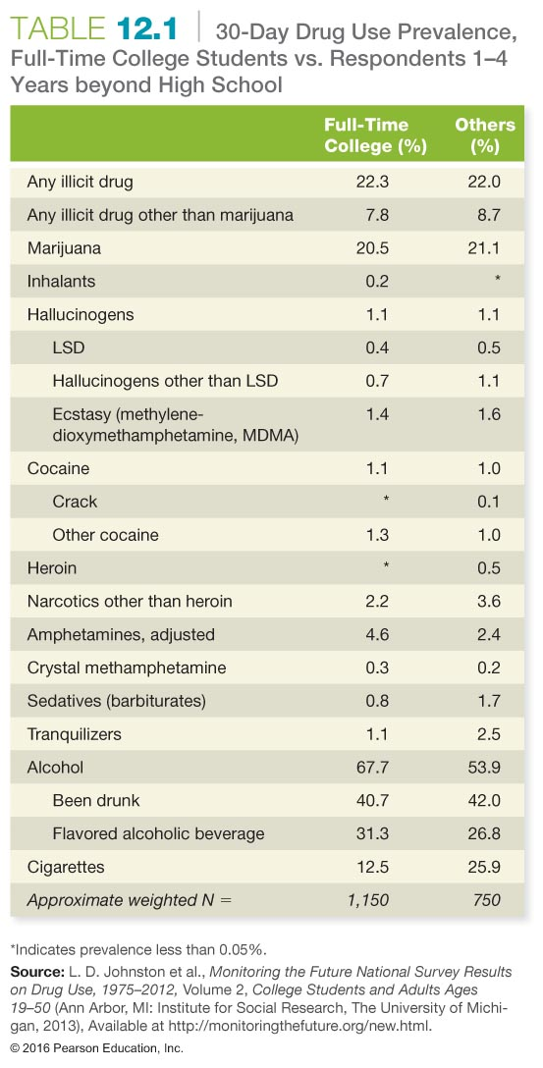

Slide 18
Why Do Some College Students Use Drugs?
Positive expectations
Genetics and family history
Substance use in high school
Mental health problems
Sorority and fraternity membership
Stress

Slide 19
Why Don't Some College Students Use Drugs?
Parental attitudes and behavior
Religion and spirituality
Student engagement
College athletics
Healthy social network

Slide 20
Common Drugs of Abuse
Stimulants
Marijuana and other cannabinoids
Depressants and narcotics
Hallucinogens
Inhalants
Steroids

Slide 21
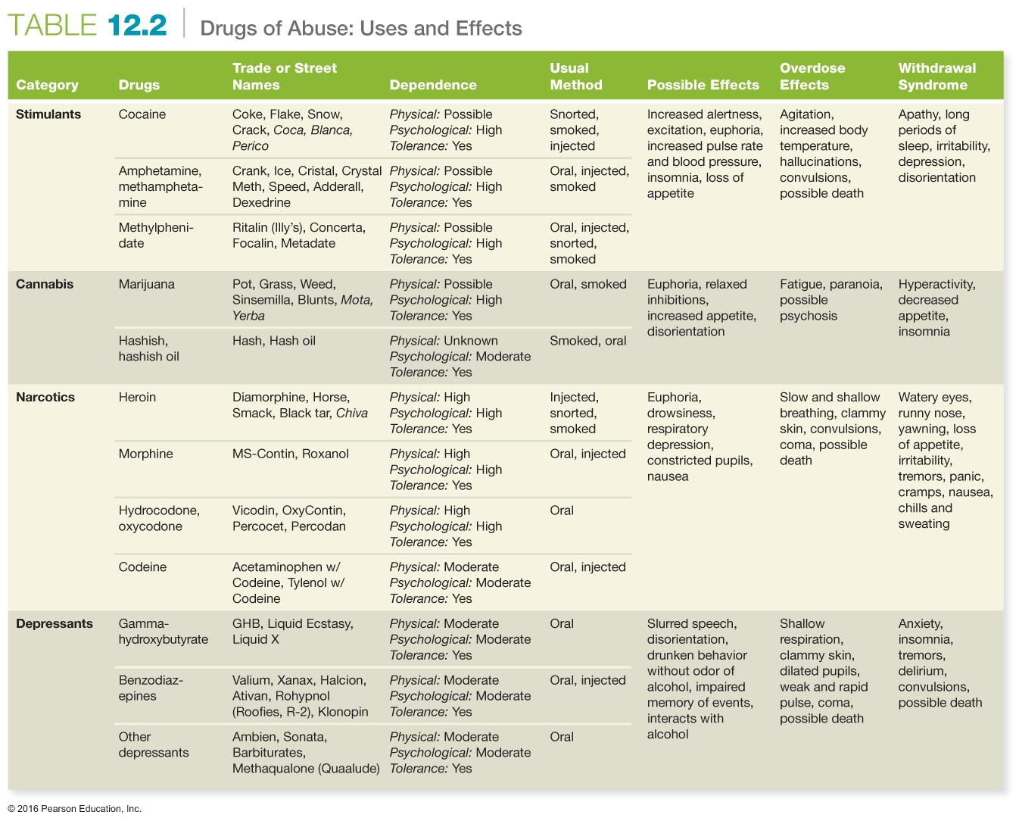

Slide 22
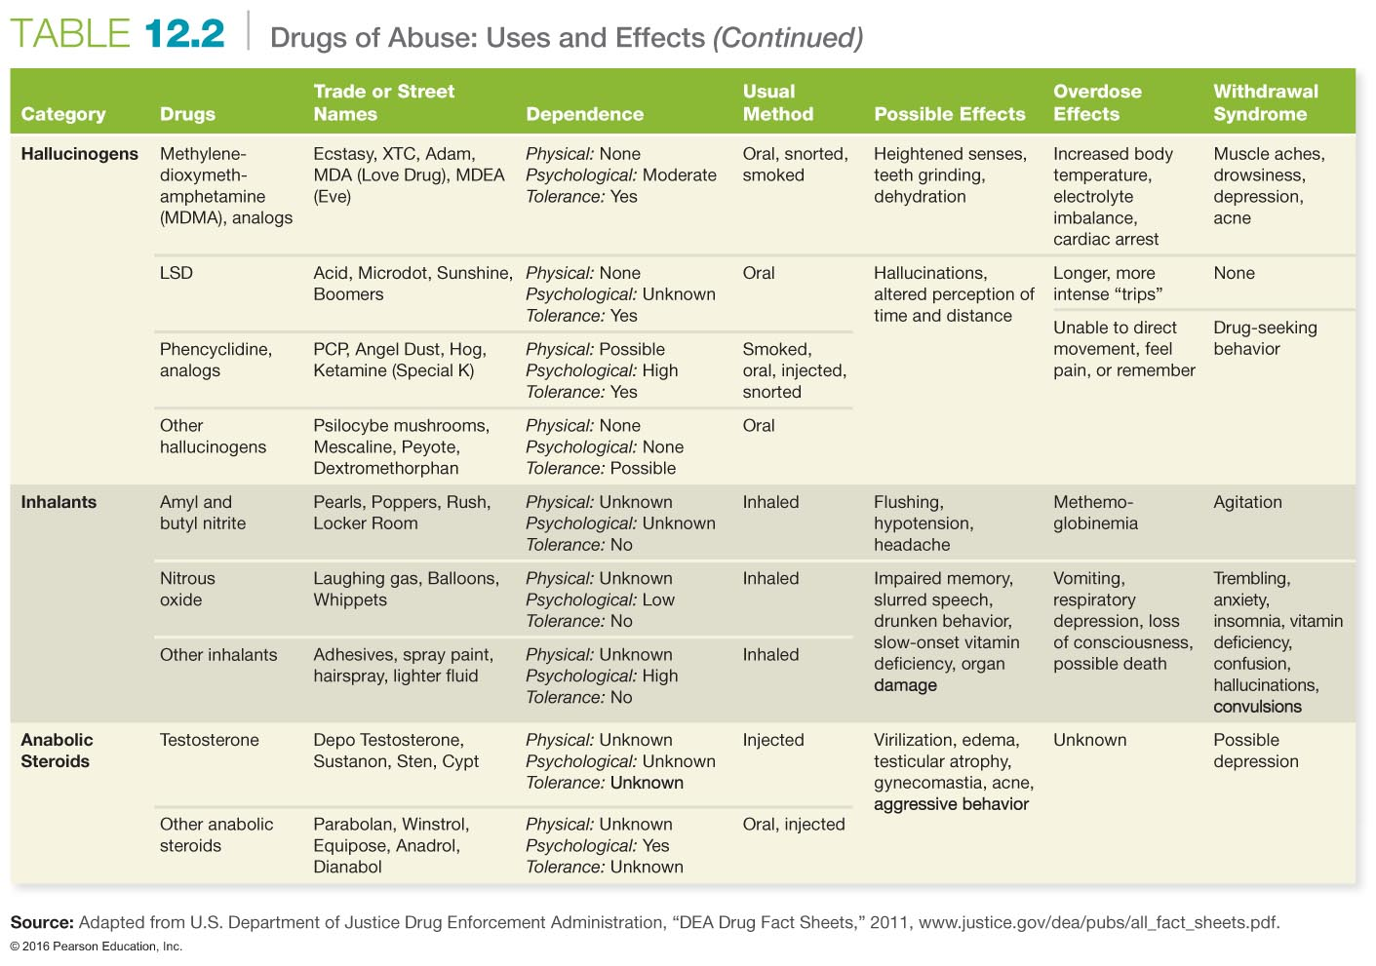

Slide 23
Stimulants
Cocaine is one of the most powerful naturally occurring stimulants.
It can be snorted, smoked, and injected.
Freebase is obtained by removing the hydrochloride salt from cocaine powder.
Cocaine is an anesthetic and a central nervous system (CNS) stimulant.
High doses can lead to increased heart rate and blood pressure, weight loss, convulsions, muscle twitching, and other effects.
Notes:
As dose increases, users become irritable and apprehensive, and their behavior may turn paranoid or violent.
23

Slide 24
Stimulants
Amphetamines are also called bennies, dex, meth, speed, cross tops, uppers, and ice.
Adderall and Ritalin are used for medical purposes.
Recently, these drugs have become popular on college campuses (for "all nighters").
Methamphetamine is powerfully addicting and easily made using over-the-counter drugs.
Small doses increase alertness and decrease appetite.
Large doses can lead to convulsions, hallucinations, and death.
Notes:
24

Slide 25
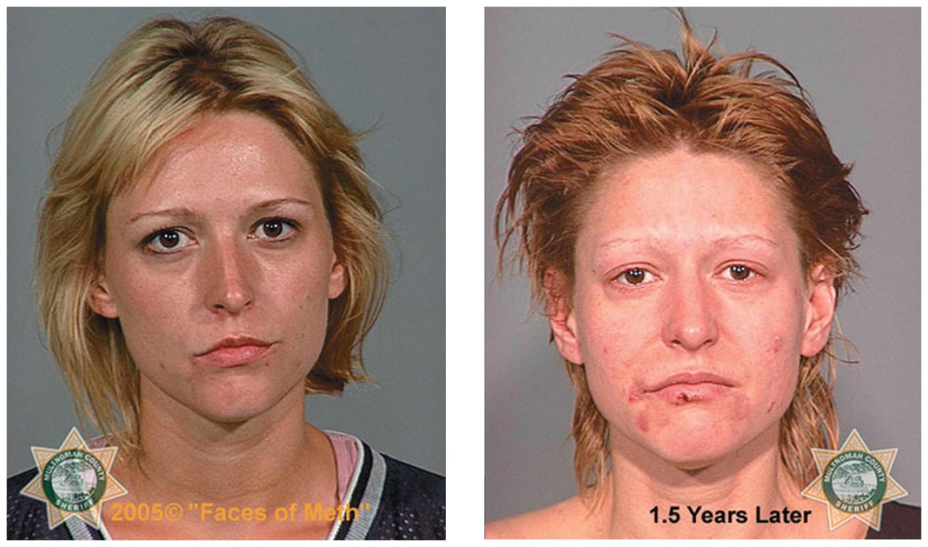
Physical Consequences of Methamphetamine
The physical consequences of methamphetamine use are often dramatic. The photos above show a person before and 1.5 years after methamphetamine use.

Slide 26
Caffeine
Caffeine is the most popular and widely consumed drug in the United States.
More than half of Americans use caffeine.
Made from xanthines, caffeine is a mild CNS stimulant that enhances mental alertness and reduces feelings of drowsiness.
It takes 4 to 6 hours for the body to metabolize half of the caffeine ingested.

Slide 27
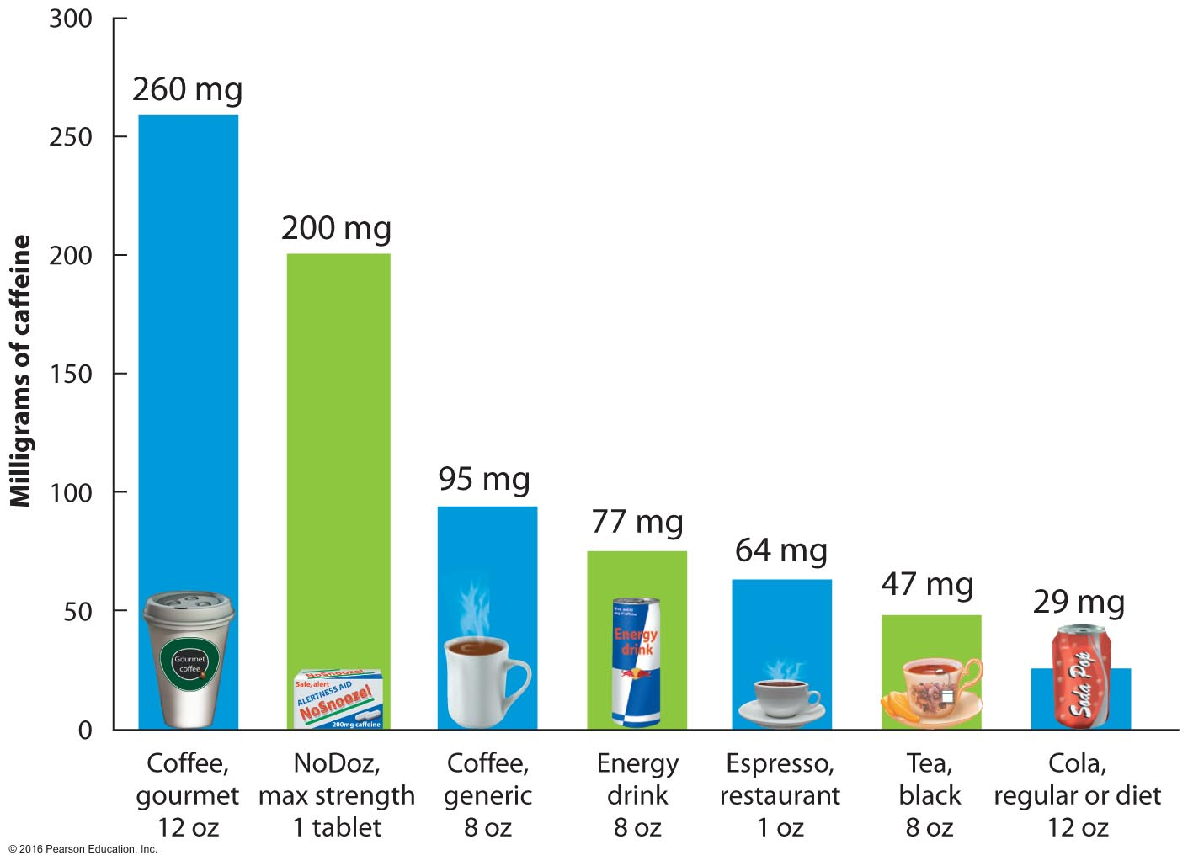
Caffeine Content Comparison

Slide 28
Marijuana
Active ingredient
Tetrahydrocannabinol (THC) is the psychoactive substance in marijuana.
Physical effects
Dilation of blood vessels in the eyes, dry mouth, increased appetite, lowered blood pressure, and mild muscular weakness
Severe anxiety, panic, paranoia, and psychosis
Notes:
28
The Facts
Marijuana is the most widely used illegal drug in the United States (by about 12 million).
Marijuana is a drug derived from the cannabis plant, which contains the active ingredient THC.
How Users Feel
A mild sense of euphoria, a sense of slowed time, a dreamy type of self-absorption, and some impairment in thinking and communicating. The euphoria peaks within a half hour and usually lasts about 3 hours.

Slide 29
Marijuana and Driving
Marijuana substantially reduces a driver's ability to react and make quick decisions. Users often fail to recognize their impairment. Marijuana is the most prevalent illegal drug detected in impaired drivers, fatally injured drivers, and motor vehicle crash victims.
Even a moderate dose alone impairs driving; but when marijuana is combined with alcohol, the two drugs synergize.

Slide 30
Effects of Chronic Marijuana Use
Marijuana contains 50 to 70 percent more carcinogenic hydrocarbons than tobacco smoke, and because of the way it is smoked, the lungs have longer exposure to carcinogens.
Chronic use results in chronic bronchitis, emphysema, oxygen-depleted blood supply, higher risk of testicular cancer, higher risk of mental health problems, and suppressed immune system.
Notes:
Pregnant women who smoke are at higher risk for stillbirth, miscarriage, delivering low birth weight babies and babies with abnormalities of the nervous system.
30

Slide 31
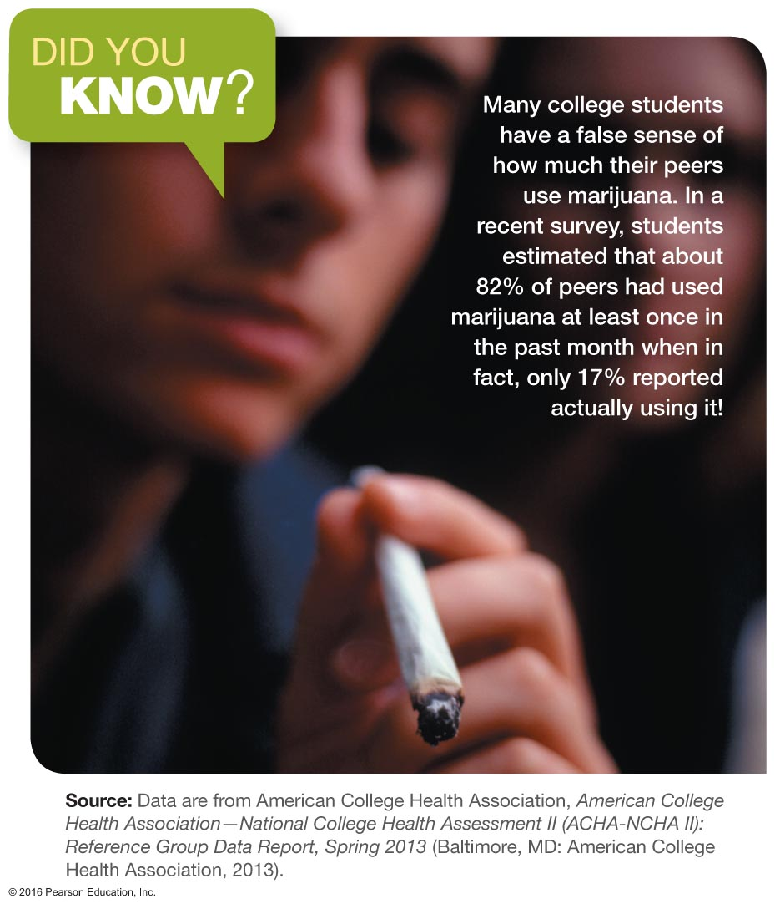
Did You Know?

Slide 32
Marijuana as Medicine
Reduces severe nausea and vomiting caused by chemotherapy
Improves appetite
Forestalls the loss of muscle mass associated with the AIDS wasting syndrome
Reduces muscle pain and spasticity caused by multiple sclerosis

Slide 33
Synthetic Marijuana
Also known as K2 or "Spice"
Mimics marijuana intoxication but with longer duration and poor detection on urine drug screens.
K2 is used by nearly 1 in 10 college students and is more commonly used by males and first- and second-year college students.
The most common way of smoking K2 was in a "joint," followed by hookah use.
Notes:
People smoking K2 may experience several adverse health effects such as hallucinations, severe agitation, extremely elevated heart rate and blood pressure, coma, suicide attempts, and drug dependence, which is not common among cannabis users.

Slide 34
Depressants: Benzodiazepines and Barbiturates
These are sedative drugs that promote mental calmness and reduce anxiety, while hypnotic drugs promote sleep or drowsiness.
Sedatives depress the CNS.
These drugs are commonly prescribed for tension, muscular strain, sleep problems, anxiety, panic attacks, and to treat alcohol withdrawal.
Notes:
34
The Facts
Benzodiazepines are sedative-hypnotics.
Rohypnol is the "date rape" drug.
How Users Feel
Low doses reduce or relieve tension but may cause rapid mood changes, impaired judgment, and impaired social and occupational functioning.
High doses produce slurred speech, drowsiness, and stupor.
Side Effects
Physical and psychological dependence within 2 to 4 weeks
Cross-tolerance is a complication
Mood and behavior changes, slurred speech, poor coordination, unsteady gait, involuntary eye movements, impaired attention or memory, and stupor and coma
Synergistic effect when used in combination with alcohol
Gamma hydroxybutyrate (GBH) is a CNS depressant known to have euphoric, sedative, and anabolic effects. Its use can result in loss of memory, unconsciousness, amnesia, and even death.

Slide 35
Depressants: Opiates
Powerful depressants of the CNS
Also called narcotics
Derived from opium, the dark, resinous substance made from the juice of the opium poppy
Derivatives: morphine and codeine
Synthetic opiates: Percodan, Demerol, and Dilaudid
OxyContin is another powerful opiate.
Heroin is highly addictive.
Endorphins (opiate-like substances) are manufactured in the body and have many receptor sites.
Notes:
35
Opioids cause drowsiness, relieve pain, and induce euphoria.
How Users Feel
Opiates are depressants, causing drowsiness; they can relieve pain and induce euphoria.
Side Effects
These include, lethargy, weight loss, loss of sex drive, anxiety, insomnia, and restlessness.
Overdose causes shock, coma, and depressed respiration.
Long-Term Injection of Opioids
This poses risks of infection of the heart lining and valves, skin abscesses, and lung congestion.

Slide 36
Treatment for Heroin Addiction
Most treatment programs for heroin addiction are not very successful.
Distinct pattern of withdrawal:
Sleep disturbance, irritability, and muscle tremors occur 12 hours after the initial dose.
Nausea, abdominal cramps, vomiting, and diarrhea occur 24 to 72 hours after the last use in the withdrawal process.
Methadone is a synthetic narcotic that blocks the effects of opiate withdrawal.
Notes:
36

Slide 37
Hallucinogens
Hallucinogens, or psychedelics, are a group of mind-altering drugs that affect the brain and nervous system and bring about changes in thought, self-awareness, emotion, and sensation.
Major receptor sites are in the reticular formation, located in the brainstem; when a hallucinogen reaches this site, messages become scrambled.
Synesthesia occurs when sensory messages are mixed (one smells colors or hears tastes).
Notes:
37

Slide 38
Hallucinogens
LSD (lysergic acid diethylamide)
Mescaline, derived from the peyote cactus
Psilocybin, also known as the "magic mushroom"
Phencyclidine (PCP) is a synthetic substance that was originally developed as an anesthetic.
Notes:
38

Slide 39
Hallucinogens: LSD
LSD is the most notorious hallucinogen.
Its physiological effects include increased heart rate, elevated blood pressure and temperature, muscle tremors, gooseflesh, headaches, and mild nausea.
Its psychological effects include euphoria, dysphoria (sense of foreboding), shortened attention span, introspection, and distorted perceptions.
Notes:
39

Slide 40
Club Drugs or Designer Drugs
Ecstasy
Mescaline
Psilocybin
PCP
Ketamine
The sources of these drugs and the chemicals in them can vary, so the drugs may be impure and their effects unpredictable.
Notes:
Research has shown that club drugs can produce hallucinations, paranoia, amnesia, dangerous increases in heart rate and blood pressure, coma, and in some cases death.
40

Slide 41
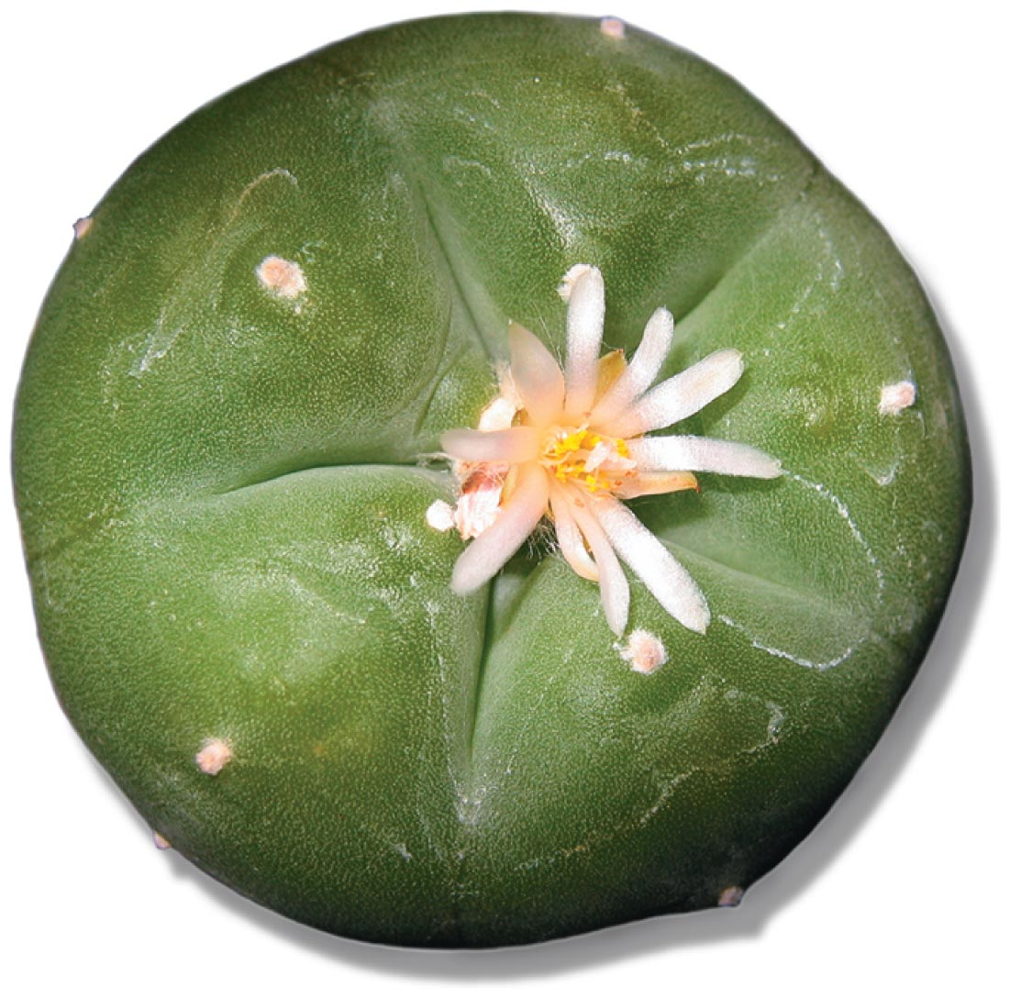
Mescaline
Mescaline is one of hundreds of chemicals derived from the peyote cactus.
It is both a powerful hallucinogen and a CNS stimulant.

Slide 42
Inhalants
Inhalants are chemicals that produce vapors capable of causing hallucinations and creating intoxicating and euphoric effects.
Some agents are organic, solvent by-products of the distillation of petroleum products.
Rubber cement, model glue, paint thinner, lighter fluid, varnish, wax, and gasoline are examples.
Notes:
42
Ask students who is more likely to use these types of drugs?
What common household products are dangerous?

Slide 43
Steroids
Anabolic steroids are artificial forms of the male hormone testosterone. They include ergogenic drugs, which are substances that enhance athletic performance.
There are two forms of anabolic steroids:
Injectable solutions
Pills
Effects of steroids include mood swings, acne, liver tumors, elevated cholesterol levels, hypertension, and kidney disease.
Anabolic Steroids Control Act of 1990
Notes:
43
Most steroids are obtained illegally. At one time an estimated 17 to 20 percent of college athletes used them. Now that the National Collegiate Athletic Association (NCAA) has instituted stricter drug-testing policies, the reported use of anabolic steroids among intercollegiate athletes has dropped.

Slide 44
Treatment and Recovery
In 2012, an estimated 23.1 million Americans age 12 or older needed treatment for a drug or alcohol problem.
The most difficult step in recovery is admitting that there is a problem. Denial is the hallmark of addiction.
Detoxification refers to the early abstinence period, during which an addict adjusts physically and cognitively.

Slide 45
Treatment Approaches
Outpatient behavioral treatment:
Residential treatment
Therapeutic communities
12-step programs:
Alcoholics Anonymous
Cocaine Anonymous
Crystal Meth Anonymous
Gambler's Anonymous
Pills Anonymous
Notes:
For college students, treatment may require time away from school. Some colleges and universities offer special services to recovering students.
45

Slide 46
Addressing Drug Misuse and Abuse in the United States
Risks associated with drug use extend beyond the personal. Illegal drug use costs about $193 billion per year.
Some 50 percent of those who use illicit drugs are employed either full or part time.
Reductions in student drug use might require changing attitudes, identifying high-risk students, and providing services.

Slide 47
Possible Solutions to the Drug Problem
Educate young people about drugs.
Implement stricter border controls.
Require longer prison sentences for drug dealers.
Increase spending on prevention and improve the enforcement of anti-drug laws; also facilitate greater cooperation among agencies.
Notes:
Harm-reduction approaches have been widely used in needle-exchange programs, where injection drug users receive clean needles and syringes as well as bleach for cleaning needles. These efforts help to reduce the number of cases of HIV and hepatitis B. Harm reduction may involve changing the legal sanctions associated with drug use, increasing the availability of treatment services to drug abusers, and/or attempting to change drug users' behavior through education.
47

Slide 48
Assessing Yourself—A Personal Inventory
Go online to MasteringHealth to take the "Learn to Recognize Drug Use and Potential Abuse" assessment.
Do you think your age impacts how you view illicit drugs and the laws that surround them?
If you have used or continue to use illicit drugs, do you think your life and the life of those you love is better for this?
Would you mind if your physician or pharmacist used drugs recreationally the day before you required the services of these people?

