Slide 1
Chapter 3: Managing Stress and Coping with Life's Challenges

Slide 2
Did you PREPARE and did you LEARN?
Define stress and examine its potential impact on health, relationships, and success in college.
Explain the phases of the general adaptation syndrome and the physiological changes that occur during them.
Examine the physical health risks that may occur with chronic stress.

Slide 3
Did you PREPARE and did you LEARN?
Discuss the sources of stress and examine the unique stressors that affect college students.
Explore stress-management techniques and ways to enrich your life with positive experiences and attitudes.

Slide 4
What Is Stress?
Stress—a real or imagined threat to one's being—leads to a series of physiological responses and adaptations.
A stressor is a physical, social, or psychological event or condition that upsets homeostasis and produces a stress response.
Notes:
Ask students to list the top five stressors in their lives. Almost every list will include time pressures, relationships, and money.
Next to each stressor, ask students to write how they experience it—including both physical and psychological symptoms.

Slide 5
Isn't Some Stress Healthy?
Stress isn't necessarily bad for you!
Notes:
This slide depicts eustress.

Slide 6
What Is Stress?
Distress is stress that can have a detrimental effect on health. We view it as negative stress. Examples may include taking an exam or not being able to pay one's monthly bills.
Eustress is positive stress and can present opportunities for personal growth. Planning a wedding or major event or going on a first date are examples.
Notes:
Even though distress is caused by a negative event and eustress by a positive event, both can result in the same physical and psychological symptoms.
Ask students to think about their feelings the last time they prepared for their first date with a new person. They will list such things as nervousness, sweaty palms, inability to eat, and so on. Compare these reactions to how they feel with a bad stressor, and the results will be similar. Personal growth from eustress depends on how one copes, just as the outcome of coping with distress depends on one's methods.

Slide 7
What Is Stress?
Acute stress is the short-term physiological response to an immediate perceived threat. When someone cuts in front of us on the freeway, for example, we take action to avoid the car immediately.
Chronic stress is an ongoing state of physiological arousal in response to ongoing or numerous perceived threats. During your first few days at a new job, you might experience this kind of stress.
Notes:
Students experience acute stress when they walk into a lecture hall and are given a pop quiz on an assigned reading that they have not done, or if they have forgotten that there was a test that day. Try to get students to experience the feelings in class, and ask them what they might do to help themselves relax.
If you have students who have moved to your location from afar, ask them to remember their first few days at school and to relive their emotions and experiences.

Slide 8
Your Body's Response to Stress
When stress levels are low, the body is often in a state of homeostasis: All body systems are operating smoothly to maintain equilibrium.
Fight-or-flight response
The general adaptation syndrome (GAS), characterized by Hans Selye in 1936, has three distinct phases:
Alarm phase
Resistance phase
Exhaustion phase
Notes:
In the first phase, your body is getting ready to do one of two things—to fight or to run. Blood is moved from the stomach and brain to the major muscle groups. Digestion is minimized. Blood pressure and blood sugar increase, so the system will be ready for either running or fighting. Body temperature increases. Perhaps this response is based on lives that humans might have experienced as hunter/gatherers where they had to fight for food and run from danger. But in our world, our threats rarely benefit from this mechanism.

Slide 9
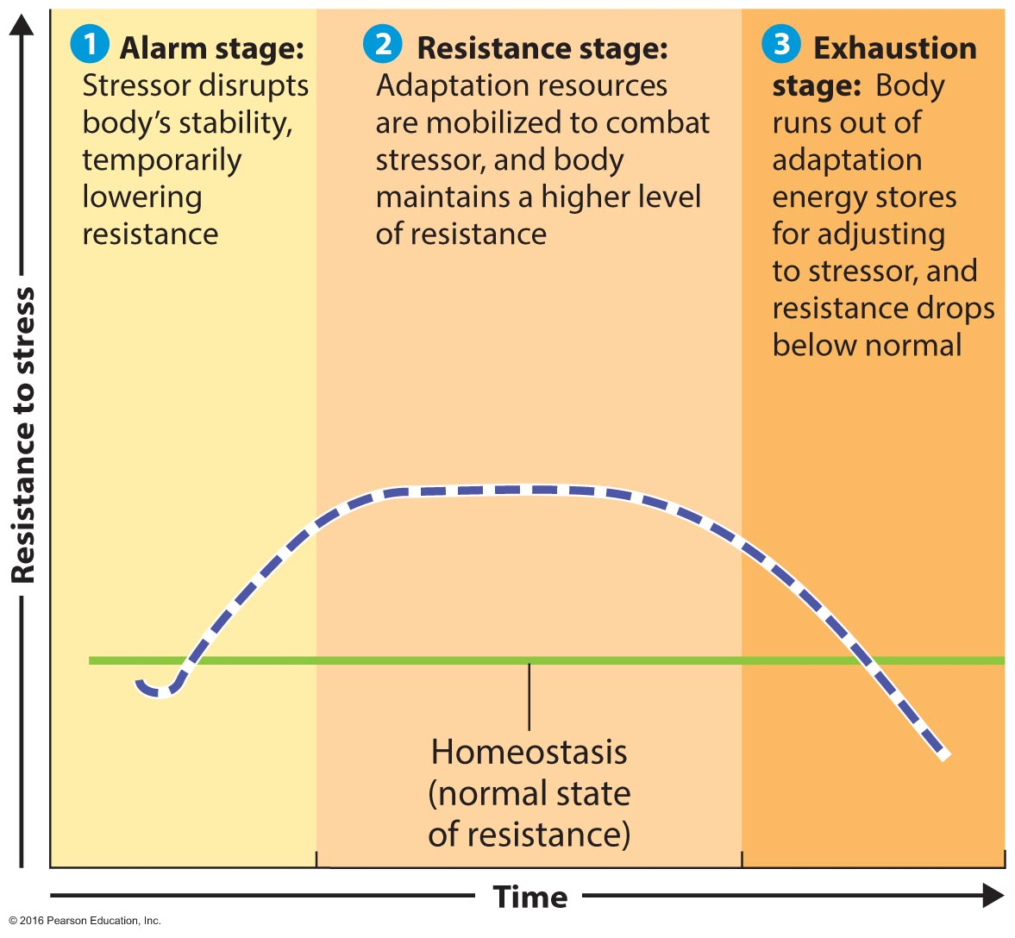
The General Adaptation Syndrome (GAS)
Notes:
As you work through this slide, discuss which part of the nervous system is being activated. The autonomic nervous system (ANS) is activated during the alarm stage. This is part of the central nervous system, and we do not consciously control it.
The ANS has two parts: the sympathetic nervous system (SNS) and the parasympathetic nervous system (PNS). In the first stage, the SNS is activated as the body prepares for fight or flight. The PNS kicks in to counterbalance the SNS and slow us down.

Slide 10
The General Adaptation Syndrome (GAS)
The hypothalamus functions as the control center for the sympathetic nervous system. It stimulates the adrenal glands to release epinephrine, which causes more blood to be pumped, more oxygen to be taken up, and glucose to be released. The body is now poised to act immediately. It is in the alarm phase.
In the resistance phase of the GAS, the body tries to return to homeostasis by resisting the alarm responses. However, because some stressor is still perceived, the body does not achieve complete calm or rest.
A prolonged effort to adapt to stress leads to allostatic load, or exhaustive wear and tear on the body, known as the exhaustion phase.
Notes:
The alarm phase also triggers a longer-term reaction to stress. The hypothalamus triggers the pituitary gland to release adrenocorticotropic hormone (ACTH) which then signals the adrenal gland to release cortisol. Cortisol, in turn, causes stored nutrients to be released. Other parts of the brain and body next release endorphins to help manage pain.
The resistance phase begins if we start to adapt to the stress. We are calmer in its presence, but the body does not completely return to normal.
The exhaustion phase sets in after a prolonged effort to adapt and causes an allostatic load, or exhaustive wear and tear on the body.

Slide 11
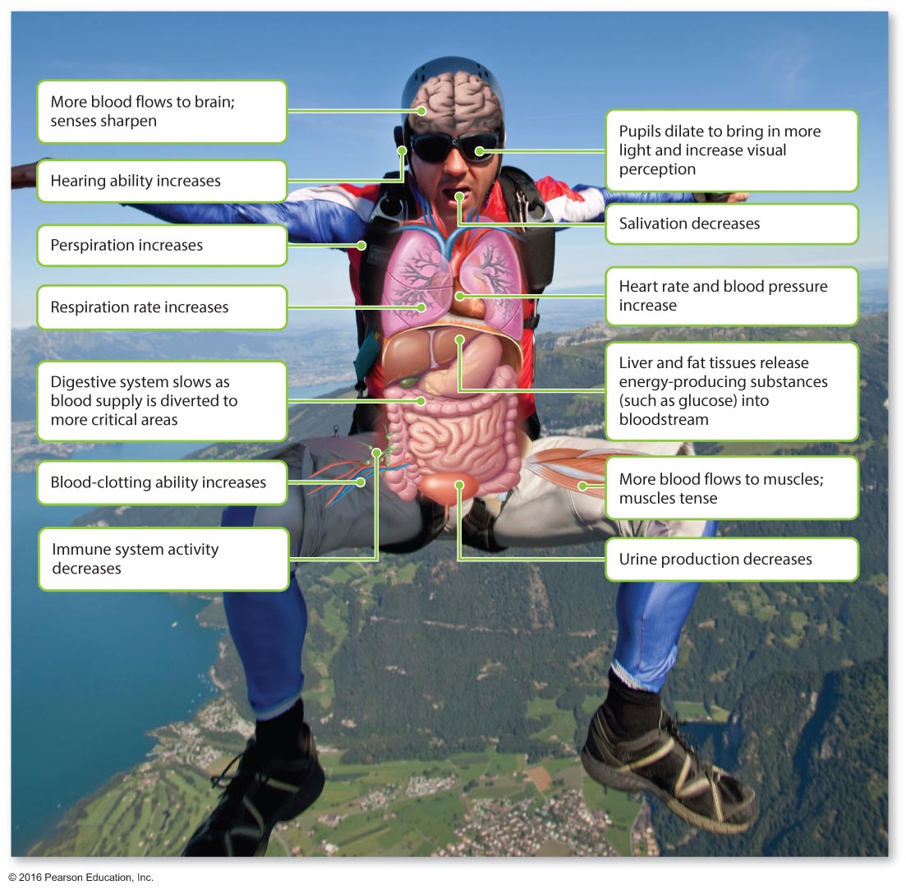
The Body's Acute Stress Response
Exposure to stress of any kind causes a complex series of involuntary physiological responses.
Notes:
Ask students to think of events during which they have experienced some of these symptoms.

Slide 12
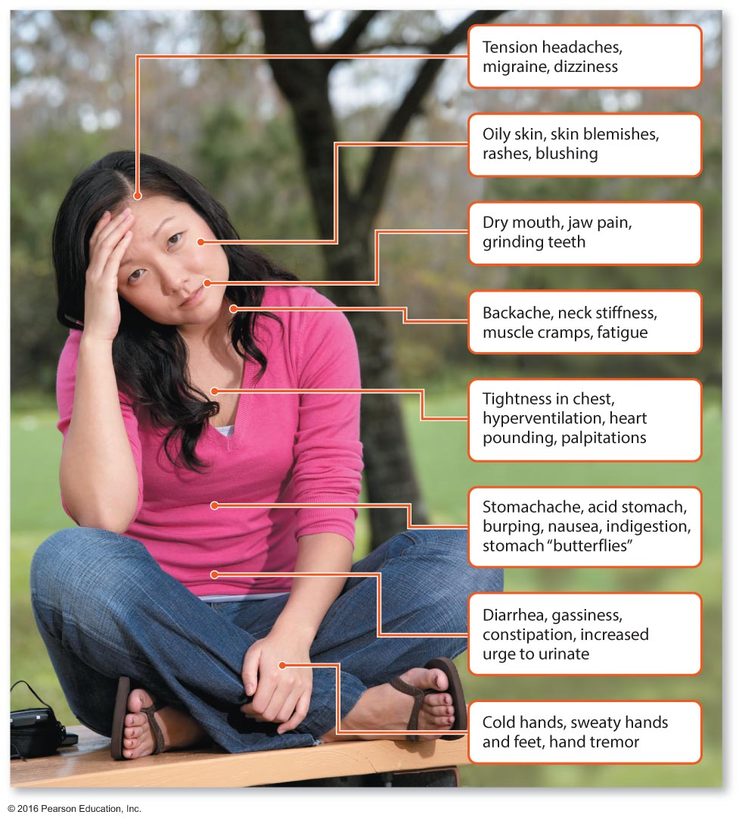
Common Physical Symptoms of Stress
Sometimes, you may not even notice how stressed you are until your body starts sending signals. Do you frequently experience any of these physical symptoms of stress?
Notes:
As students evaluate these symptoms, ask them to write down which symptoms they have experienced. Ask students to try to identify the stressful events that cause them. Different stressors may lead to different symptoms, and it would be good for students to recognize the association. As you move through stress management, ask them to review their lists and determine what techniques might be appropriate for different situations.

Slide 13
Life Effects of Stress
Diseases related to stress
Cardiovascular Disease
Weight Gain
Hair Loss
Diabetes
Digestive Problems
Impaired Immunity and libido
Alcohol Dependence
Notes:
The INTERHEART Study, comprising 3,000 participants, identified stress as one of the key modifiable risk factors for cardiovascular disease. Stress is linked to increasing arterial blockage due to elevated cholesterol, hardening of the arteries, arrhythmias, and hypertension.
Since higher stress levels may increase cortisol levels in the blood, there is an associated increase in hunger. Cortisol also seems to activate fat storage enzymes. Hair loss can be seen in those who have suffered a death in the family, had a difficult pregnancy, and so on. Prolonged stress may cause hair to fall out in clumps.
Stress can affect how we eat, sleep, and exercise. Those with diabetes may lose track of appropriate diet tools and exercise habits, which can lead to hyperglycemia. Digestive problems often have unknown origins, but stress can exacerbate the symptoms. Impairment of the immune system and libido may occur after prolonged stress.

Slide 14
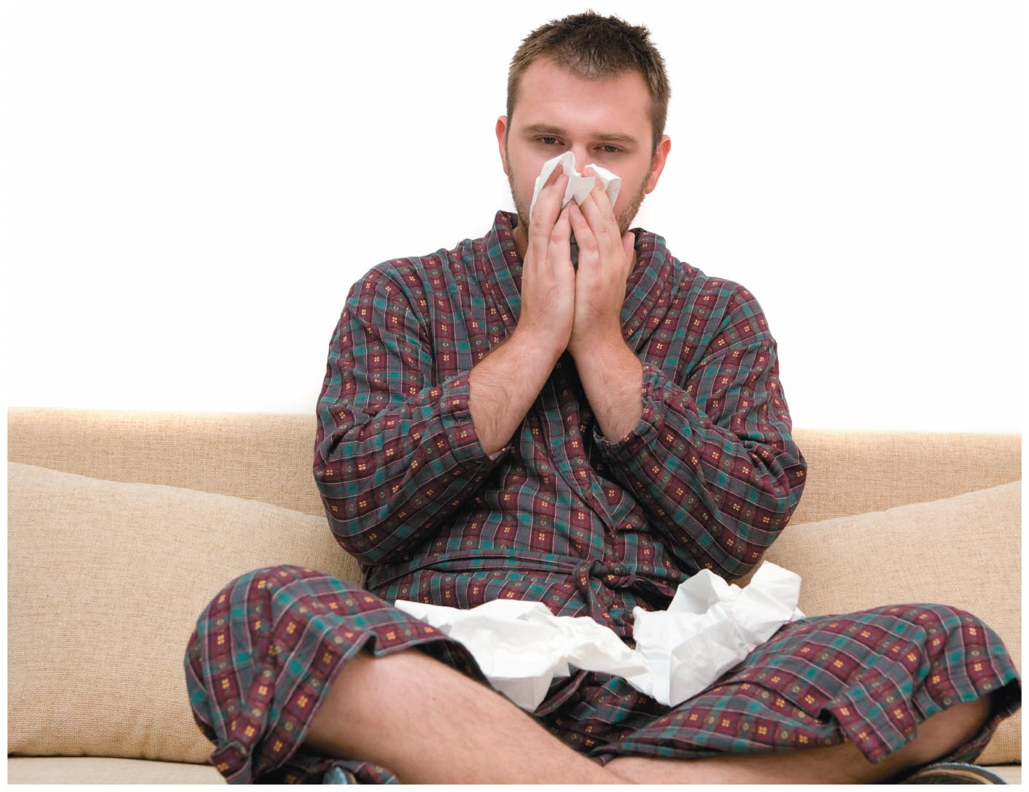
Why Do You Always Get Sick during Finals Week?
Prolonged stress can compromise the immune system, leaving you vulnerable to infection. If you spend exam week in a state of high stress, sleeping too little and worrying a lot, chances are you will reduce your body's ability to fight off cold and flu viruses.
Notes:
Remind students that pathogens—not events—cause disease. Events may cause a student to become tired, sleep less, eat poorly, fail to exercise, and so on, all of which can impair the immune system. With better planning, students can keep their immune systems working well and avoid sickness during finals week.

Slide 15
Intellectual Effects of Stress
Stress may be the number one impediment to academic achievement.
Acute stress has been shown to impair short-term memory, particularly verbal memory.
Prolonged stress may be linked to cortisol (a key stress hormone), which shrinks the hippocampus.
Nearly half of all college students in a national survey felt overwhelmed by all they had to do.
Notes:
The hippocampus is the brain's major memory center.

Slide 16
Psychological Effects of Stress
Stress may be one of the single greatest contributors to mental disability and emotional dysfunction in industrialized nations.
Studies have shown rates of mental disorder, particularly depression and anxiety, are associated with various environmental stressors.
The high incidence of suicide among college students is assumed to indicate high personal and societal stress in the lives of young people.
Notes:
The rate of mental disorder, particularly depression and anxiety, is associated with environmental stressors like divorce, marital conflict, economic hardship, and other worrisome life events.
Ask students whether it might be possible to think about the effects of stress and learn how to handle them while also trying to manage the major upheavals that might have caused them. Would these management techniques then help one to deal with the environmental stressors? Or would it be better to deal with the stressor first?

Slide 17
See It! Video: Stress Can Damage Women's Health
Discussion Questions
Discuss symptoms of increased cortisol production and the physiological process of the body's production of cortisol.
Discuss the signs and symptoms of stress and ways to decrease stress.

Slide 18
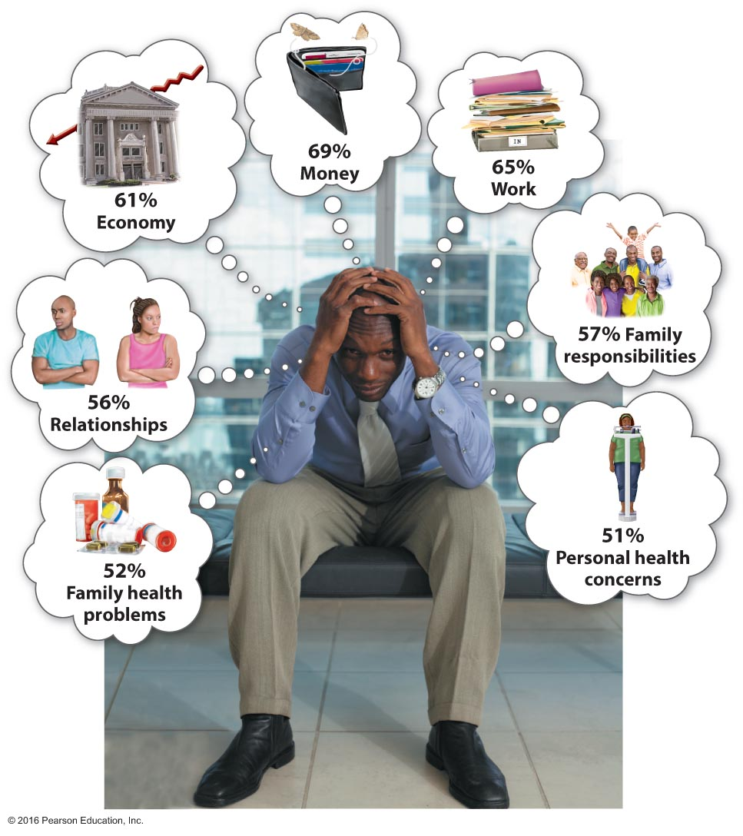
What Stresses Us?
Notes:
Ask students to create bubbles of their own showing their major stress categories and have them add percentages to each stressor.

Slide 19
What Causes Stress?
Psychosocial Stressors
Adjustment to Change
Relationships
Overload
Hassles
Academic & Money Pressures
Technostress
Frustrations and Conflict
Notes:
Ask students to create a hierarchy of their major stressors and how they might influence each other's stress.
Stressful environments may be a common theme among students because of overcrowding, unclean/unhealthy living places, and noise.
Racial and ethnic diversity also influences everyone's experience on campus. Those considered dissimilar may be victims of subtle or not so subtle forms of bigotry. Ask students to list differences that may cause stress and how we can each contribute to the reduction of this stress. The lists might include gender, age, income, religion, sexual orientation, race, ethnicity, clothing, and even speech patterns.

Slide 20
What Causes Stress?
Internal Stressors
Self-Esteem & Self-Efficacy
Type A & B personality
Type C & D personality
Psychological Hardiness
Appraisal and Stress
Notes:
Appraisal: Defined as the interpretation and evaluation of information provided to the brain by the senses. This is done unconsciously. Appraisal helps us to recognize and evaluate stress and decide how to cope.
Self-esteem is how we feel about ourselves, and self-efficacy is our perceived mastery of skills and performance.
Ask students to evaluate their personality types based on the definitions starting on page 84. Many will be type A personalities, so from here move to psychological hardiness and how this influences one's perception of control. With stress, the more out of control you feel, the higher your stress level will be.

Slide 21
Managing Stress in College
Practicing Mental Work to Reduce Stress | Developing a Support Network | Managing Emotional Responses | Taking Physical Action
Assess your stressors and solve problems | Invest in your loved ones | Learn to laugh, be joyful, and cry | Exercise regularly
Change the way you think about and talk to yourself | Cultivate your spiritual side | Fight the anger urge | Get enough sleep
 | Find supportive people |  | Learn to relax
 |  |  | Eat healthfully
Notes:
Ask students to discuss the Health Headlines box "Find Happiness and Reduce Stress" on page 86 of the textbook. Have them evaluate how they invest in each item listed in the subheadings.

Slide 22
Fight the Anger Urge
Anger results when we are frustrated or feel out of control.
We usually manage anger by expressing it, suppressing it, or calming it. Expressing anger may be the healthiest method if it is not done aggressively.
Identify your anger style.
Learn to recognize patterns in your anger responses and how to de-escalate them.
Find the right words to de-escalate conflict.
Plan ahead.
Vent to your friends.
Develop realistic expectations of yourself and others.
Turn complaints into requests.
Leave past anger in the past.
Notes:
Many students may not have learned how to manage anger. Ask them to identify their anger response from the following list:
Explosive rage
Use of "you" statements instead of "I" statements
Ignoring the feelings of others and walking away
4. Trying to calm the feelings of those involved
5. Making an effort to solve problems
6. Identifying the issues and offering options
7. Compromising
Ask students if there are other methods that might be used and discuss ways to move from inappropriate methods to more appropriate methods.

Slide 23
Taking Physical Action
Exercise regularly.
Get enough sleep.
Practice self-nurturing.
Eat healthfully.
Notes:
23

Slide 24
Managing Your Time
Use the following time-management tips in your stress-management program:
Do one thing at a time.
Clean off your desk.
Prioritize your tasks.
Find a clean, comfortable place to work, and avoid interruptions.
Reward yourself for work completed.
Work when you're at your best.
Break overwhelming tasks into small pieces, and allocate a certain amount of time to each.
Remember that time is precious.

Slide 25
Consider Downshifting
Downshifting involves a fundamental alteration in values and honest introspection about what is important in life.
It is important to consider the following:
Plan for health care costs.
Determine your ultimate goal.
Make both short- and long-term plans for simplifying your life.
Complete a financial inventory.
Select the right career.
Consider options for saving money.

Slide 26
Relaxation Techniques for Stress Management
Relaxation techniques for reducing stress have been practiced for centuries, and there is a wide selection from which to choose.
Yoga is an ancient practice that combines meditation, stretching, and breathing exercises to relax, refresh, and rejuvenate the practitioner.
Notes:
Ask students how many of them have attended a yoga class or have used a yoga DVD. For yoga classes, write where they are located and their cost on the board. If the college offers yoga, offer students information on days and times at which it is offered. This is a good way to promote yoga activity in those who may never have experienced its benefits.

Slide 27
Other Relaxation Techniques
Qigong
Tai chi
Diaphragmatic or deep breathing
Meditation
Visualization
Progressive muscle relaxation
Massage therapy
Biofeedback
Hypnosis
Notes:
To get students more involved, create nine groups and have each group explain one of these techniques to the class, citing how it might be beneficial.

Slide 28
ABC News Video: Meditating to Happiness
Discussion Questions
Discuss the positive effects of meditation as supported by the research in the video.
What are differences in disposition between those who meditate and those who do not meditate?
Discuss the positive impact meditation may have in the workplace or in school settings.

Slide 29
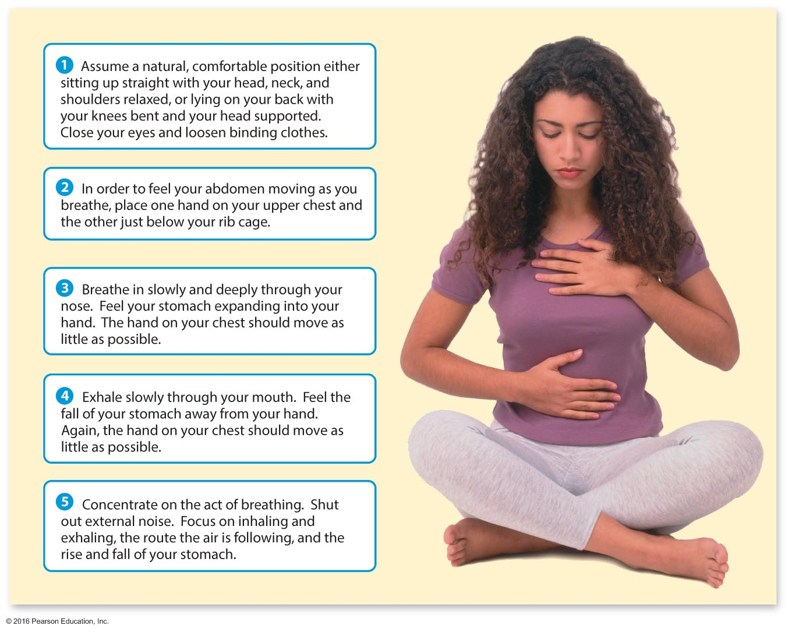
Diaphragmatic Breathing
Notes:
This is usually a simple and worthwhile activity that can be done in class.

Slide 30
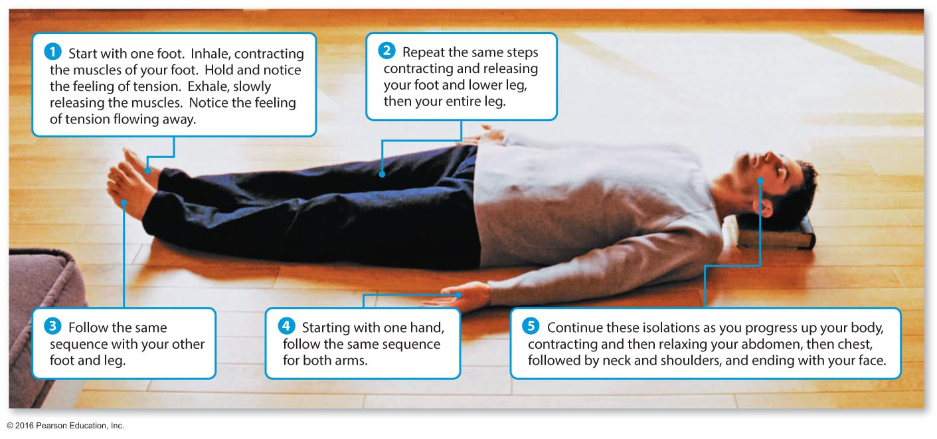
Progressive Muscle Relaxation
Sit or lie down in a comfortable position and follow the steps described above to increase your awareness of tension in your body.
Notes:
This is a simple exercise that can be performed in class, even with students sitting at their desks.

Slide 31
Assessing Yourself—A Personal Inventory
Go online to MasteringHealth to take the "How Stressed Are You?" assessment.
What was your score on the stress test?
Do you believe you can take steps to manage the stress in your life better?
How mindful are you of stressors and how often do you work to restore homeostasis in your life?
As you leave class, consider a new method that you might try to use to help you control your stress response.
Notes:
Remind students that the scores on the scale do not predict illness but rather are assessments of likelihood of illness. Learning better management techniques and learning to recognize your control level can help to manage your stress response.
Regarding homeostasis, have students visualize a scale where each stands on one side and the "content" of his or her life is on the other. How can the student make sure that the scale remains balanced?

