Slide 1
Chapter 2: Promoting and Preserving Your Psychological Health

Slide 2
Did you PREPARE and did you LEARN?
Define each of the four components of psychological health, and identify the basic traits shared by psychologically healthy people.
Learn what factors affect your psychological health.
Describe the interactions between emotions and health.
Discuss the positive steps you can take to enhance your psychological well-being.
Define mental illness and discuss its prevalence among college students.

Slide 3
Did you PREPARE and did you LEARN?
Identify causes, characteristics, and treatments of mood disorders.
Describe the causes, characteristics, and treatment options for anxiety disorders.
Describe the symptoms, causes, and treatment options for obsessive-compulsive disorders.

Slide 4
Did you PREPARE and did you LEARN?
Explore common causes, characteristics, and treatment options for people with post-traumatic stress disorder.
Differentiate personality disorders from other disorders, and describe causes and treatments.
Characterize schizophrenia, and explain causes and treatments.
Discuss risk factors and possible warning signs of suicide, as well as actions that can be taken to help a person contemplating suicide.

Slide 5
Did you PREPARE and did you LEARN?
Explain the different types of treatments and mental health professionals, and examine how they can play a role in managing mental health disorders.

Slide 6
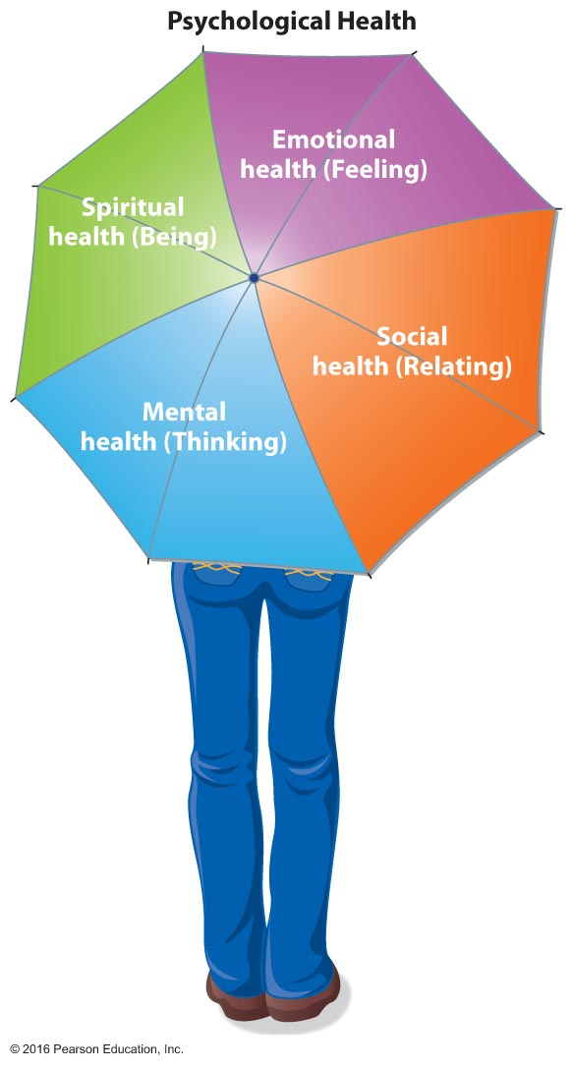
Psychological Health
Psychological health stems from a complex interaction among the mental, emotional, social, and spiritual dimensions of one's life.
Strength and resilience in these dimensions will support your overall well-being and help you weather the storms of life.
Notes:
These four components are interrelated and dynamic. As with the dimensions of physical wellness, if one of the dimensions of psychological health is out of balance, the other dimensions may also be affected.

Slide 7
What Is Psychological Health?
Psychologically healthy people feel good about themselves.
They feel comfortable with other people; they express their respect and feel compassion for them.
They control their own tension and anxiety.
They meet the demands of life.
Notes:
It might easier to define what psychological health is not rather than what it is.
Ask students to come up with their definitions of both good and bad psychological health.

Slide 8
What Is Psychological Health?
People who are psychologically healthy curb their own feelings of hate and guilt.
They maintain a positive outlook.
They value diversity.
They appreciate and respect the world around them.
To achieve these characteristics, their basic needs must first be met.
Notes:
Maslow's basic needs slide will come soon, but now is a good time to ask students to rank their own basic needs and then compare the two lists.

Slide 9
Mental Health
The term mental health is used to describe the "thinking" or "rational" dimension of our health.
A mentally healthy person perceives life in realistic ways; he or she can adapt to change, develop rational strategies to solve problems, and carry out his or her personal and professional responsibilities.
Notes:
Psychological health is the outcome of how we think, feel, relate, and exist in our day-to-day lives. Our thoughts, perceptions, emotions, motivations, interpersonal relationships, and behaviors are a product of our experiences and the skills we have developed along the way to meet life's challenges.
Ask students to brainstorm some positive steps they could take to enhance their psychological well-being.

Slide 10
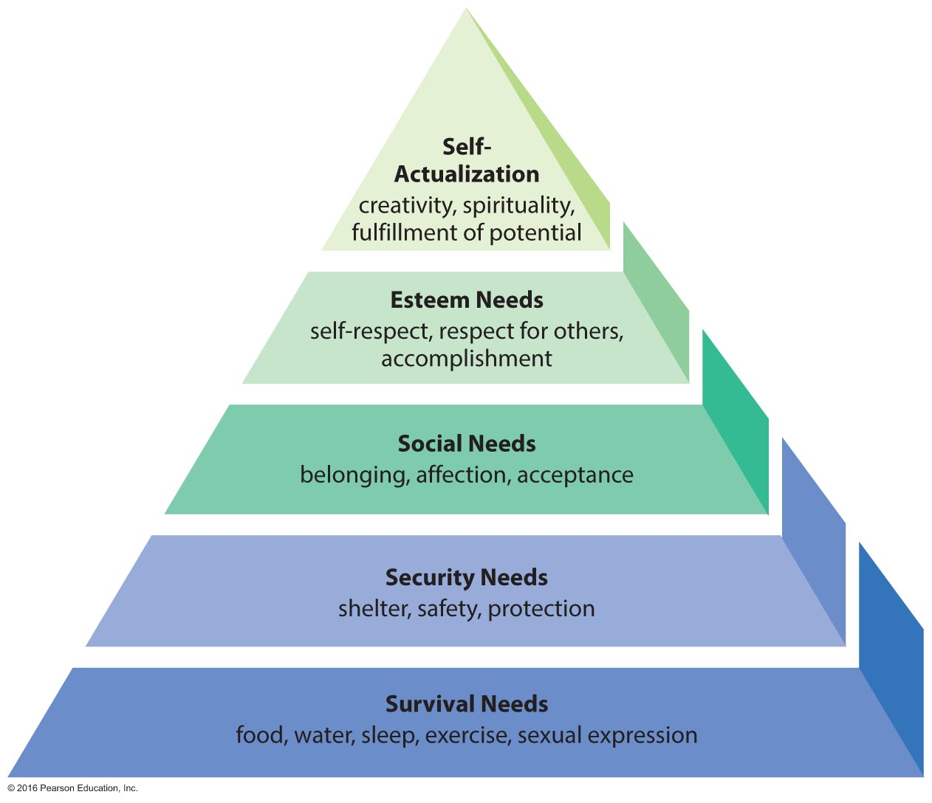
Maslow's Hierarchy of Needs
Notes:
Challenge students to compare this list with the lists they created earlier. Can they justify Maslow's hierarchy, or do they see ways in which it might be improved? One common issue is that we generally teach that self-esteem and a positive self-concept are prerequisites for successful relationships, but Maslow lists social needs before esteem needs. Can this be justified?

Slide 11
Emotional Health
The term emotional health refers to the feeling, or subjective, side of psychological health.
Emotionally healthy people usually respond appropriately to upsetting events.
Emotional health affects social and intellectual health.
Emotional turmoil may seriously affect your ability to think, reason, and act rationally.
Notes:
Ask students to describe inappropriate responses to upsetting events and write them on the board. Then have them turn these inappropriate responses into more appropriate ones.

Slide 12
Characteristics of Psychologically Healthy and Unhealthy People
Notes:
Ask students to identify where they are on this continuum and to consider steps they might take to move in a more positive direction.

Slide 13
Social Health
Social health includes your interactions with others on an individual and group basis, your ability to use social resources and support in times of need, and your ability to adapt to a variety of social situations.
Socially healthy individuals enjoy a wide range of interactions with family, friends, and acquaintances, and are able to have healthy interactions with an intimate partner.
Such individuals act in socially acceptable and responsible ways and find the best fit for themselves in society.
Notes:
Since the focus of this text is on self-assessment and positive change, ask students to evaluate both their family and friend relationships. How do they manage conflict? Could their ability to listen and talk be improved?

Slide 14
Spiritual Health
Spiritual health refers to the sense of belonging to something greater than the purely physical or personal dimensions of existence.
For some, this unifying force is nature; for others, it is a connection to other people; and for still others, it is a god or some higher power.
Notes:
According to the National Center for Complementary and Alternative Medicine (NCCAM), spirituality is broader in meaning than religion and is defined as an individual's sense of purpose and meaning in life. It goes beyond material values.
It can be hard for some students to view spiritual health outside of a "higher power" entity. Have students work in groups and ask each group to define spiritual health. Compare the definitions on the board.

Slide 15
Factors That Influence Psychological Health
Family
Social supports
Community
Self-efficacy and self-esteem
Personality
Personality traits related to psychological well-being include extroversion, openness to experience, emotional stability, conscientiousness, and resiliency.
Life span and maturity
Notes:
If any of these components is affecting psychological health negatively, suggest that students create lists of ways in which it could be overcome or managed.

Slide 16
The Mind-Body Connection
Psychoneuroimmunology (PNI) is the study of the brain and behavior and how they affect the body's immune system.

Slide 17
The Mind-Body Connection
Happiness is a collective term for several states in which individuals embrace the world around them.
Hopefulness, optimism, and contentment appear to reduce the risk of some chronic diseases.
Subjective well-being is an uplifting feeling of inner peace or an overall "feel good" state; it includes satisfaction with one's present life, a relative presence of positive emotions, and a relative absence of negative emotions.
Notes:
A good exercise here is to ask students to create a continuum for each of these dimensions—happiness, hopefulness, optimism, and contentment. Have them mark where they are in relation to the concept, but tell them that they must make a decision and cannot put themselves in the middle.
Now ask students to list positive factors above each line that help them maintain that place and negative items below the line that are holding them back. How can they move these negative items into the positive column?

Slide 18
Strategies to Enhance Psychological Health
Develop a support group.
Complete required tasks.
Form realistic expectations.
Make time for yourself.
Maintain physical health.
Examine problems and seek needed help.
Get adequate sleep.

Slide 19
When Psychological Health Deteriorates
Stress, abusive relationships, anxiety, loneliness, financial upheavals, and other trauma can derail a person's coping resources.
Mental illnesses are disorders that disrupt thinking, feeling, moods, and behaviors, and cause varying degrees of impaired functioning in daily living.
Mental health problems are common among college students, and they appear to be increasing in number and severity.
Notes:
Everyone suffers from bouts of mild depression at some time or other. The key to moving forward is the ability to recognize that "this is temporary, this will pass, and I (the individual) have control."

Slide 20
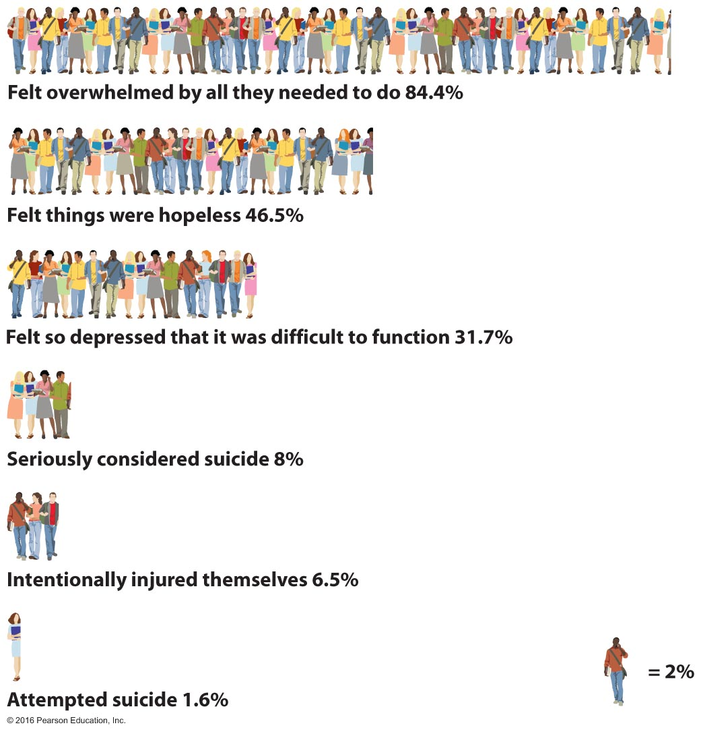
Mental Health Concerns of American College Students, Past 12 Months
Notes:
Ask students to evaluate their mental health in relation to these factors. Are there other issues that they think should be added to this chart?

Slide 21
Mood Disorders
A chronic mood disorder—such as persistent sadness or feelings of euphoria—affects how you feel.
Mood disorders include major depression, dysthymic disorder, bipolar disorder, and seasonal affective disorder (SAD).

Slide 22
Major Depression
Major depression, or clinical depression, is characterized by a combination of symptoms that interfere with work, study, sleep, appetite, relationships, and the enjoyment of life.
Major depression affects approximately 8 percent of the U.S. population in a given year.

Slide 23
Major Depression
Symptoms include:
Sadness and despair
Loss of motivation and interest
Preoccupation with failures
Difficulty concentrating
Loss of sex drive
Fatigue and loss of energy
Sleeping too much or too little; insomnia
Feeling agitated
Withdrawal from friends and family
Diminished or increased appetite
Significant weight loss or weight gain
Recurring thought that life isn't worth living; thoughts of death or suicide
Notes:
Discuss differences in depression based on gender. Note that women are more likely to seek help than men and consider how men might be encouraged to change in that respect.
23

Slide 24
Other Types of Depression
Dysthymic disorder (dysthymia) is a less severe type of depression that is milder, chronic, harder to recognize, and often characterized by fatigue, pessimism, or a short temper.
Bipolar disorder is characterized by alternating mania and depression; it is also called manic depression.
Seasonal affective disorder (SAD) is a type of depression that occurs in the winter months, when there is less sunlight.

Slide 25
See It! Video: Antidepressant Use Increases Among Women
Discussion Questions
What are some of the factors which contribute to the growing number of middle-aged women taking antidepressants?
Research tells us women are more likely to seek treatment for mental health issues. Why might the numbers that show women are more susceptible to depression and, therefore, likely to take antidepressants be skewed?
More than one in 10 Americans over the age of 12 take antidepressants. Discuss the reasons for the overall 400% increase in those who are taking antidepressants in the past 15 years.

Slide 26
Causes of Mood Disorders
Multiple factors contribute to mood disorders, including genetics, hormones, life events, and early childhood trauma.

Slide 27
Anxiety Disorders
Anxiety disorders are characterized by persistent feelings of threat and worry and are the number one mental health problem in the United States, affecting about 18 percent of all adults.
Anxiety disorders include generalized anxiety disorder (GAD), panic disorders, obsessive-compulsive disorder (OCD), phobic disorders, and post-traumatic stress disorder (PTSD).
Notes:
27

Slide 28
Anxiety Disorders
Generalized anxiety disorder (GAD) is severe enough to interfere significantly with daily life. Commonly, the person with GAD is a consummate worrier who develops a debilitating level of anxiety.
Panic disorders are characterized by the occurrence of panic attacks, a form of acute anxiety that brings on an intense physical reaction.

Slide 29
Anxiety Disorders
Phobic disorders, or phobias, involve a persistent, irrational fear of a specific object, activity, or situation.
People with obsessive-compulsive disorder (OCD) feel compelled to perform rituals over and over again, are fearful of dirt or contamination, are abnormally attentive to (obsessed with) order, and have persistent intrusive thoughts.

Slide 30
Anxiety Disorders
Post-traumatic stress disorder (PSTD) affects those who have experienced or witnessed a natural disaster, serious accident, violent assault, terrorist incident, or other traumatic life event.

Slide 31
See It! Video: Battling Post Traumatic Stress
Discussion Questions
Discuss the challenges soldiers have upon re-entry into the United States after serving abroad. Discuss the signs and symptoms associated with PTSD.
Why is it critical to address the mental health needs of soldiers? What are the societal implications of not treating those who suffer from PTSD?
If you were to develop a plan to provide support for veterans, what types of professionals would you include in your efforts? What services would you offer?

Slide 32
Causes of Anxiety and Phobic Disorders
Biology
Environment
Social and cultural roles
Notes:
Ask students to consider one of their personal fears. For many, this will be public speaking. Put a list of the fears on the board and ask how these fears might be minimized.
32

Slide 33
Personality Disorders
Paranoid personality disorder involves pervasive, unfounded suspicion and mistrust of other people.
Narcissistic personality disorder is an exaggerated sense of self-importance and a tendency to be absorbed with self rather than others.
Antisocial personality disorders display a long-term pattern of manipulation and taking advantage of others, often in a criminal manner.
Borderline personality disorder (BPD) is characterized by impulsiveness and risky behaviors such as gambling sprees, unsafe sex, use of illicit drugs, and other reckless acts, such as daredevil driving.
Notes:
33

Slide 34
Schizophrenia
Schizophrenia is a mental illness with biological origins that is characterized by irrational behavior, severe alterations of the senses (hallucinations), and often an inability to function in society.
It affects about 1 percent of the U.S. population.
It is characterized by alterations of the senses; the inability to sort incoming stimuli and make appropriate responses; an altered sense of self; and radical changes in emotions, movements, and behaviors.

Slide 35
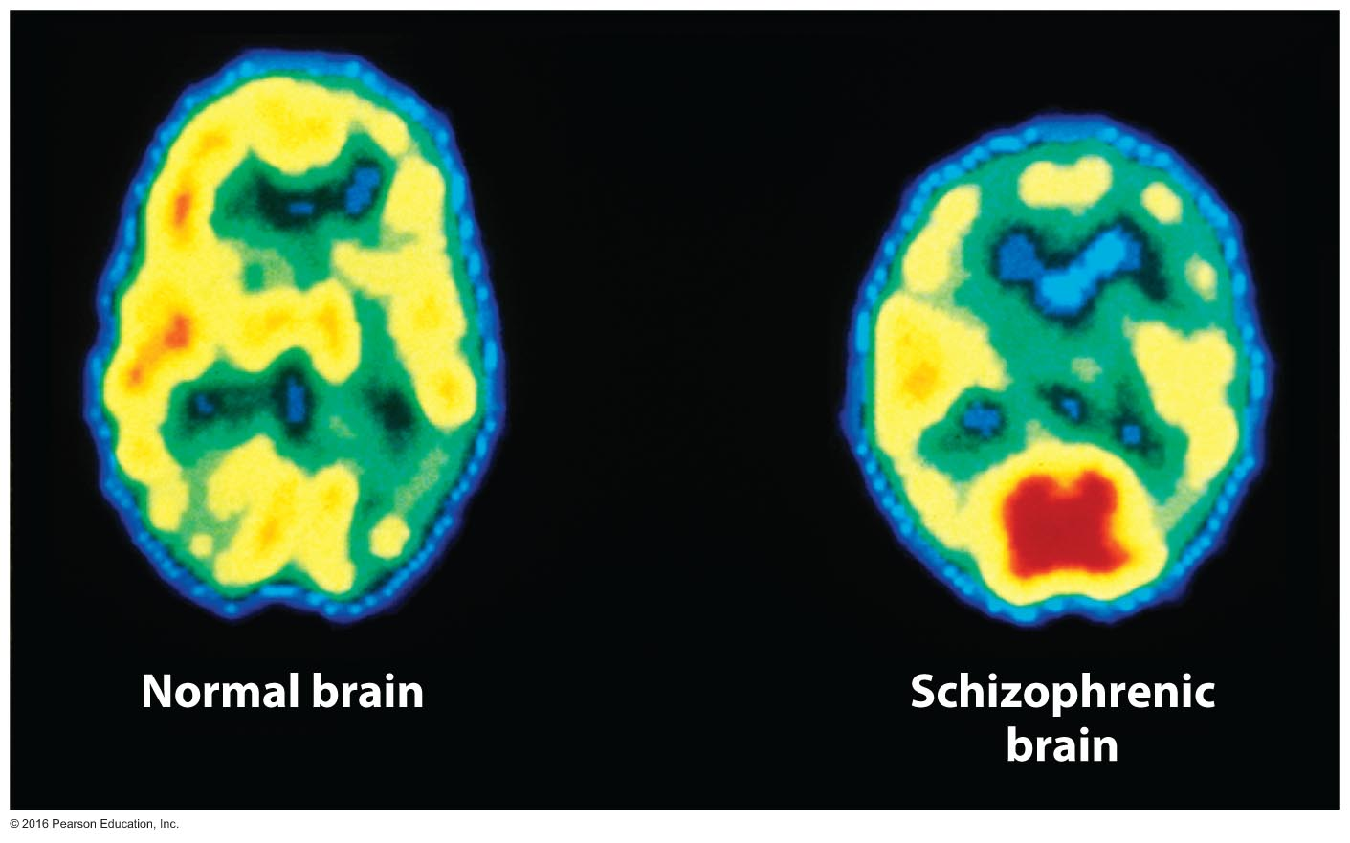
Comparison of Two Brains
Notes:
These brain images reveal a significant reduction in brain activity in a person with untreated schizophrenia. Yellow and red identify areas of greatest activity, and blue signifies reduced activity.

Slide 36
Suicide: Giving Up on Life
Anyone who expresses a desire to kill themselves or who has made an attempt to do so is at risk for suicide.
Common signs that a person is contemplating suicide include:
Recent loss; inability to let go of grief
History of depression
Change in personality/behavior
Sexual dysfunction
Expressions of self-hatred

Slide 37
Suicide: Giving Up on Life
Common signs continued…
Change in sleep patterns
Direct or indirect statements about committing suicide
Final preparations, such as writing a will, giving away possessions, or writing revealing letters
Preoccupation with death themes
Marked change in personal appearance

Slide 38
Preventing Suicide
You can take the following specific actions to help prevent someone from committing suicide:
Monitor the warning signals.
Take threats seriously.
Let the person know how much you care about him or her.
Listen.
Ask directly.
Do not belittle the person's feelings.
Help come up with alternatives.
Tell someone; do not keep your suspicions to yourself.

Slide 39
Activity Break
Get into groups of four or five.
Write a plan of action as if you suspected that your roommate was contemplating suicide.
List the steps you might take to intervene and get him or her help.
Notes:
39

Slide 40
Seeking Professional Help
The stigma of mental illness
The stigma of mental illness often leads to feelings of shame and guilt, loss of self-esteem, and a sense of isolation, but those at risk should be encouraged to seek help.
Getting evaluated for treatment
A physical checkup
A psychiatric history
A mental status examination
Once physical factors have been ruled out, you may decide to consult a professional who specializes in psychiatric symptoms.

Slide 41
Seeking Professional Help
Treatment models
Cognitive therapy focuses on the impact of thoughts and ideas on our feelings and behavior.
Behavioral therapy focuses on what we do—our behavior patterns.
Pharmacological treatment
Drug therapy can be an important adjunct in the treatment of many psychological disorders, especially as new medications are continually developed.

Slide 42
What to Expect in Therapy
Before your first interview with a therapist, briefly explain your needs and ask about fees.
The first visit is a verbal and mental sizing up between you and the therapist.
The therapist will want to take down your history and details about the problems that have brought you to therapy.
Be open and honest.
Do not expect the therapist to tell you what to do or how to behave.
The responsibility for learning more helpful behaviors lies with you.

Slide 43
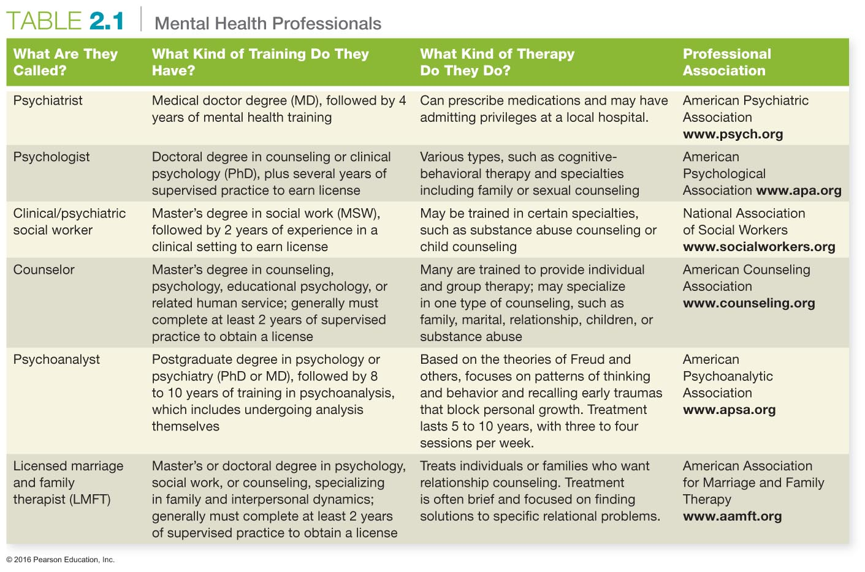
Notes:
Have students turn to page 55 for a closer look at Table 2.1.
Identify which of the listed professionals can prescribe medications in your state.
43

Slide 44
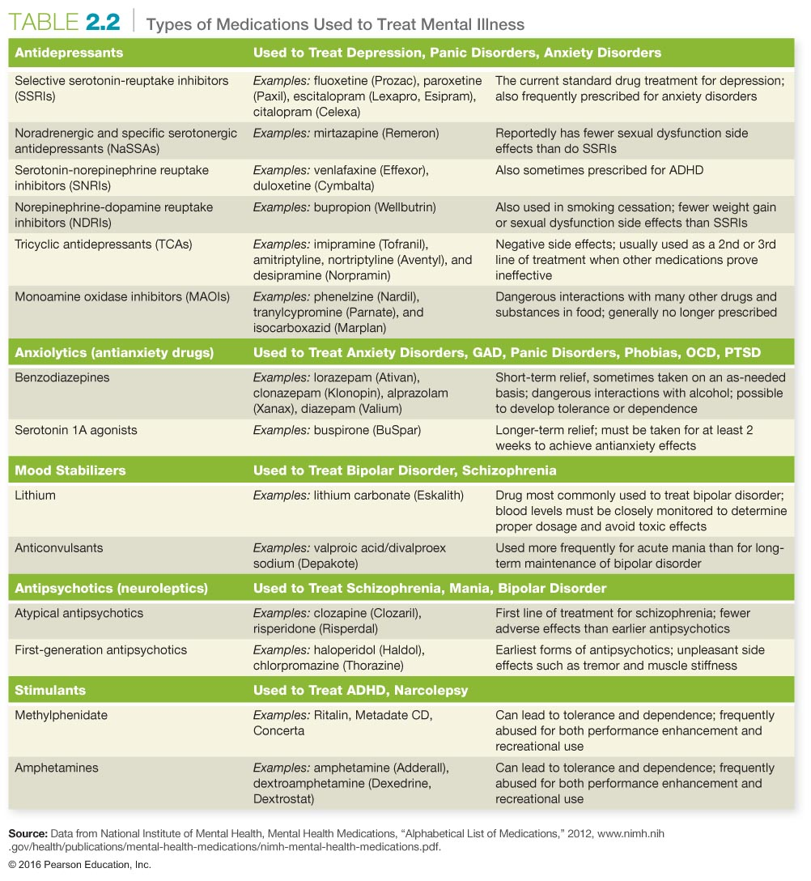
Notes:
Have students turn to page 56 for a closer look at Table 2.2.

Slide 45
Assessing Yourself—A Personal Inventory
Go online to MasteringHealth to take the "How Psychologically Healthy Are You?" assessment
Are you ready to consider ways in which you might improve your psychosocial health? If so, what methods would you use?
If you have concerns about your mental health, are you ready to make an appointment with a counselor or therapist?
Notes:
Work together to list options for mental health therapy on the board along with the associated phone numbers.

