Slide 1
Chapter 1: Accessing Your Health
Notes:
Ask students to write down a three-line statement about their current health. Next ask them to write three things they do that undermine their health. Remind them that being healthy is a choice—that many of the top leading causes of death are influenced by lifestyle behaviors.
Ask them to again look at the health statement and those of their behaviors that may undermine their health. Give an overview of why behaviors, even those that undermine health, are maintained and suggest that, as we move through this chapter, they think about how to change those behaviors.

Slide 2
Did you PREPARE and did you LEARN?
Describe the immediate and long-term rewards of healthy behaviors and the effects that your health choices may have on others.
Compare and contrast the medical model of health and the public health model and discuss the six dimensions of health.
Identify modifiable and nonmodifiable personal and social factors that influence your health; discuss the importance of a global perspective on health; and explain how gender, racial, economic, and cultural factors influence health disparities.

Slide 3
Did you PREPARE and did you LEARN?
Compare and contrast the health belief model, the social cognitive model, and the transtheoretical model of behavior change, and explain how you might use them in making a specific behavior change.
Identify your own current risk behaviors, the factors that influence those behaviors, and the strategies you can use to change them.

Slide 4
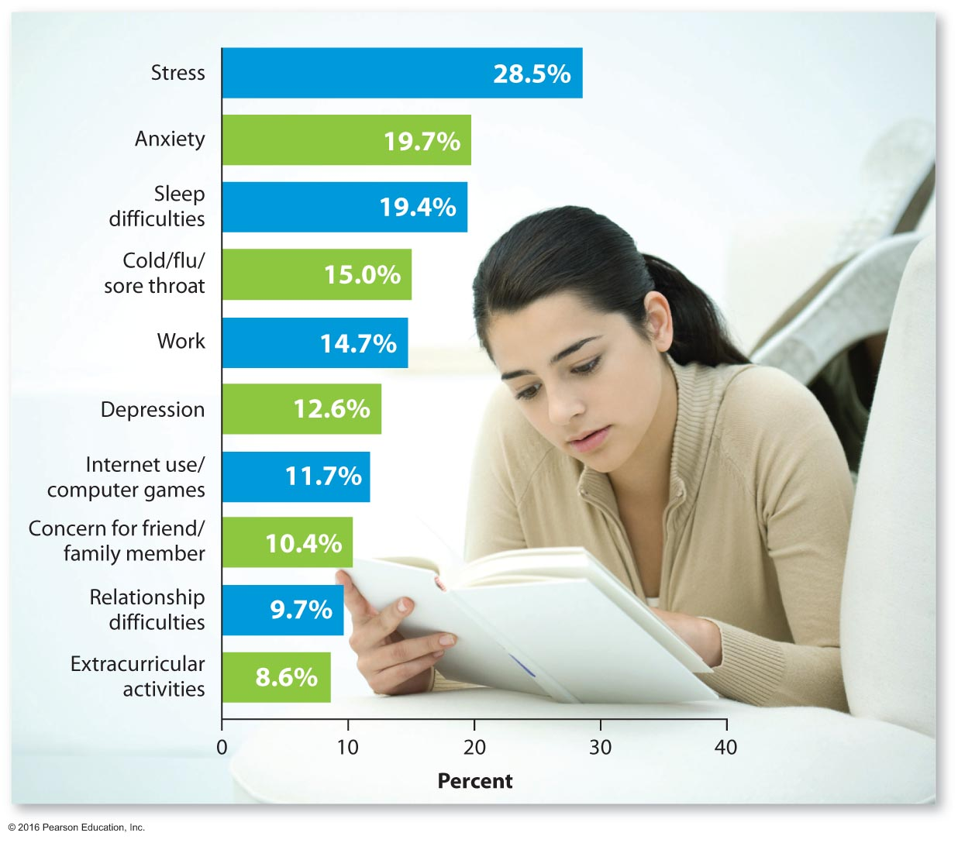
Top Ten Reported Impediments to Academic Performance—Past 12 Months
Notes:
Ask each student to list the top ten impediments s/he perceives to be influencing his or her academic performance. Next to each impediment, ask students to state how this could be modified and whether it is worth it to them to actually change this.

Slide 5
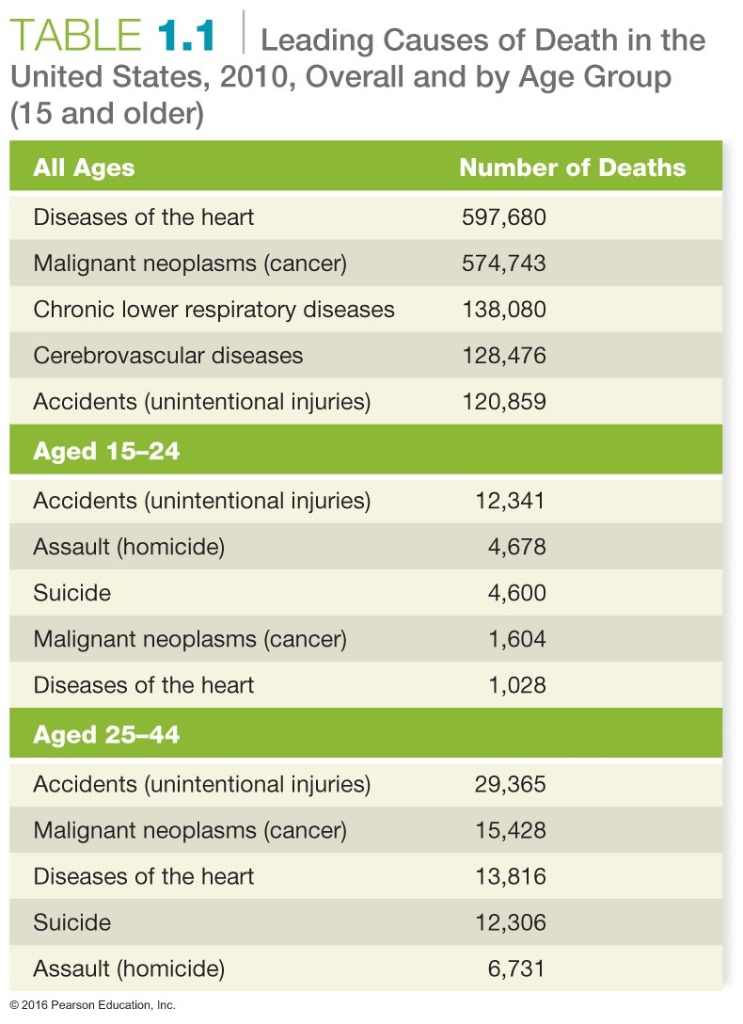
Notes:
Divide students into five groups. Assign each group to one of the age categories listed in the chart and ask them to identify how each leading cause of death is influenced by personal behavior. Ask them if it is realistic to expect people to consider behavior change relative to their health. You will have either current or former smokers in the room. Get them to focus on why they maintain a habit that they know will influence their health or, for the reformed smokers, ask how they were able to stop smoking and why they did so.
Ask students to consider the cost of negative health behaviors, which we all must bear. Is this fair? Test their preparation for class by asking them why today's children may have a shorter life expectancy than their parents and then ask whose responsibility this is. Are parents responsible for the overweight issues we see in children, or does the school system or even food manufacturers have some responsibility?

Slide 6
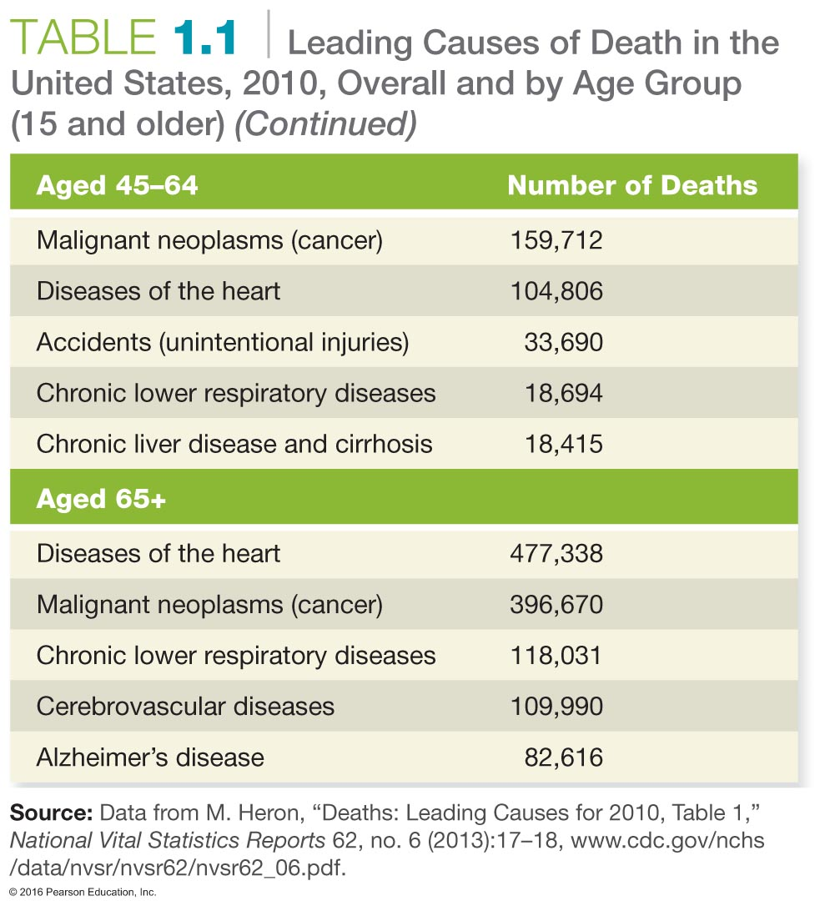
Notes:
Divide students into five groups. Assign each group to one of the age categories listed in the chart and ask them to identify how each leading cause of death is influenced by personal behavior. Ask them if it is realistic to expect people to consider behavior change relative to their health. You will have either current or former smokers in the room. Get them to focus on why they maintain a habit that they know will influence their health or, for the reformed smokers, ask how they were able to stop smoking and why they did so.
Ask students to consider the cost of negative health behaviors, which we all must bear. Is this fair? Test their preparation for class by asking them why today's children may have a shorter life expectancy than their parents and then ask whose responsibility this is. Are parents responsible for the overweight issues we see in children, or does the school system or even food manufacturers have some responsibility?

Slide 7
Why Health, Why Now?
Choosing healthy behaviors now will provide immediate benefits.
Choosing health now will help bring long-term rewards.
Notes:
Ask students to consider what healthy behaviors they currently employ and why they have them. Try to get students to focus on the fact that behaviors are maintained when they provide immediate pleasure or anticipated reward.
Ask students to think about how old they would like to be when they die. Most will not provide an immediate age but will rather focus on the personal conditions they want to have, and if they don't have them, they may consider death a better alternative. You will hear things like, "I want to be alive as long as I can…"
From this, move from the thought process into the long-term rewards of healthy behaviors.

Slide 8
Personal Choices Influence Your Life Expectancy
Life expectancy has almost doubled over the last 100 years, moving from about 47 years in the early 1900s to over 78.7 years for a child born in 2011.
In 1900, over 30 percent of all deaths occurred among children under the age of 5. Infectious disease was the leading cause of death.
With the development of vaccines and antibiotics, life expectancy increased dramatically and the leading cause of death shifted to chronic diseases.
Notes:
Remind students that most infectious diseases are now controlled by vaccinations. Public health mandates require that children be vaccinated to protect not only the individual, but also the general population. You might want to consider asking students if they have maintained appropriate vaccinations, such as tetanus, pneumonia, and influenza shots.
8

Slide 9
Choose Health Now to Benefit Others
Personal health choices contribute to global health or the global burden of disease.
According to a report from the Brookings Institution
Nearly 21 percent of current medical spending in the United States is due to obesity.
Without obesity, Medicaid spending would drop by roughly 12 percent.
Indirect costs take the form of reduced tax revenues, premature death, increased disability payments, and increased health insurance costs.
Notes:
Obesity has become an epidemic in the United States.
Ask students to consider whether being overweight is a choice. This is a sensitive issue, because thinner students will respond yes while those with a higher BMI will want to excuse or justify their body mass. Should we mandate that every student in this college take an exercise class each semester? Should we consider higher taxes on foods that are calorie-dense and nutritionally weak?

Slide 10
What Is Health?
Is health just the absence of disease?
Is health being in good physical shape and being able to resist illness?
The Medical Model views health status as focused on the individual and their tissues or organs.
The Public Health Model views health as a result of the individual's interactions with the social and physical environment.
Notes:
Ask students to define what health is for them. Discuss whether the Medical Model and the Public Health Model are contradictory or complementary.

Slide 11
The Ten Greatest Public Health Achievements of the 20th Century
Notes:
Using this slide as your base, introduce the concepts of disease prevention, health promotion, risk behaviors, and wellness.
Ask students to review their lists of the healthy behaviors they practice and to consider the risks they choose. Focus on the choice issue involved in both scenarios. Again, move them to think about the cost involved in negative choices that are not only personally managed but also shared by the family, community, and even beyond.

Slide 12
Wellness and the Dimensions of Health
Physical health: body size and functioning
Social health: having a broad social network and successful interaction with others
Intellectual health: ability to think clearly and make responsible decisions
Emotional health: ability to express emotions and maintain a level of self-confidence
Spiritual health: having a sense of meaning and purpose in one's life
Environmental health: appreciation of one's external environment

Slide 13
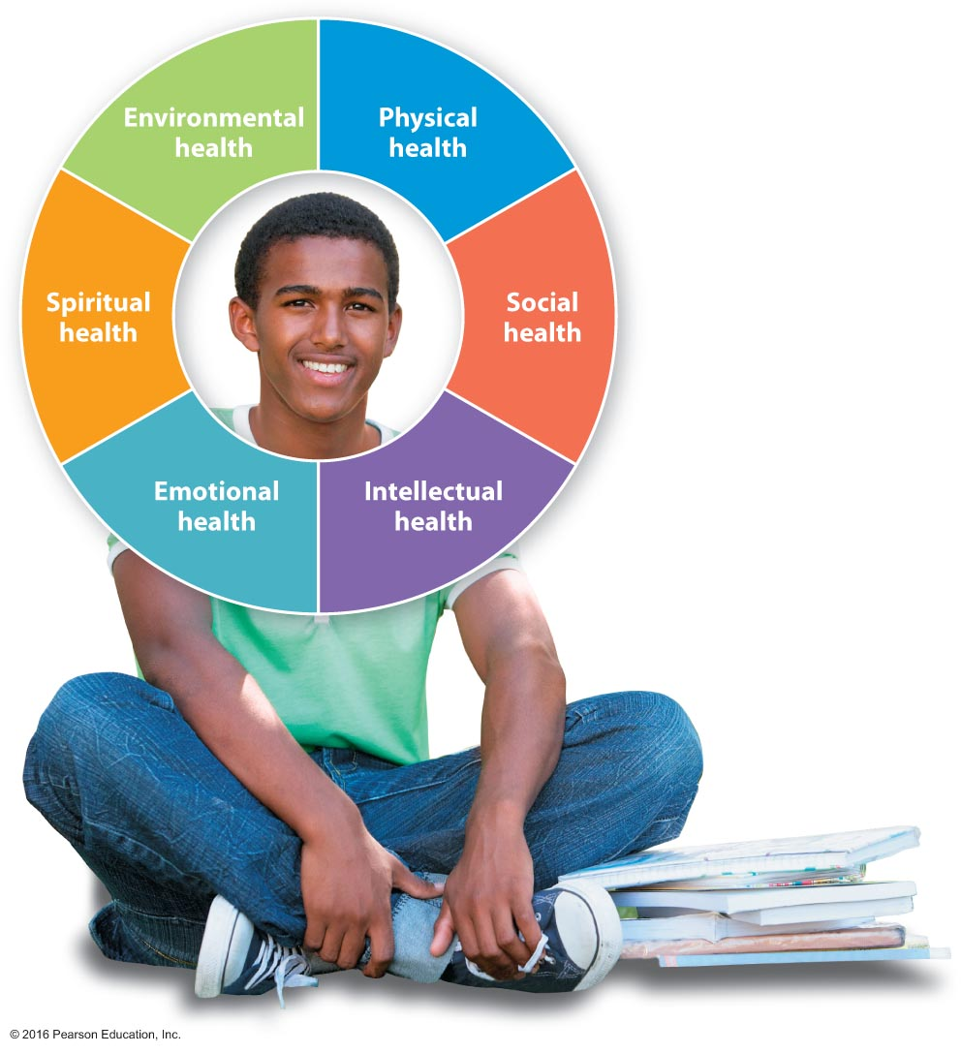
The Dimensions of Health
Notes:
To get students to understand the interrelationship of the dimensions, have students rank the dimensions as they are reflected in their health.
Ask students to consider how they could improve their rankings in each dimension and why it might be important to do this.

Slide 14
The Wellness Continuum
Notes:
Ask students to draw a line where, at the left end, the words "ever-deteriorating health" are written and, at the right end, "ever-improving health" is written. Now ask them to place a marker where they are on this line. Most will select a point in the center. Ask for a show of hands for how many did this. Now tell them that they must choose either side of the center.
Ask them to write behaviors that move them to the right, above the line, and behaviors that move them to the left, below the line. As they do this, get students to focus on how "rewarding" each of the behaviors is to them. For the negative behaviors, ask them to assess whether the "health cost" is truly worth it.

Slide 15
What Influences Your Health?
Biology refers to an individual's genetics, ethnicity, age, and gender.
Biological determinants cannot be changed; they are nonmodifiable determinants.
Behaviors refer to an individual's response to internal and external conditions.
Behaviors are modifiable determinants because they can be changed.
Notes:
Introduce Healthy People 2020 with this slide.
Although we cannot change our biology, we can still influence it to maximize health. We cannot change our age, but our behaviors can influence how well we age. We cannot change our genetics, but we can become educated to know what health effects might result from our genetic heritage. We cannot change our ethnicity, but we can learn the risks our ethnicity might pose.
Introduce concepts such as Tay-Sachs disease, hypertension in African Americans, etc., and discuss how knowledge can reduce risk.

Slide 16
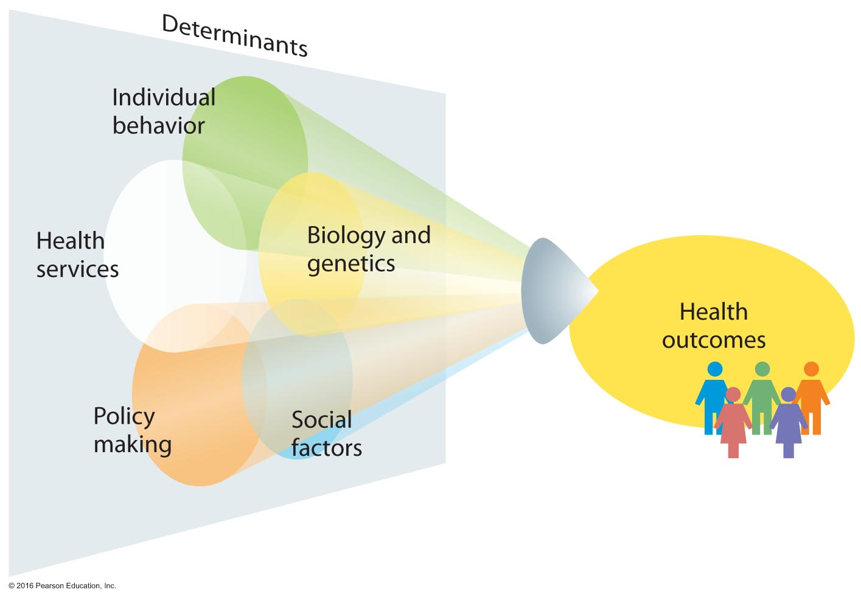
Healthy People 2020 – Health Determinants

Slide 17
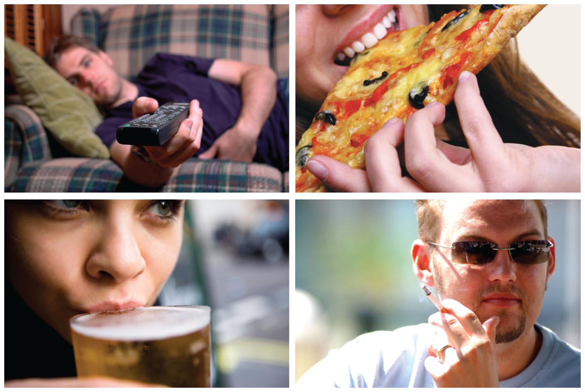
Four Leading Causes of Chronic Disease in the United States

Slide 18
See It! Video: Women's Life Expectancy in Decline
Discussion Questions
Discuss the possible reasons for the decline in women's life expectancy in America.
Describe the medical and social reasons the rates of heart disease are elevated in women.
Discuss methods for raising awareness of heart disease rates in women. Discuss how to educate the American population about the higher rates of the disease in women than men.

Slide 19
Social Factors
Economic disadvantages affect all determinants of health.
Lack of access to quality education
Residing in poor housing
The inability to afford nourishing food and other essentials
Having insecure employment
Having few assets to fall back on
Notes:
Have students evaluate their current social environment and how it is impacting their well-being. Ask how many of them have adequate health insurance and discuss how lack of health insurance can affect not only their finances but may increase medical costs for all of us.

Slide 20
Social Factors
The Built Environment
Includes roads, recreational areas, transportation systems, electric transmission lines, and communication cables.
Walter Willet of the Harvard School of Public Health proposes that sidewalks and bike lanes be federally funded.
Pollutants and Infectious Agents
Includes the quality of the air we breathe, our land, water, and foods.
Global travel and commerce can cause the health status of one region to influence that of another region.

Slide 21
See It! Video: Hunger at Home
Discussion Questions
In what ways can pay-as-you-can restaurants have a wider impact on impoverished people?
In what ways do pay-as-you-can programs help to inspire volunteerism and giving back?
What are the benefits and challenges to pay-as-you-can restaurants? How would you discuss the pay-as-you-can idea with a restaurant franchise with the hopes of inspiring them to consider this method of payment?
The video gives several examples of pay-as-you-can restaurants across the country. How have pay-as-you-can restaurants been successful and prosperous?

Slide 22
Policymaking
Policies and interventions can have powerful and positive effects on the health of individuals and communities.
Examples include:
Campaigns to prevent smoking
Laws mandating child restraint and seat belt use in cars
Laws mandating helmets for bikes and motorcycles
Vaccination programs
Public funding for mental health services
Notes:
Ask students to brainstorm what policies exist on campus that promote and protect health. What interventions might be necessary to improve health and safety on campus?

Slide 23
Access to Quality Health Care
The final health determinant for Healthy People Initiatives was access to quality health care.
This involves not only the services of health care providers, but also access to relevant health information and products.
This determinant is related to economics, public policies, interventions, and the sponsorship of health care.
Notes:
Ask students whether they are medically insured and whether they are receiving quality health care.

Slide 24
How Can You Improve Your Health Behaviors?
Models of Behavior Change
The Health Belief Model
The Social Cognitive Model
The Transtheoretical Model

Slide 25
Health Belief Model (HBM)
A belief is an appraisal of your relationship to some object, action, or idea.
The Health Belief Model (HBM) was developed by psychologist I. Rosenstock in 1966.
The HBM holds that a healthy behavior change is more likely if:
The health problem is perceived to be serious
The individual perceives that the health problem poses a threat
There are cues to action
Notes:
Ask students to again consider those of their behaviors that may undermine their health and have them evaluate them in light of this model.

Slide 26
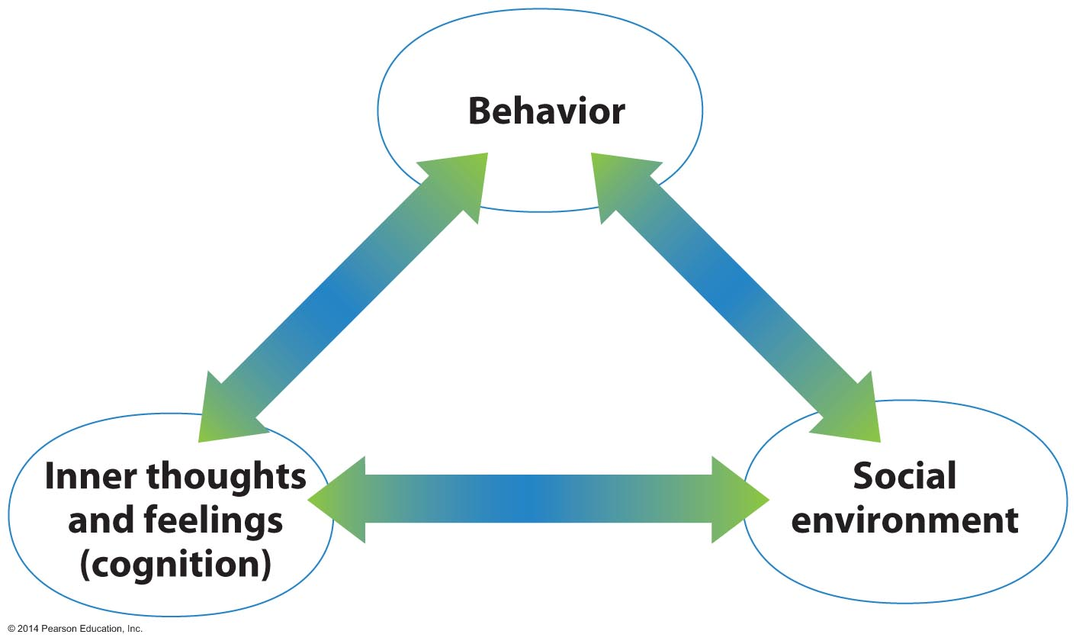
Social Cognitive Model
The Social Cognitive Model was developed from the work of several researchers, but it is most closely associated with the work of psychologist Albert Bandura.
Notes:
Based on the combined efforts of many researchers, but especially those of Bandura, this model suggests that change occurs in a reciprocal fashion. We change our behaviors in part by observing models in our environments, from childhood to the present, reflecting on our observations and regulating ourselves accordingly.

Slide 27
Transtheoretical Model (TTM)
The TTM (Stages of Change Model) was developed by Drs. James Prochaska and Carlos DiClemente and includes the following stages:
Precontemplation stage
Contemplation stage
Preparation stage
Action stage
Maintenance stage
Termination stage
Notes:
Precontemplation stage – There is no current intention to change behavior.
Contemplation stage – The problem is recognized and change is contemplated, but it may take years to begin.
Preparation stage – Action is imminent; there may even be a plan.
Action stage – Action plans begin to be followed.
Maintenance stage – The actions begun in the action stage are continued, and the individual works toward making them permanent.
Termination stage – The new behavior is ingrained and is now a part of daily life.

Slide 28
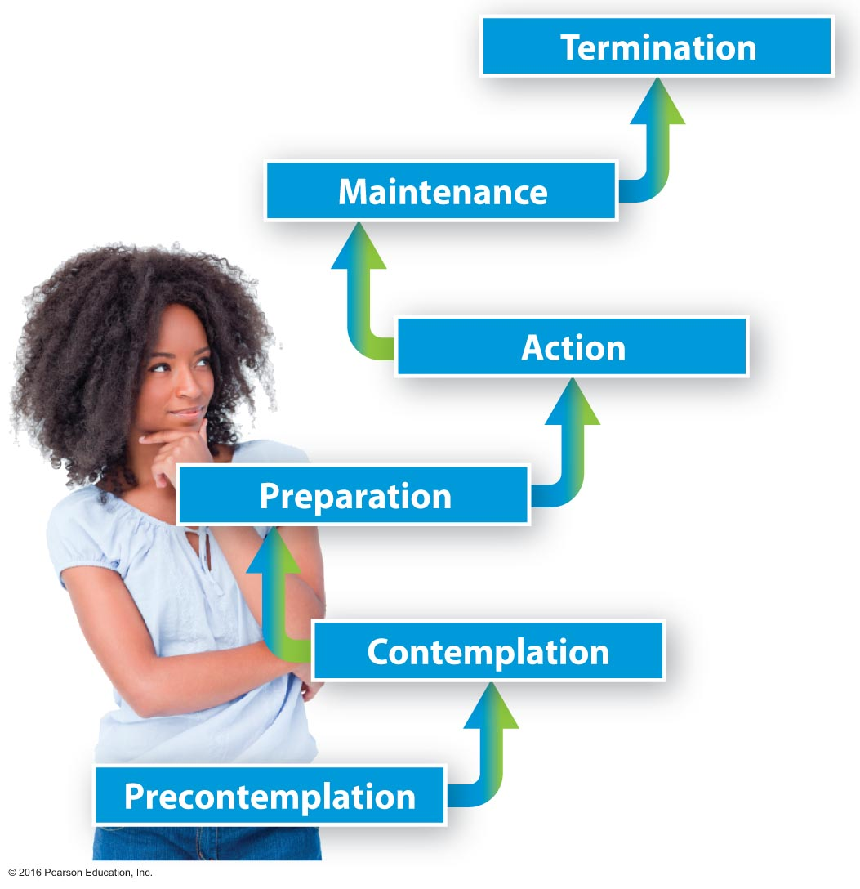
How Can You Improve Your Health Behaviors?
Increase your awareness.
Contemplate change.
Prepare for change.
Take action to change.

Slide 29
See It! Video: New Year's Resolutions
Discussion Questions
Provide examples of resolutions that can have a positive impact on health and wellness.
Discuss the ways in which the top three resolutions discussed can have a positive impact on overall health and wellness.
Discuss how spending time with family and friends positively impacts our health.

Slide 30
How Can You Improve Your Health Behaviors?
Identify a target behavior.
Learn more about the target behavior.
Assess your motivation and readiness to change.
Develop self-efficacy.
Cultivate an internal locus of control.
Set a realistic goal.
Use shaping.
Anticipate barriers to change.
Enlist others as change agents.
Sign a contract.
Visualize new behavior.
Learn to "counter."
Control the situation.
Change your self-talk.
Reward yourself.
Keep a journal.
…Let's get started!

Slide 31
Maintain Your Motivation
How can I stay motivated to improve my health habits?
Notes:
With this slide, have students consider their health behaviors and go over increasing awareness for change, contemplating change, identifying a target behavior, learning more about the target behavior, assessing motivation and readiness for change, and any other bullet points on the previous slide.

Slide 32
Use the SMART System
Unsuccessful goals are vague and open-ended. In contrast, successful goals are SMART:
Specific
Measurable
Action-oriented
Realistic
Time-oriented

Slide 33
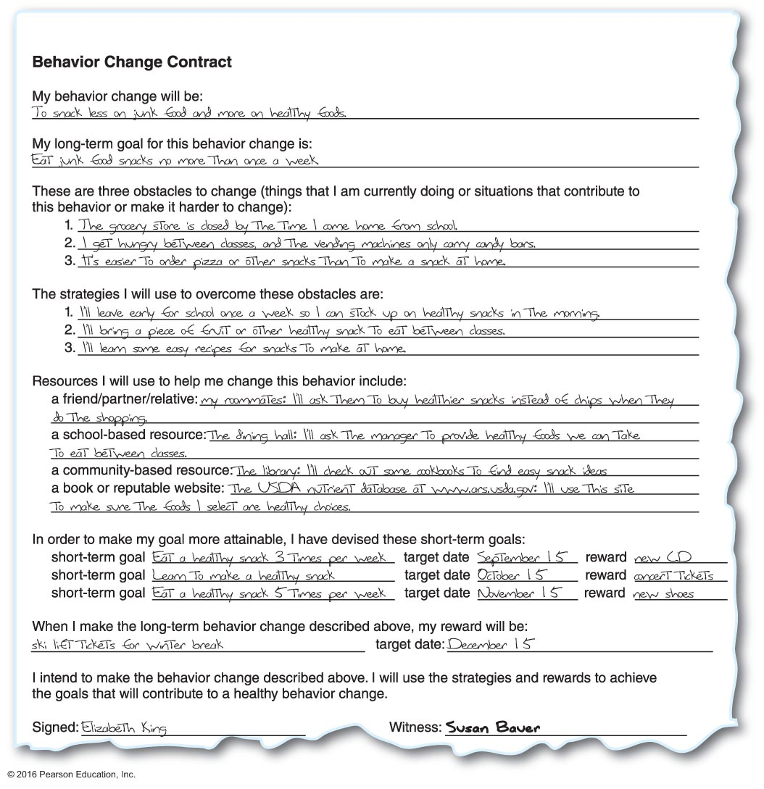
Example of a Completed Behavior Change Contract
Notes:
Ask students to complete a blank version of this contract, which is included in their textbook.

Slide 34
Assessing Yourself–A Personal Inventory
Go online to MasteringHealth to take the "How Healthy Are You?" assessment.
While reading this chapter, did you consider the impact that your health behaviors might have on society?
Are there things you can do today to improve your health?
Are you ready to make some changes to improve your health?

