Slide 1
Chapter 8: Reaching and Maintaining a Healthy Weight

Slide 2
Did you PREPARE and did you LEARN?
Explain overweight and obesity, describe the current epidemic of overweight/obesity in the United States and globally, and demonstrate understanding of risk factors associated with weight problems.
Describe factors that put people at risk for problems with obesity, distinguishing between controllable and uncontrollable factors.

Slide 3
Did you PREPARE and did you LEARN?
Learn reliable options for determining your percentage of body fat and a healthy weight.
Explain the effectiveness and potential pros/ cons of various weight control strategies, including exercise, diet, lifestyle modification, supplements/diet drugs, surgery, and other options.

Slide 4
Factors Contributing to Overweight and Obesity
Obesogenic: This term describes environments that promote increased food intake, unhealthy foods, and physical inactivity; it refers to conditions that lead people to become excessively fat.
More than 68 percent of U.S. adults are considered overweight or obese.
Overweight refers to having a body mass index (BMI) of 25.0 to 29.9; obesity refers to a BMI of 30.0 or higher.
Notes:
Ask students which foods they think are more heavily promoted in a school cafeteria. Ask them to count the number of fast-food restaurants they pass on their way to school. Have them compare the town's highest-income area and its availability of exercise space with a low-income area of town. Discuss how this affects the choices that people make.

Slide 5
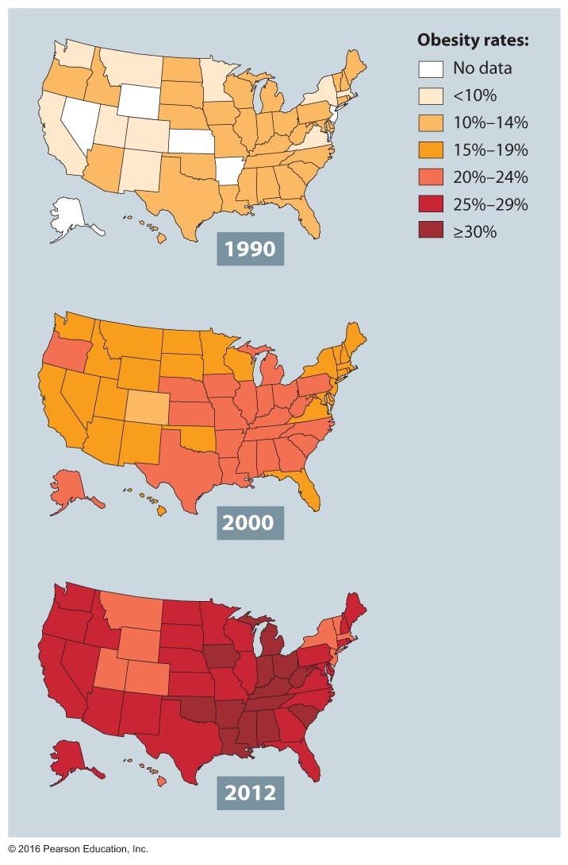
Obesity Trends among U.S. Adults, 1990, 2000, and 2012

Slide 6
Genetic and Physiological Factors
Several factors appear to influence why one person becomes obese and another remains thin, including:
Body type and genes
"Thrifty gene" theory
Metabolic rates
Hormonal influence: ghrelin and leptin
Fat cells and predisposition to fatness
Notes:
The role of genes remains unclear. It might be that family behavior leads to overweight or obesity. Genetics may play a role in body composition, but the environment also plays a substantial role in the development of obesity.
Thrifty gene theory relates to ancestors who have struggled through famine and adapted. These predecessors may have passed on genetic, hormonal, or metabolic predispositions toward fat storage, making it more difficult to lose fat.
The basal metabolic rate (BMR) is the rate at which the body uses energy at complete rest. The resting metabolic rate (RMR) is slightly higher than the BMR. It includes the BMR plus any additional energy expended through daily sedentary activities. The exercise metabolic rate (EMR) accounts for the remaining percentage of all daily caloric expenditures. There are many theories, so try to explain why rates are different.
Less than 2 percent of people are obese as a result of a thyroid problem. But hormones may still play a part in one's ability to lose weight, control appetite, and sense fullness.
An average person has about 25 to 35 billion fat cells, whereas a moderately obese person has 60 to 100 billion and an extremely obese person has as many as 200 billion. This is called hyperplasia, and it may be due to the mother's dietary habits even prior to birth. The next slide illustrates this theory.

Slide 7
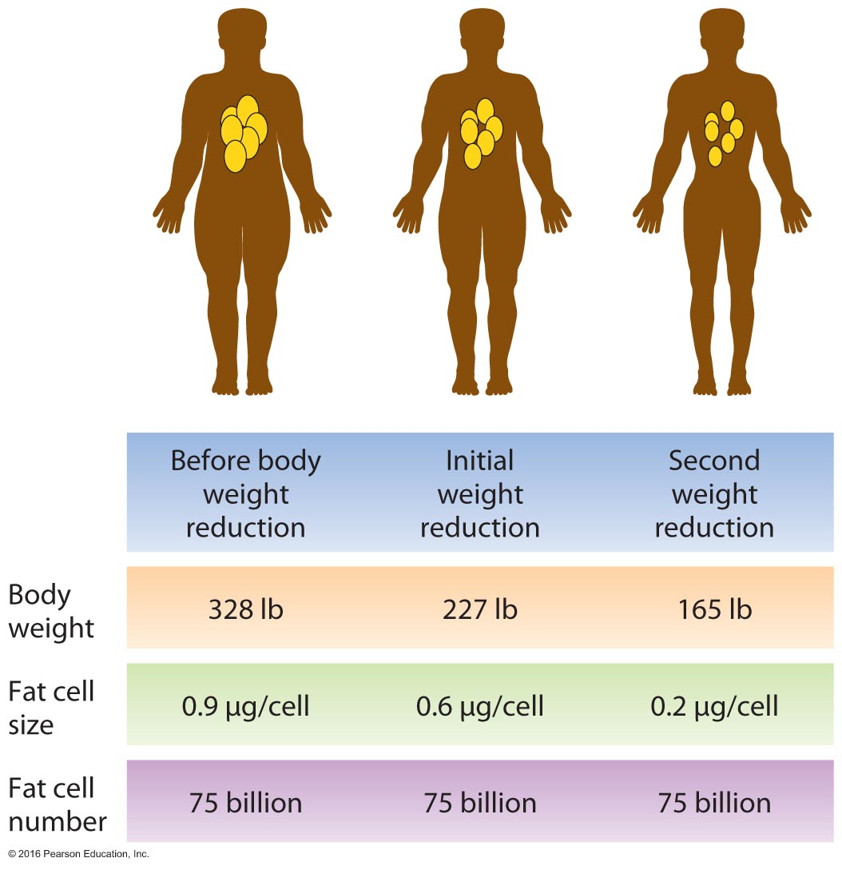
One Person at Various Stages of Weight Loss
Notes:
Hyperplasia theory

Slide 8
Environmental Factors
We sit more and move less because we use cars and remote controls, have desk jobs, and often spend many hours in front of the computer.
We are bombarded with advertising designed to increase our energy intake in the form of high-calorie foods.
Prepackaged high-fat meals, fast food, and sugar-laden soft drinks are widespread.
Notes:
Ask students how long they drive around a parking lot to find the spot closest to the door. Do they consider this a form of laziness?

Slide 9
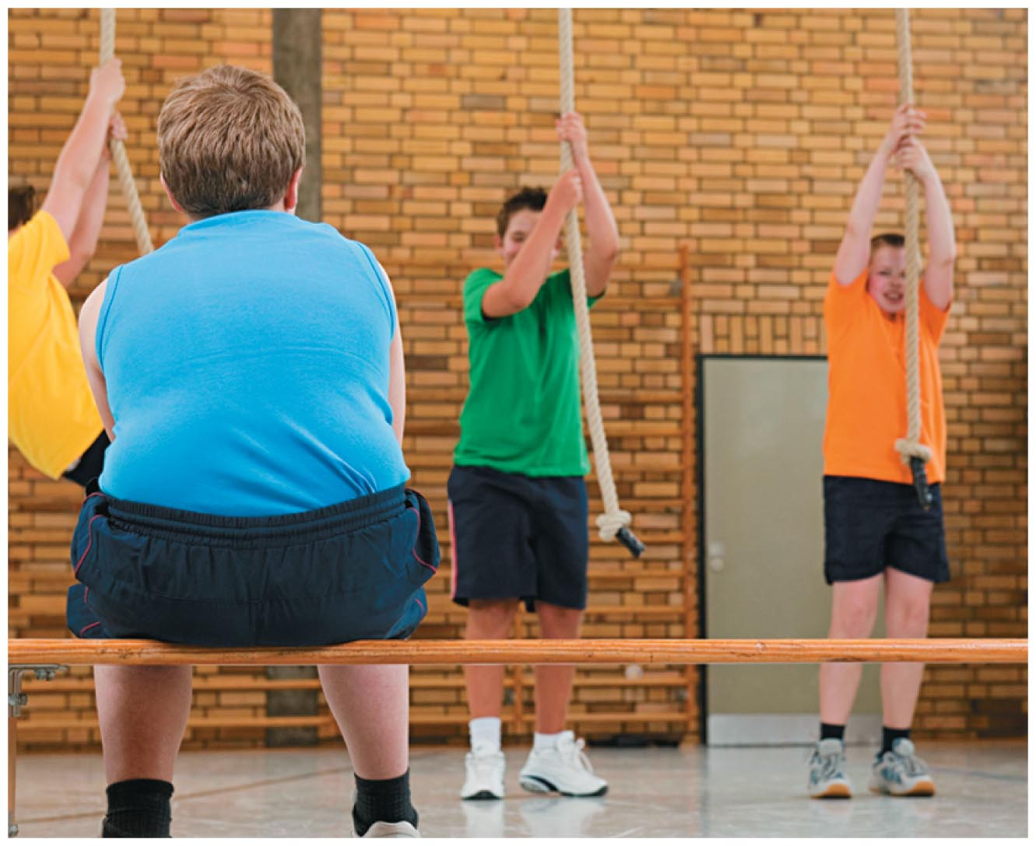
Early Sabotage: A Youthful Start on Obesity
Today's youth tend to eat larger portions and, from their earliest years, exercise less than any previous generation.
In addition to environmental, social, and cultural factors, epidemiological studies suggest that maternal undernutrition, obesity, and diabetes during gestation and lactation are also strong predictors of obesity in children.
Insert photo on page 232

Slide 10
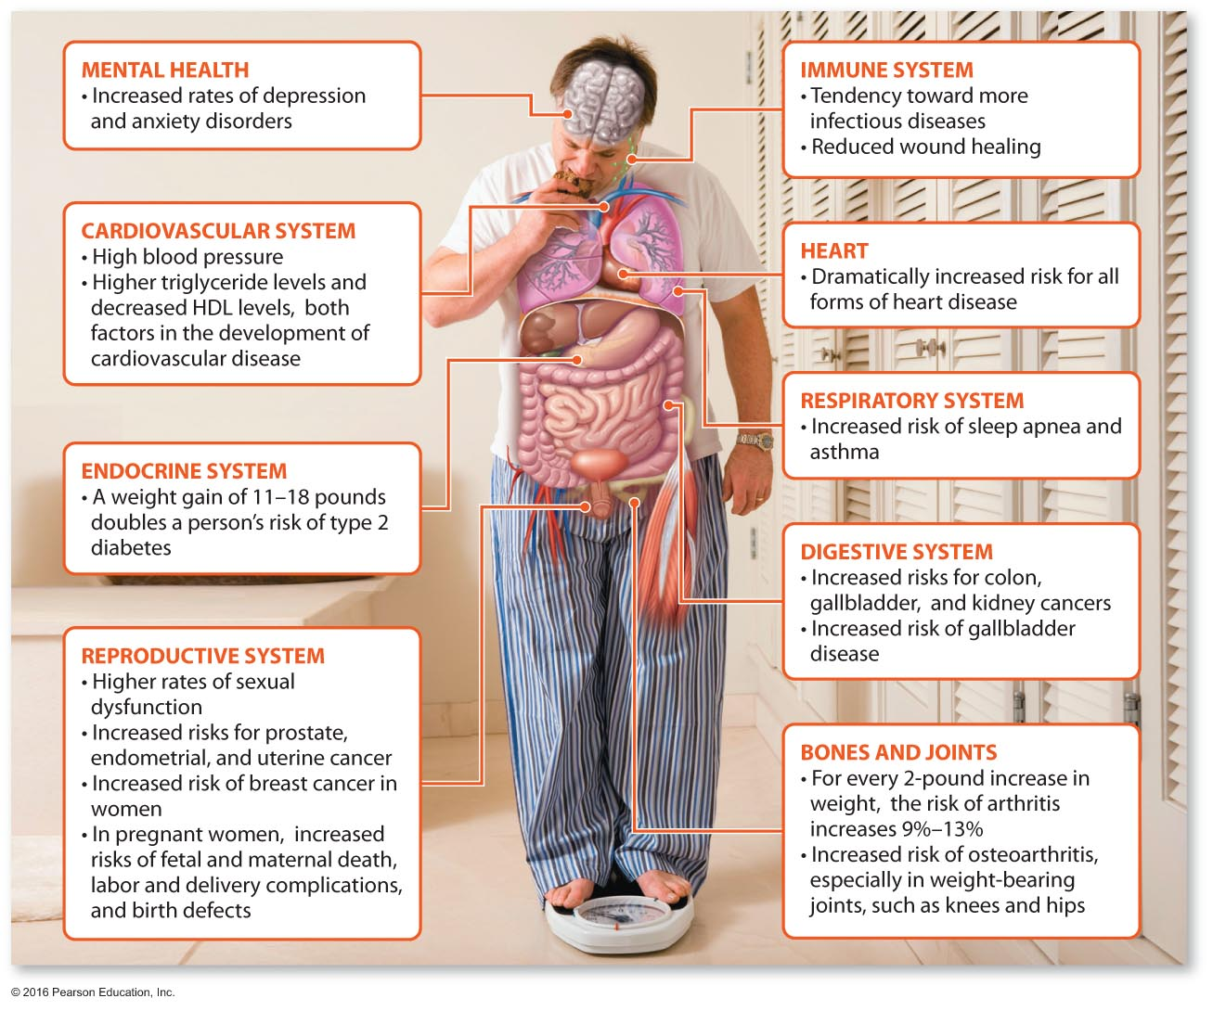
Potential Negative Health Effects of Overweight and Obesity

Slide 11
Psychosocial and Economic Factors
Eating tends to be a focal point of people's lives; it has become a social ritual associated with companionship, celebration, and enjoyment. For many people, the psychosocial aspect of the eating experience is a major obstacle to successful weight control.
Studies show that socioeconomic factors—how much money you have, where you live, and how well educated you are—also provide obstacles or aids to weight control.

Slide 12
Lifestyle Factors
Although heredity, metabolism, and environment have an impact on weight management, overweight and obesity are largely due to the way we live.
Data from the National Health Interview Survey show that 30 percent of adults in the United States never engage in any exercise, sports, or physically active hobbies in their leisure time.
Only 31 percent of adults aged 18 and over report they engage in 30 minutes or more of moderate physical activity on five or more days per week.
Notes:
Survey the class about their exercise habits. Ask students if their habits are similar to those of their family members.

Slide 13
Assessing Body Weight and Body Composition
Many people worry about becoming fat, but some fat is essential for healthy body functioning.
Essential fat is the fat necessary for the maintenance of life and reproductive functions. Fat regulates body temperature, cushions and insulates organs and tissues, and is the body's main source of stored energy.
Storage fat, the nonessential fat that many of us try to shed, makes up the remainder of our fat reserves.

Slide 14
Overweight and Obesity
Overweight is having a body weight more than 10 percent above healthy recommended levels: in an adult, a BMI of 25 to 29.
Obesity means having body weight that is more than 20 percent above healthy recommended levels; in an adult, a BMI of 30 or more equals obesity.
Morbid obesity is having a body weight 100 percent or more above healthy recommended levels; in an adult, a BMI of 40 or more equals morbid obesity.

Slide 15
Underweight
Underweight refers to having a body weight more than 10 percent below healthy recommended levels; in an adult, a BMI below 18.5 equals underweight.
For men, this refers to body fat that is only 3 to 7 percent of total body weight; for women, it refers to a level of body fat that is 8 to 15 percent of total body weight.
Extremely low body fat causes hair loss, visual disturbances, skin problems, and other issues.
Notes:
Ask students to consider what is promoted in the media relative to body size. Do today's supermodels have enough body fat?

Slide 16
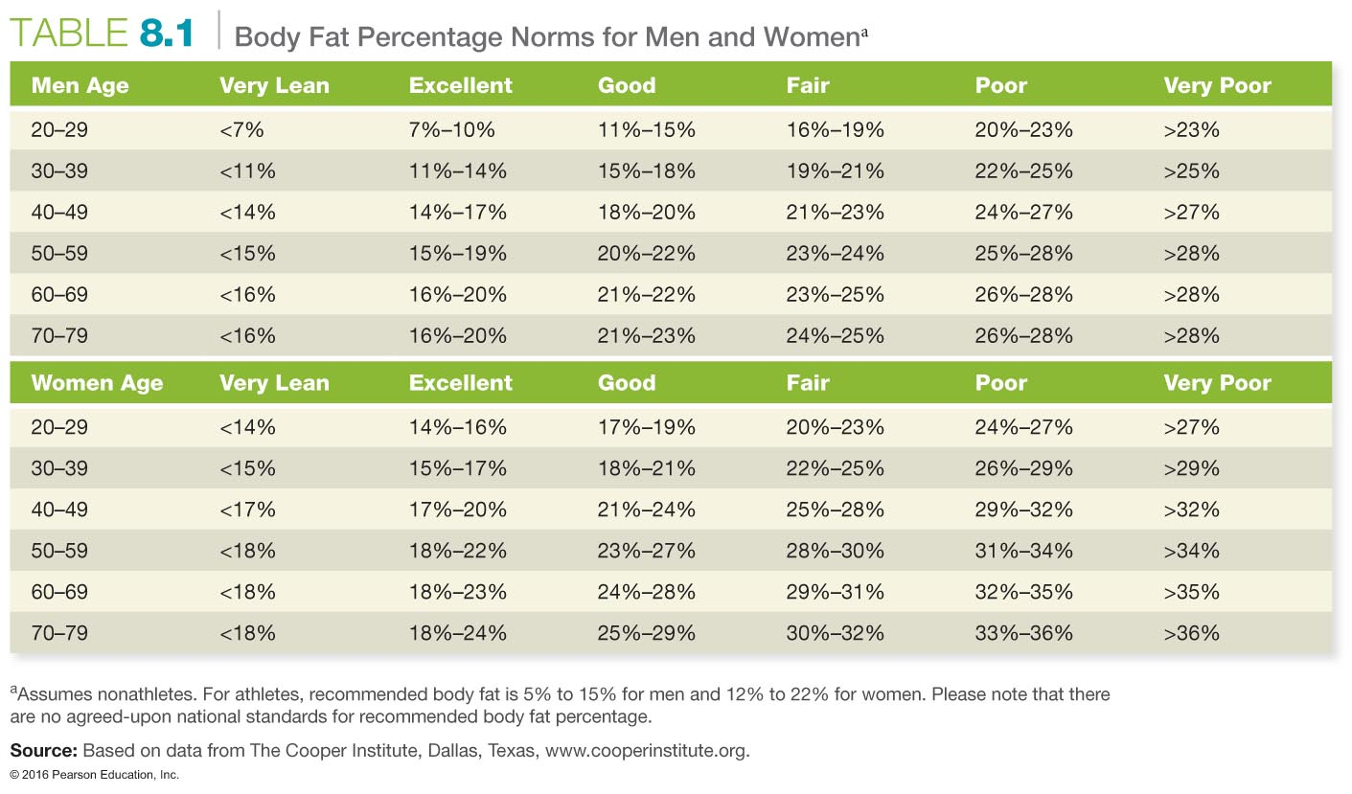

Slide 17
Body Mass Index
Body mass index (BMI) is a number calculated from a person's weight and height that is used to assess risk for possible present or future health problems.
BMI = weight (kg)/height squared (m²)
People with healthy weights are those with BMIs of 18.5 to 25.
BMI does not consider the difference between the weight of muscle and fat. A well-muscled person may have a high BMI but still be healthy.
Notes:
Discuss with students the problems with BMI. Have students determine their BMIs for a homework assignment, and have them compare this value to their waist circumferences and waist-to-hip ratios. Does each result suggest the same health implication?

Slide 18
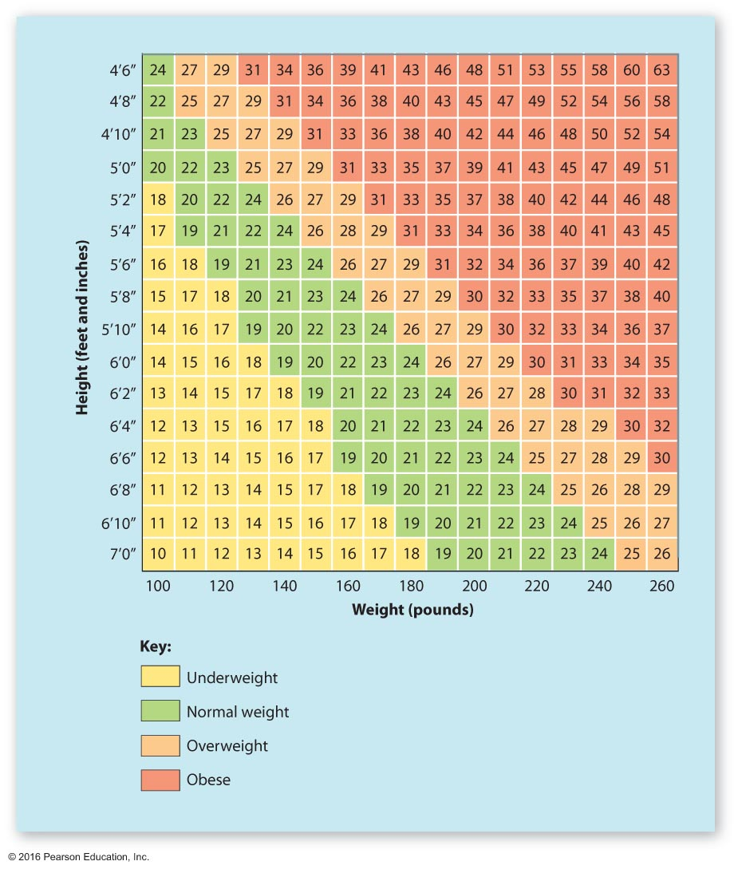
Body Mass Index (BMI)

Slide 19
Waist Circumference and Ratio Measurements
Waist circumference measurement is increasingly recognized as a useful tool in assessing abdominal fat, which is considered more threatening to health than fat in other regions of the body.
A waistline of greater than 40 inches for men and 35 inches for women may be indicative of greater health risk.
Waist-to-hip ratio measures regional fat distribution. A ratio of greater than 1 in men and 0.8 in women indicates increased health risk.
Notes:
Waist-to-hip ratio is determined by finding the narrowest point at the waist and measuring it. Find the widest point around the hips and buttocks and measure this. Divide the waist measurement into the hip measurement to determine the ratio.
For instance, a waist measurement of 36" with a hip measurement of 42" becomes a ratio of 0.86.

Slide 20
Measures of Body Fat
Look in the mirror!
Underwater (hydrostatic) weighing
Skin folds
Bioelectric impedance analysis (BIA)
Dual-energy X-ray absorptiometry (DXA)
Bod Pod

Slide 21
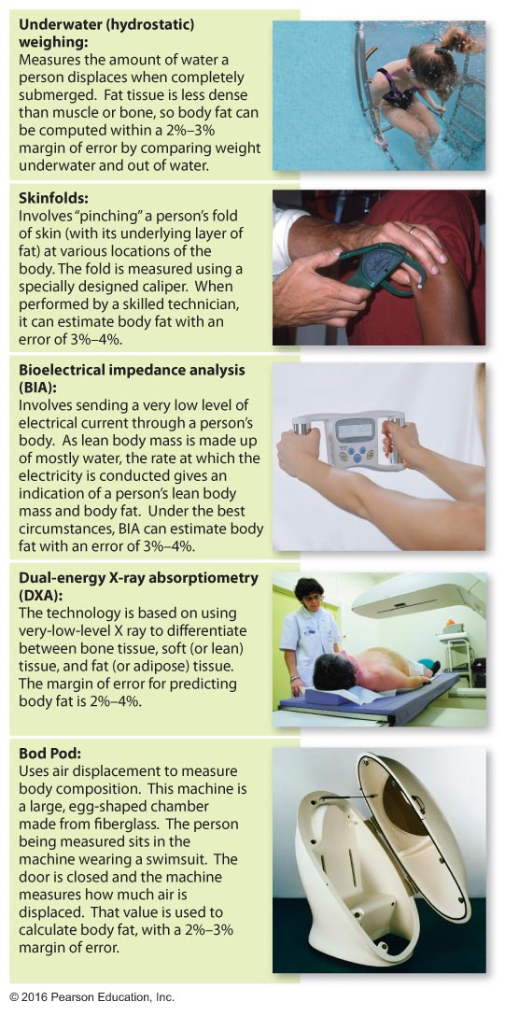
Overview of Various Body Composition Assessment Methods

Slide 22
Managing Your Weight
Failure in weight loss is related to thinking about losing weight in terms of short-term dieting rather than long-term lifestyle changes in eating behavior.
Repeated bouts of restrictive dieting may be physiologically harmful.
Drugs and intensive counseling may be helpful, but after treatment, many people still regain any weight that they may have lost. Maintaining a healthful body takes constant attention and nurturing over the course of one's whole life.

Slide 23
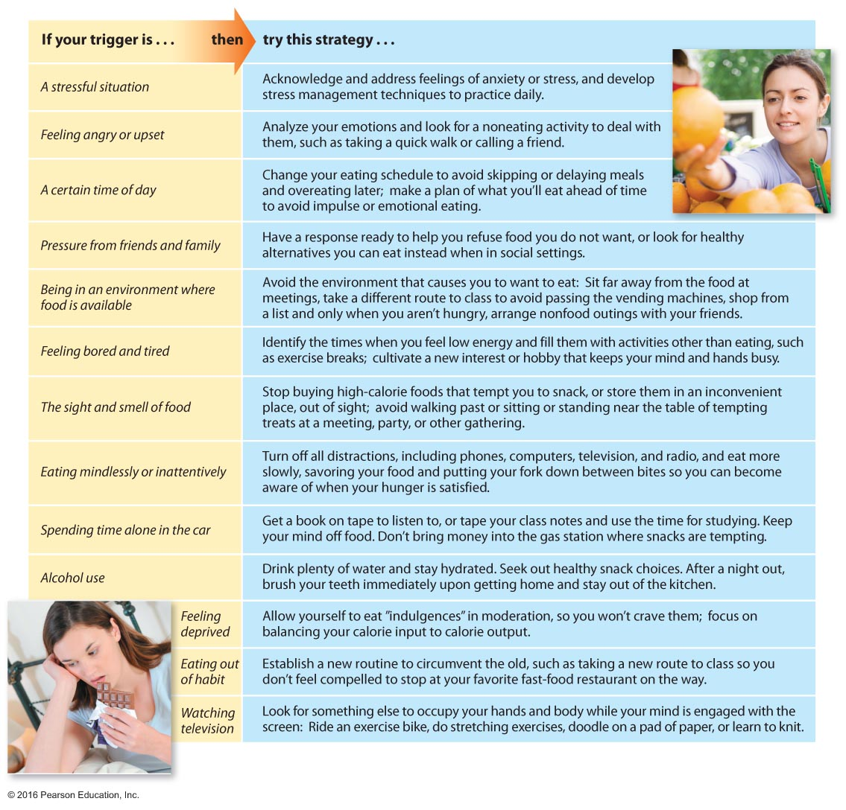
Avoid Trigger-Happy Eating

Slide 24
Improving Your Eating Habits
Keep a daily log of your eating patterns.
Look for clues in your environment or emotions that may cause you to want food.
Stress can increase or decrease appetite.
Once you have evaluated your behaviors and know your triggers, you can devise a plan for improving your eating habits.

Slide 25
See It! Video: Keeping It Off
Discussion Questions
Discuss the practical methods used for keeping weight off.
Discuss psychological factors or contributors for the inability to maintain weight loss.
What tips would you give someone who wanted to lose weight safely and to maintain weight loss?

Slide 26
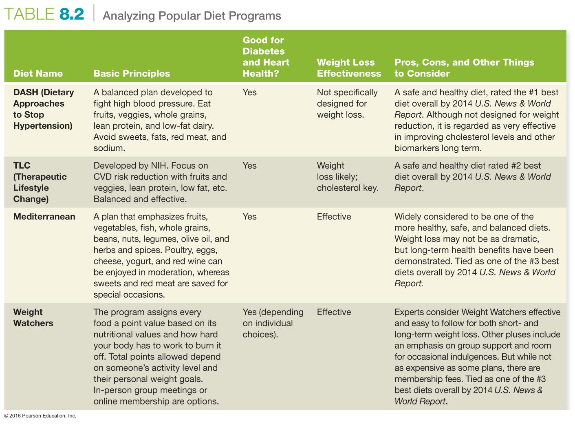

Slide 27
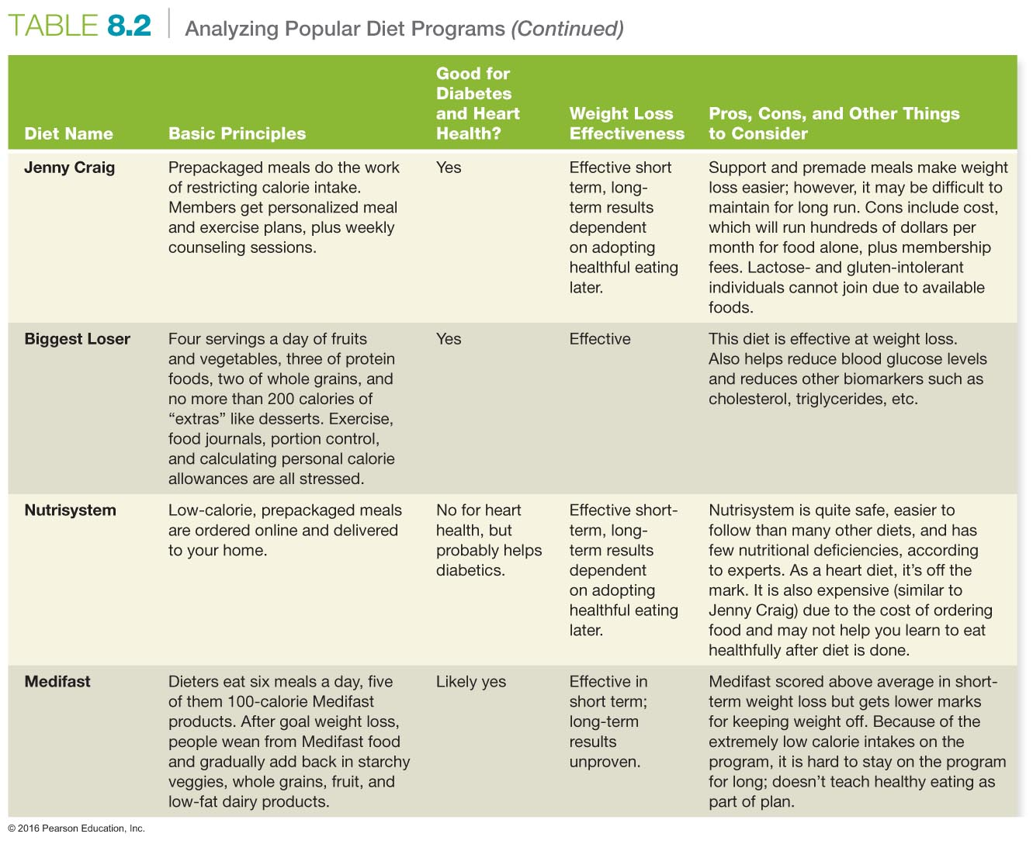

Slide 28
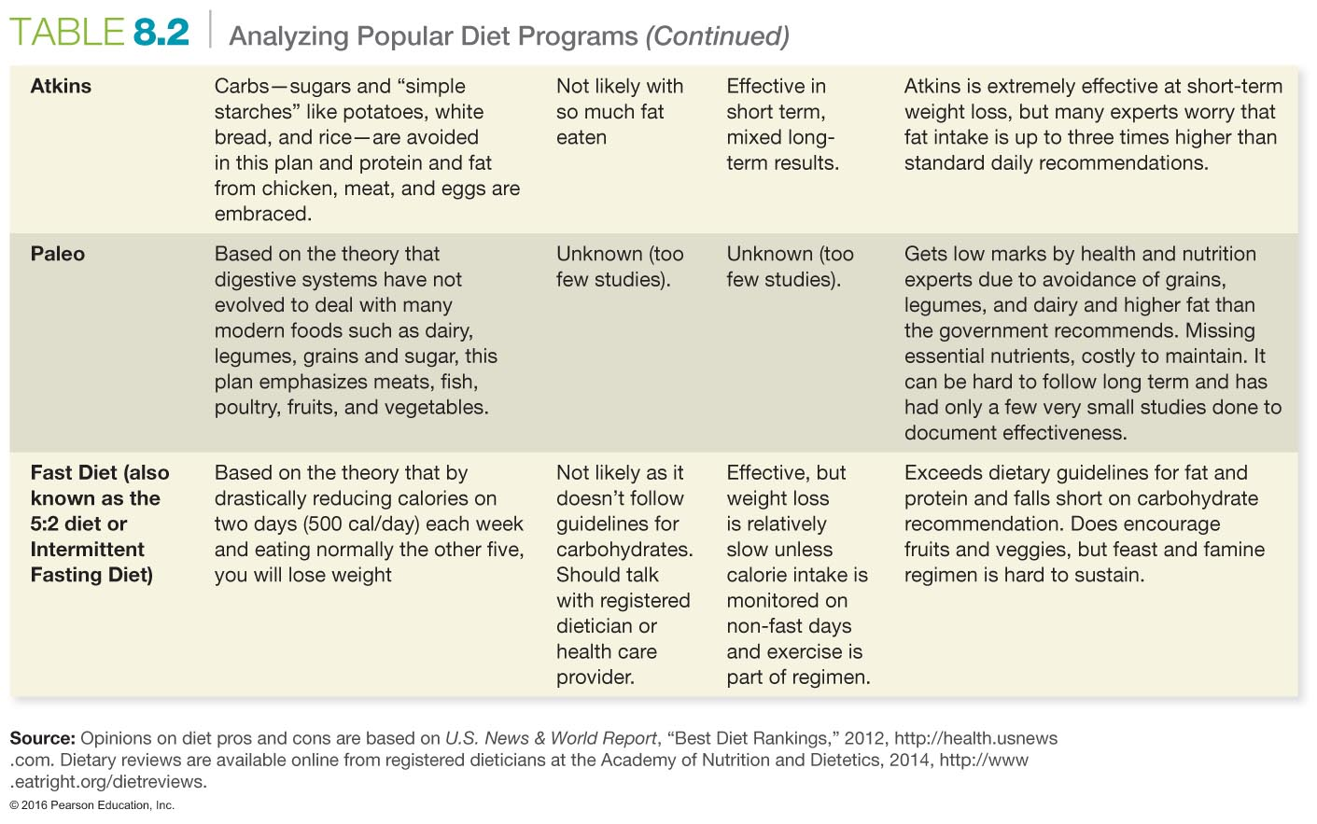

Slide 29
Understanding Calories and Energy Balance
A calorie is a unit of measure that indicates the amount of energy gained from food or expended through activity.
Each time a person consumes 3,500 extra calories, it results in one pound of additional storage fat.
Conversely, each time your body expends 3,500 extra calories, it results in one pound less of body fat.
Notes:
As a homework assignment, you might ask students to create a list of foods that equals 3,500 calories. Suggest using the website mypyramid.gov.

Slide 30
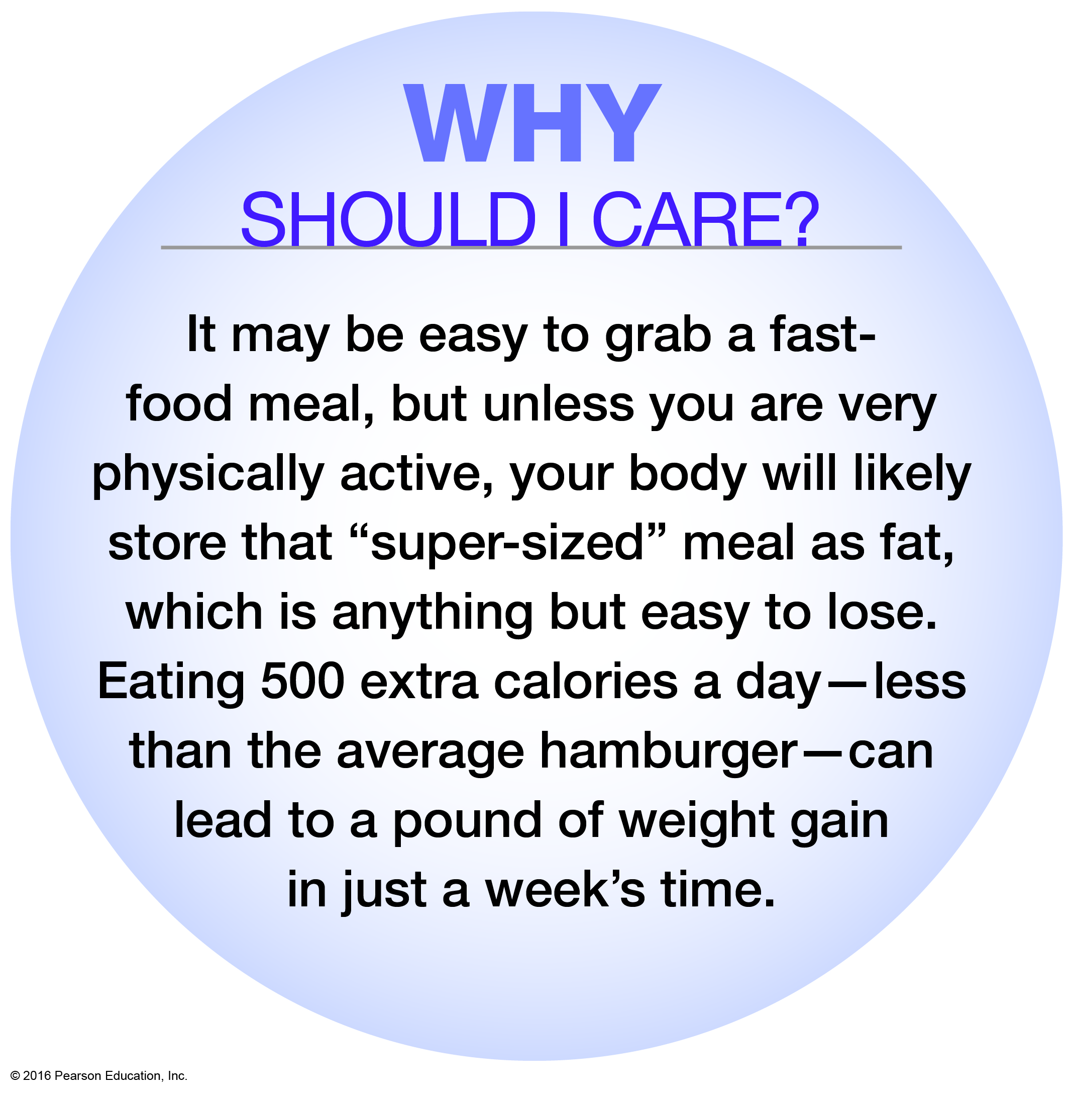
Why Should You Care?

Slide 31
See It! Video: Best Diet Plan Apparently Works
Discussion Questions
Why do you think the Weight Watchers program has been so successful? What role does social support play in the program?
What are some recommendations or strategies for those who want to lose weight but cannot afford Weight Watchers?

Slide 32
Including Exercise
Increasing BMR, RMR, or EMR levels will help burn calories.
Using large muscle groups improves energy expenditure.
The number of calories spent depends on:
The number and proportion of muscles used
The amount of weight moved
The length of time the activity takes

Slide 33
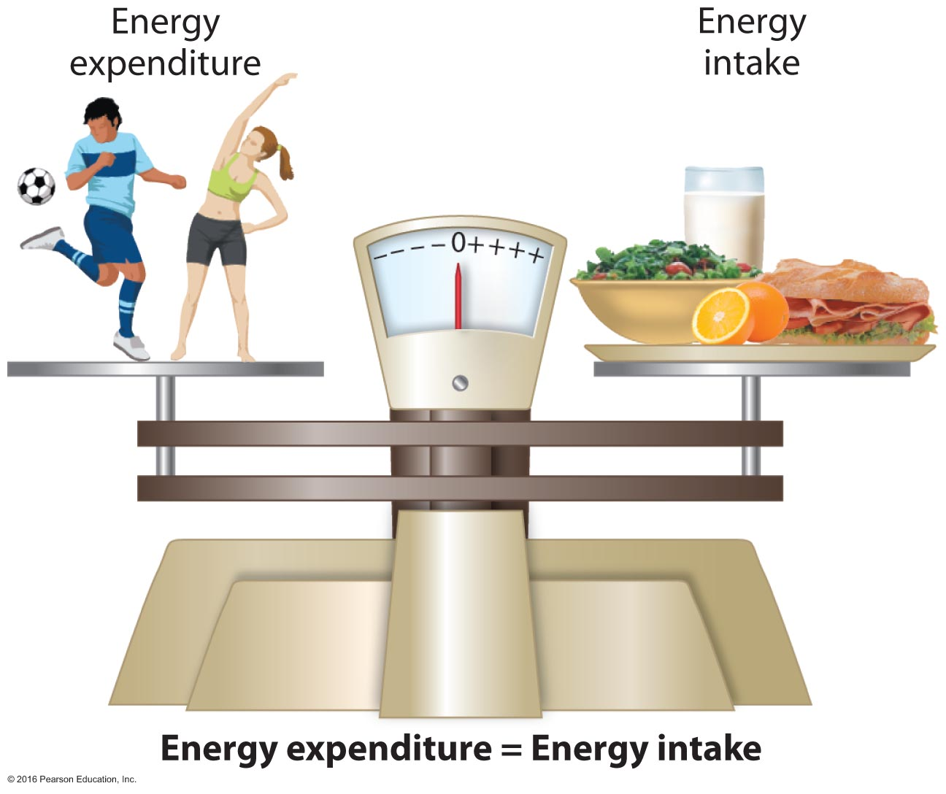
The Concept of Energy Balance

Slide 34
Keeping Weight Control in Perspective
Weight loss is difficult for many people. People of the same age, sex, height, and weight may have differences of as much as 1,000 calories a day in RMR.
It is unrealistic and potentially dangerous to punish your body by trying to lose weight in a short period of time.
It is better to try to lose 1 to 2 pounds of weight during the first week and stay with a slow, easy regimen.

Slide 35
Considering Drastic Weight-Loss Measures
Miracle diets, fasting, starvation, and other very-low-calorie diets (VLCDs) have been shown to have serious health risks and should always be followed only under medical supervision.
Low-calorie intake forces the body to convert fat into energy, a process called ketosis.
Drug treatment, though potentially helpful, can result in health risks over time.
Surgery may be the only option for some, but it is associated with health risks and potentially serious side effects.

Slide 36
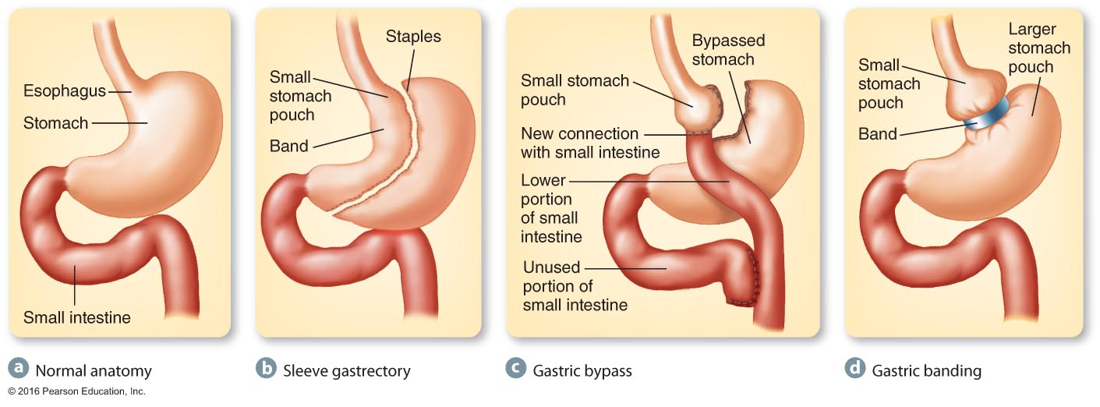
Weight-Loss Surgery Alters the Normal Anatomy of the Stomach

Slide 37
Activity Break
If you wanted to lose weight, what weight-loss strategies would you be most likely to choose?
Which strategies, if any, have worked for you before?
Which strategies offer the lowest health risk and the greatest chance for success?
What factors might serve to help or hinder your success in losing weight?
Notes:
Using this slide, you might have students work independently to assess their knowledge. In place of weight loss, it can be changed to weight gain.

Slide 38
Trying to Gain Weight
Tips include:
Eat at regularly scheduled times.
Eat more frequently.
Take time to shop, to cook, and to eat more slowly.
Put extra spreads on your foods.
Supplement your diet.
Eat with people you are comfortable with.
Moderate your exercise.
Avoid diuretics.
Relax.

Slide 39
Assessing Yourself—A Personal Inventory
Go online to MasteringHealth to fill out the "Are You Ready to Lose Weight?" assessment.
If your weight is within the normal range, congratulations! But even if it is normal and you choose to eat nutritionally poor foods and/or you do not exercise, are you ready to make some changes?
If your weight is not within the normal range, are you ready to make dietary adjustments and to begin an exercise program?

