Slide 1
Chapter 9: Improving Your Physical Fitness

Slide 2
Did you PREPARE and did you LEARN?
Describe the health benefits of being physically active.
Distinguish between the physical activity required for health, fitness, and performance.
Identify lifestyle obstacles to physical activity, describe ways to surmount them, and make a commitment to getting physically fit.
Use the FITT guidelines (frequency, intensity, time, and type) to design a fitness program that meets your personal goals.

Slide 3
Did you PREPARE and did you LEARN?
Devise a plan to implement your safe and effective fitness program.
Describe optimal foods and fluids consumption recommendations for exercise and recovery.
Explain how to prevent and treat common exercise injuries.

Slide 4
Using Physical Activity for Health, Fitness, and Performance
Inactivity has been linked to the high incidence of obesity, type 2 diabetes, and other chronic physical and mental health diseases.
Approximately 23.1 percent of American adults do not engage in leisure-time physical activity.
About 52.2 percent of college women and 45.3 percent of college men do not meet recommended guidelines for physical activity.

Slide 5
Physical Activity for Health
Physical activity provides both primary and secondary prevention of
Cardiovascular disease
Diabetes
Cancer
Hypertension
Obesity
Depression
Osteoporosis
Premature death
Notes:
If all Americans followed the 2008 guidelines, it is estimated that about one-third of deaths related to coronary heart disease; one-quarter of deaths related to stroke and osteoporosis; one-fifth of deaths related to colon cancer, hypertension, and type 2 diabetes; and one-seventh of deaths related to breast cancer could be prevented.

Slide 6
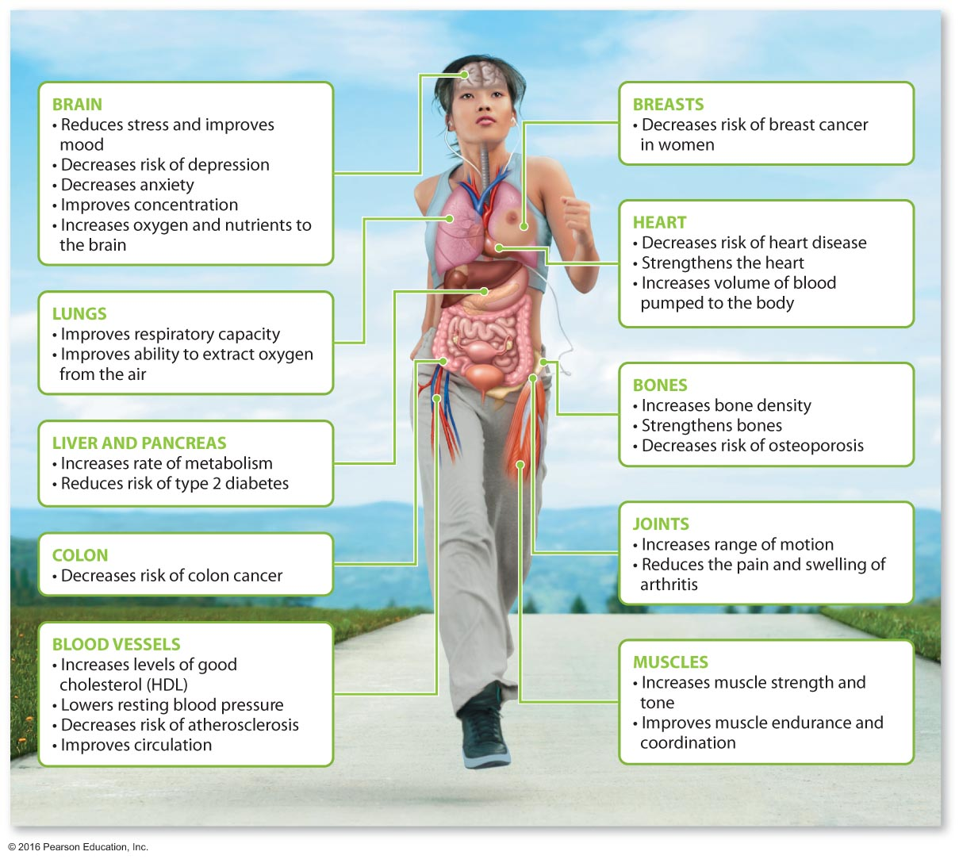
Some Health Benefits of Regular Exercise

Slide 7
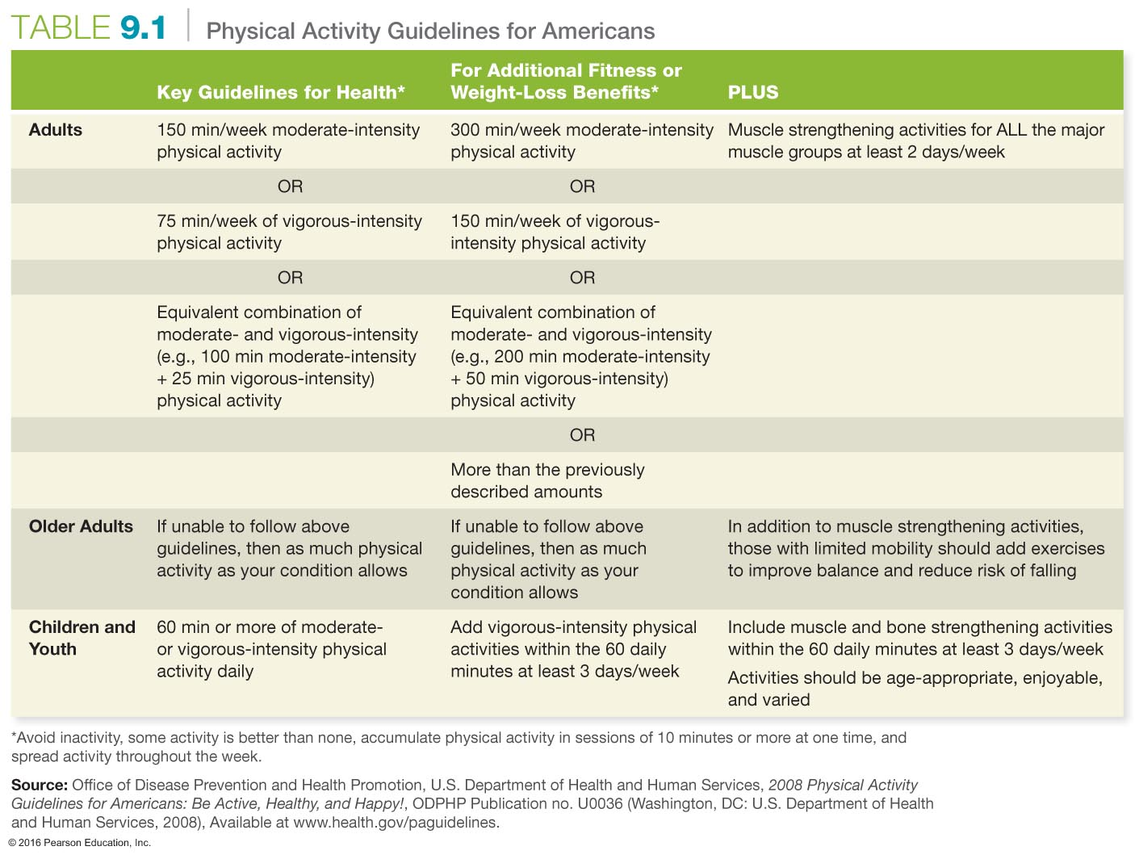

Slide 8
What Are the Health Benefits of Regular Physical Activity?
Reduced risk of cardiovascular disease
Reduced risk of metabolic syndrome and type 2 diabetes
Reduced cancer risk
Improved bone mass and reduced risk of osteoporosis
Improved weight management
Notes:
Metabolic syndrome includes high blood pressure, abdominal obesity, low HDL levels, high triglyceride levels, and impaired glucose tolerance.

Slide 9
What Are the Health Benefits of Regular Physical Activity?
Improved immunity
Improved mental health
Improved stress management
Longer life span

Slide 10
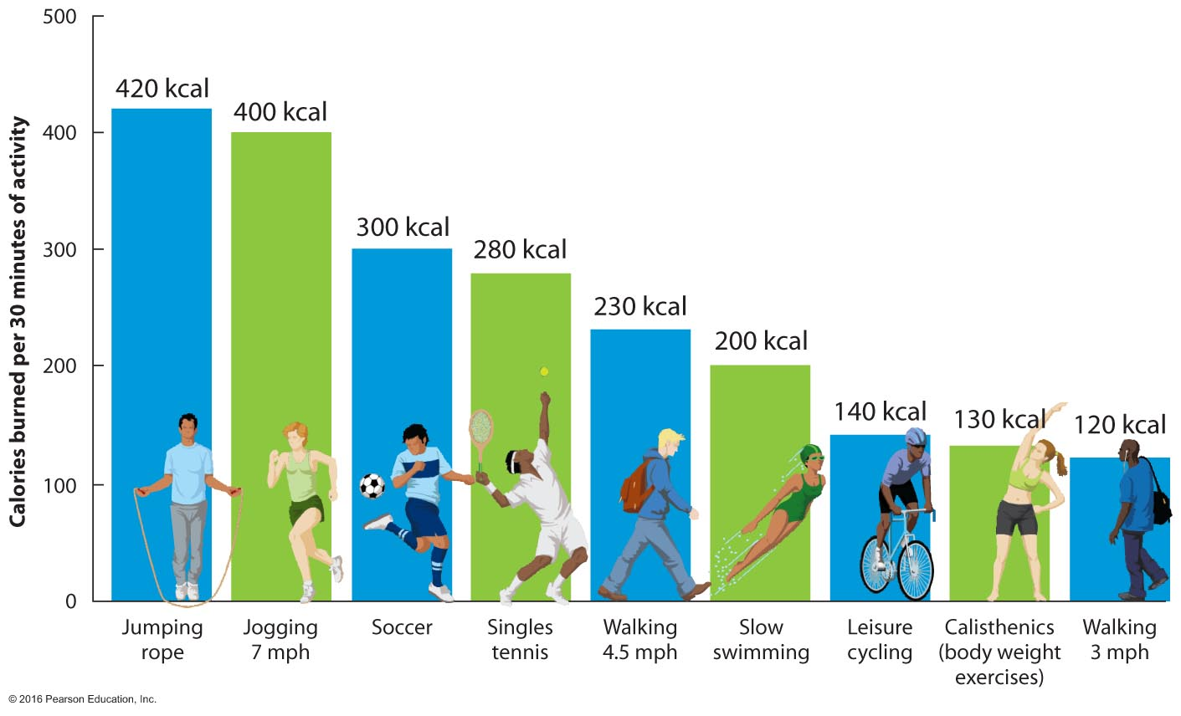
Calories Burned by Different Activities

Slide 11
Physical Activity for Fitness
Physical fitness refers to attributes that are either health or performance related.
Health-related attributes are cardiorespiratory fitness, muscular strength, muscular endurance, flexibility, and body composition.
Aerobic capacity (or power) refers to the volume of oxygen the muscles consume during exercise.

Slide 12
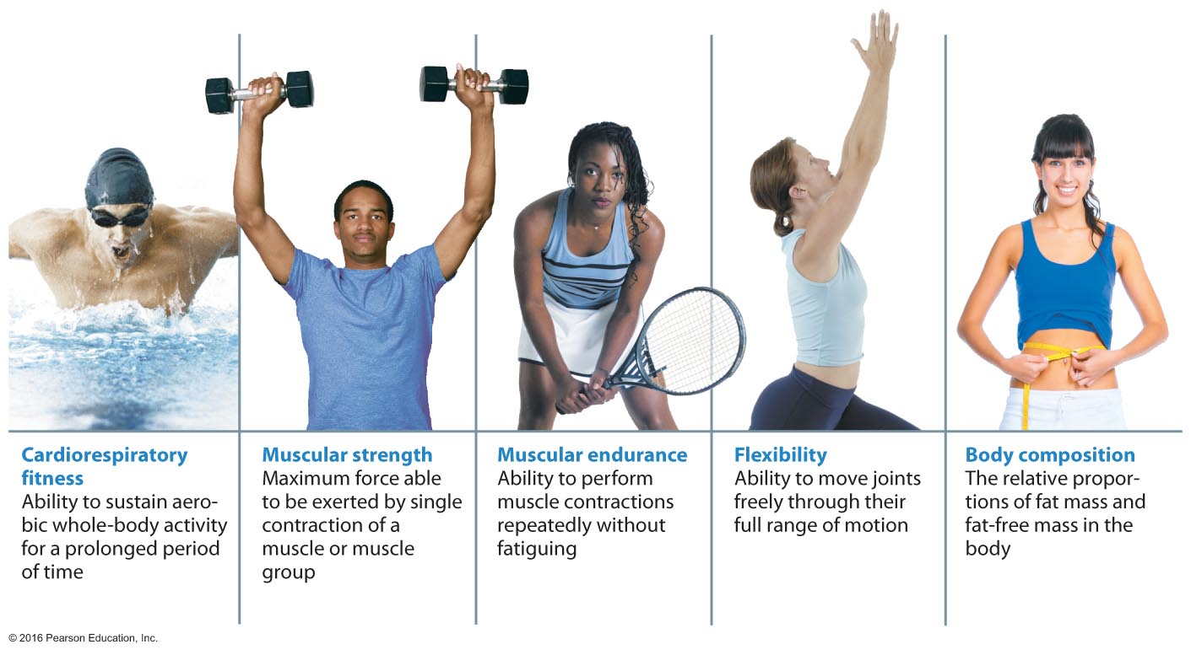
Components of Physical Fitness

Slide 13
Physical Activity for Performance
Athletes engage in specific exercises to increase their speed, power, agility, coordination, and other performance-related attributes.
Recreational exercisers may use interval training to improve their fitness, but performance training is safest for individuals who are already highly fit.

Slide 14
Committing to Physical Fitness
The first step in starting a physical fitness program is to identify your goals.
Then you should consider the obstacles that might get in the way of achieving those goals.
Once you consider these factors, you are ready to create your individual exercise program.

Slide 15
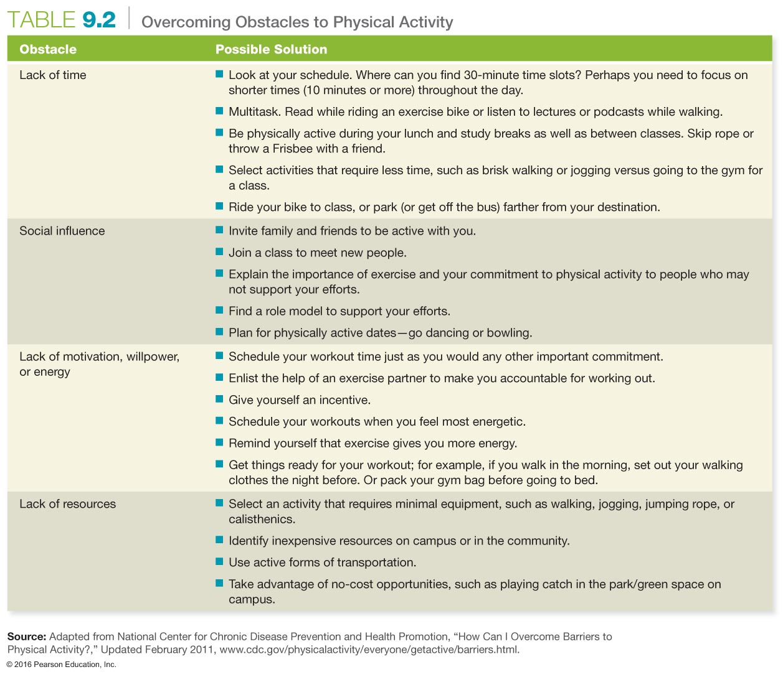

Slide 16
Incorporating Fitness into Your Life
Choose activities that are appropriate for you, that you like doing, and that are convenient.
Choose activities that are suitable for your current fitness level. Start slowly, and then challenge yourself as your physical fitness improves.
Try to make exercise a part of your routine by incorporating it into something you already do, such as getting to class or work.

Slide 17
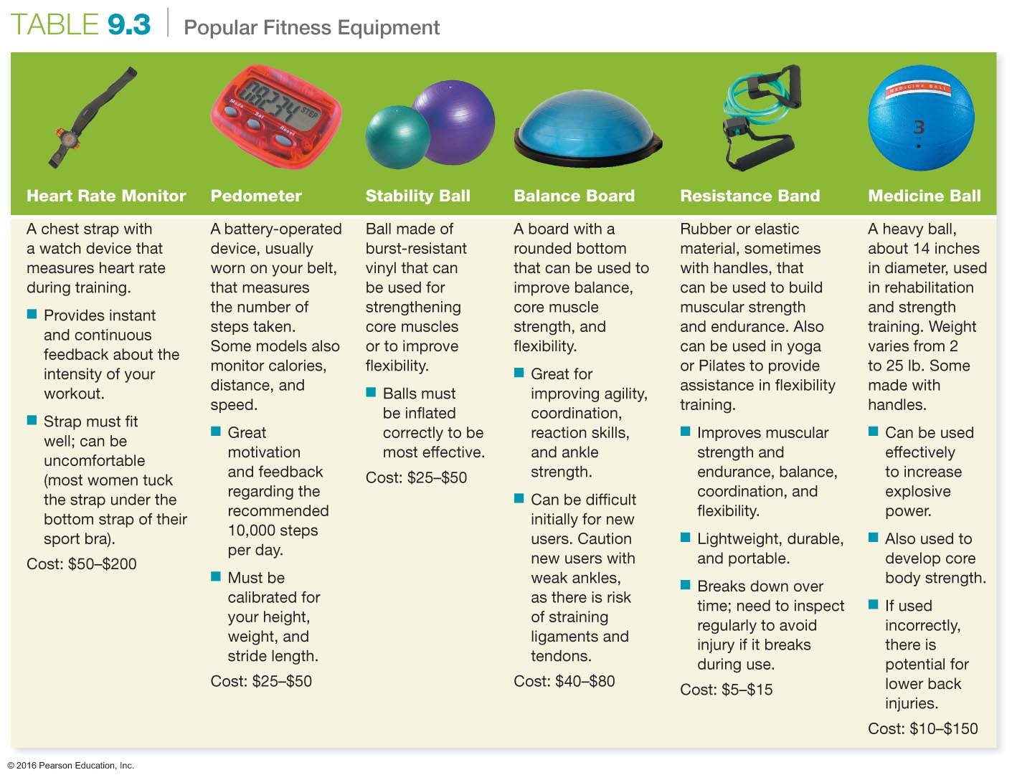

Slide 18
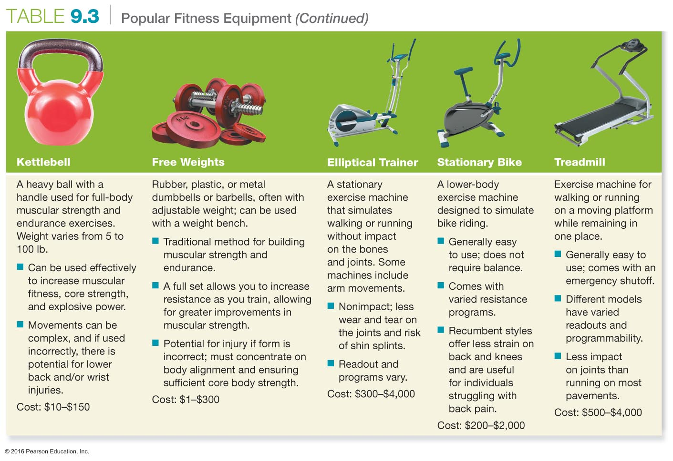

Slide 19
Identifying Your Physical Fitness Goals
Do you want to be more physically active and more physically fit?
Are you hoping to improve your health and reduce your risk of chronic disease?
Are you hoping to become better at sports?
Do you want to feel better about your body?
Do you want to manage stress better?

Slide 20
Creating Your Own Fitness Program: The FITT Principle
FREQUENCY – the number of times you engage in the activity per week
INTENSITY – how hard your workout must be to achieve the desired results
TIME – how many minutes or repetitions of an exercise are required to attain the desired fitness level
TYPE – what kind of exercise should be done

Slide 21
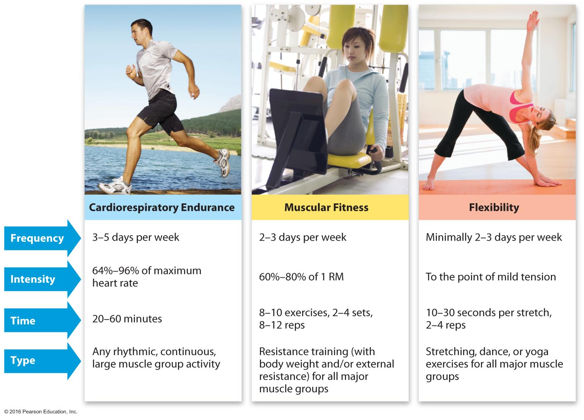
The FITT Principle Applied to Cardiorespiratory Fitness, Muscular Strength and Endurance, and Flexibility

Slide 22
The FITT Principle for Cardiorespiratory Fitness
To improve cardiovascular fitness, you must exercise vigorously 3 to 5 days a week.
Intensity can be determined by target heart rate, perceived exertion rate, or the talk test. Intensity should be between 64 and 95 percent of your maximum heart rate.
Exercise should last at least 20 minutes for vigorous activity and 30 minutes for moderate activity.
The type of exercise can include any sort of rhythmic, continuous, or vigorous physical activity that improves cardiorespiratory fitness.
Notes:
Some examples of types of activities include walking briskly, cycling, jogging, fitness classes, and swimming.

Slide 23
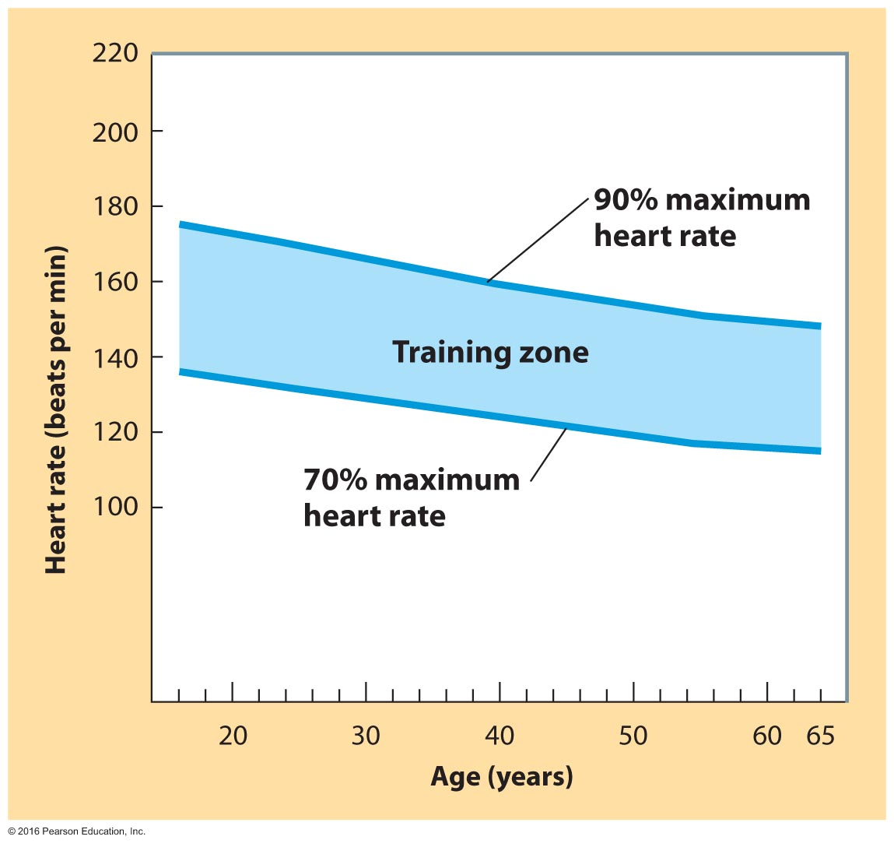
Target Heart Rate Ranges

Slide 24
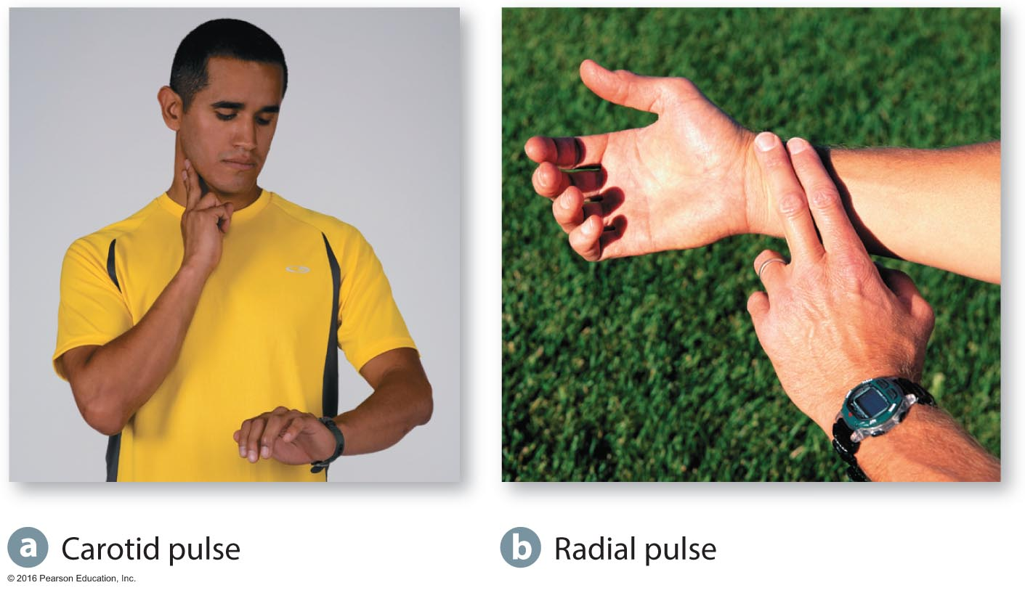
Taking a Pulse

Slide 25
The FITT Principle for Muscular Strength and Endurance
Performing eight to ten exercises that train major muscle groups 2 to 3 days each week is recommended.
Intensity is determined by resistance loads that are greater than 60 percent of 1 repetition maximum (1 RM), and endurance requires using loads less than 60 percent.
Time is based on the number of sets and repetitions within a set.
Type can involve using your own body weight or devices that provide a fixed, variable, or accommodating load or resistance.
Notes:
One repetition maximum is the amount of weight that can be lifted in one contraction.
For muscular strength, higher intensity and fewer repetitions and sets are required, for example, 2 to 6 repetitions and 1 to 3 sets.
Endurance requires 2 to 6 sets with 10 to 15 repetitions in each.
Resting for 2 to 3 minutes for multiple joint exercises and 1 to 2 minutes for single joint exercises is key to effective strength training.

Slide 26
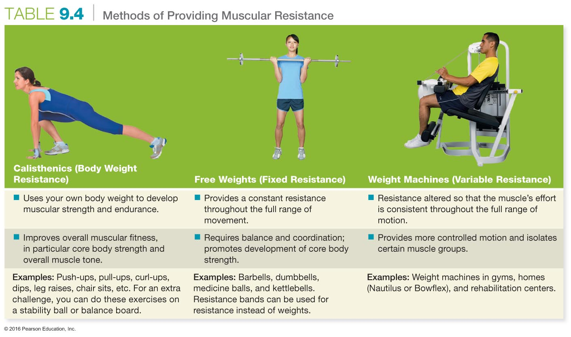

Slide 27
The FITT Principle for Flexibility
Flexibility exercises should be performed 2 to 3 days each week at a minimum.
Intensity requires that the stretch is held without movement to the point of mild tension.
Stretches should be held for 10 to 30 seconds and repeated two to four times in close succession.
The safest types of exercises for improving flexibility involve static stretching.

Slide 28
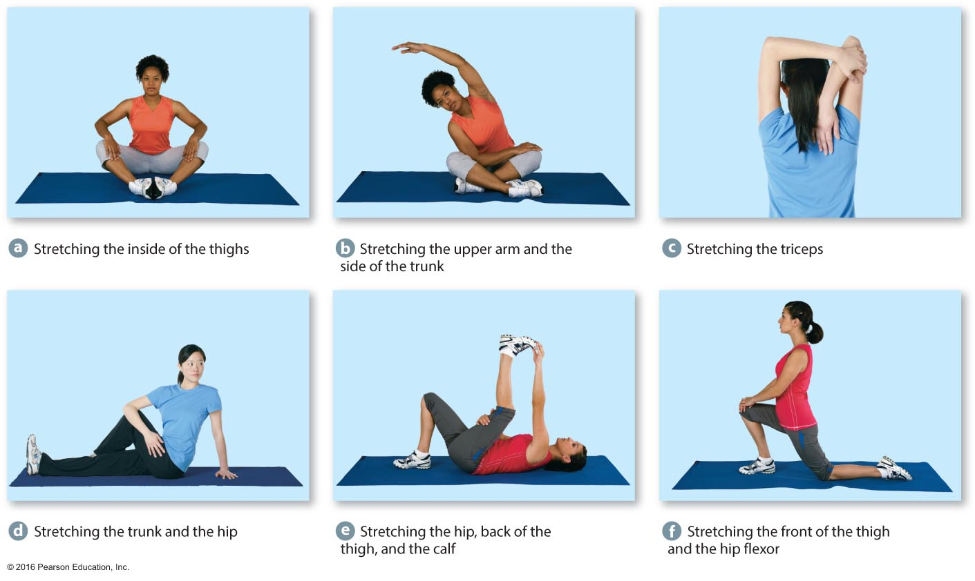
Stretching Exercises to Improve Flexibility

Slide 29
Implementing Your Fitness Program: Develop a Progressive Plan
As fitness improves, adjustments must be made to the frequency, intensity, time, and type of exercise.
In addition, reevaluate your overall fitness goals and action plan monthly.
Do not put your greatest effort into getting started and then allow your effort to dwindle once you are in the action phase.

Slide 30
Design Your Exercise Session
A warm-up generally involves large body movements followed by light stretching of the muscle groups to be used. It usually lasts about 5 to 15 minutes.
Cardiorespiratory and/or resistance training is the next stage of your workout. This stage should last 20 to 30 minutes.
A cool-down generally includes 5 to 10 minutes of moderate- to low-intensity movement followed by 10 minutes of stretching exercises.
Notes:
Stretching is best performed after an activity, while the body and muscle groups are warm.

Slide 31
Explore Fitness Activities
Yoga, tai chi, and Pilates have the potential to improve muscular strength and endurance, particularly to core strength, flexibility, balance, coordination, and agility.
Some people view these activities as strongly connected to the development of their spiritual health.

Slide 32
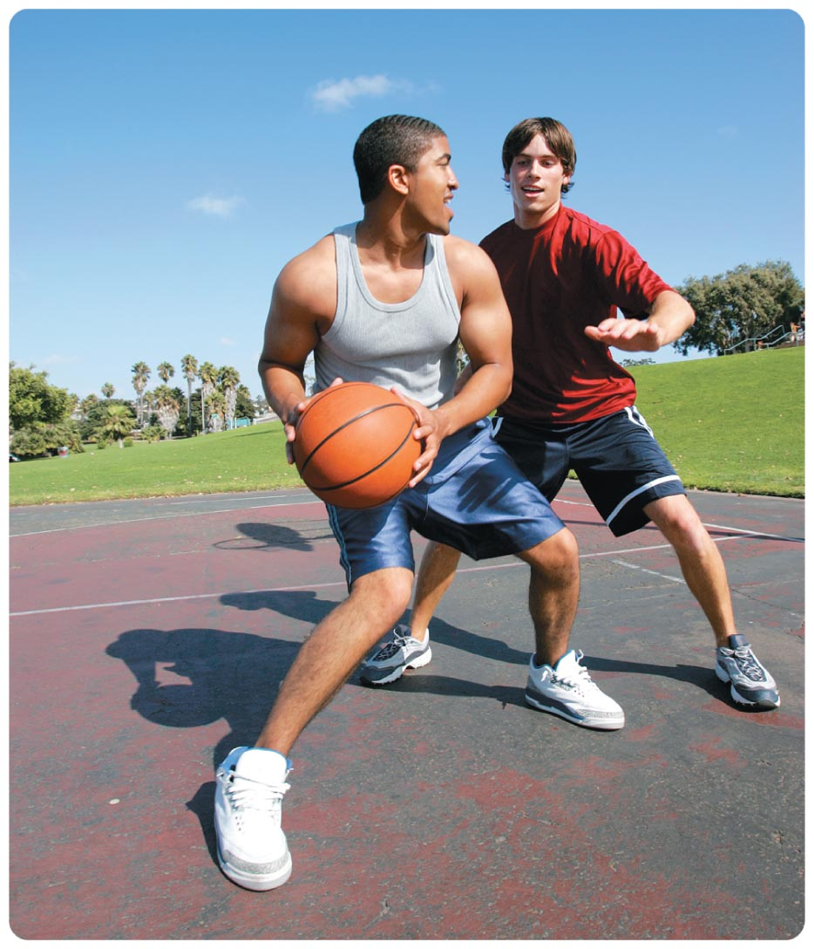
Why Is Core Strength Training Important?
Your core muscles are essential for supporting your spine in everything you do—from standing to sitting; from dancing to playing basketball.

Slide 33
Yoga
Yoga focuses attention on controlled breathing as well as physical exercises; it also incorporates a complex array of static stretching exercises.
Some forms are more meditative; other forms are more athletic.
Hot yoga, or Bikram yoga, is performed in rooms heated to 105 degrees.

Slide 34
See It! Video: Beginner's Guide to Yoga
Discussion Questions
What are the physiological, physical, and mental benefits of yoga? Which style of yoga is beneficial for those who want to maximize the mental benefits of yoga? What style is beneficial for those who want to maximize weight loss?
How do you choose the best way to practice yoga if you are a beginner? Discuss the benefits and barriers to the three modes of instruction: 1) group instruction; 2) private instruction; 3) DVD instruction.
How do you determine if yoga is the type of exercise you should pursue based on your fitness goals? How do you determine which style of yoga (power, iyengar, hatha, kudalini) is right for you?

Slide 35
Tai Chi
Tai chi combines stretching, balance, muscular endurance, coordination, and meditation.
It is based on Qigong, a Taoist philosophy dedicated to spiritual growth and good health.
Tai chi is a series of positions called forms, which are performed continuously.

Slide 36
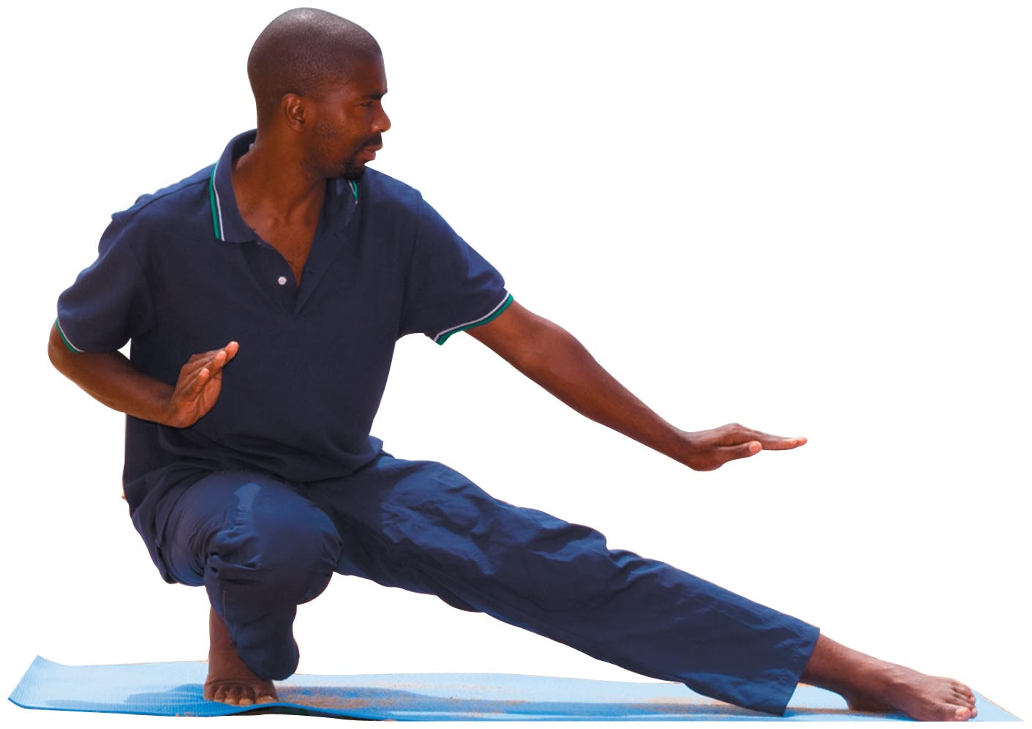
Tai Chi
Tai chi and other styles of exercise that strengthen core body muscles can also enhance flexibility and help lower stress levels.

Slide 37
Pilates
Pilates was developed in 1926 by Joseph Pilates. This exercise form combines stretching with movement against resistance, frequently aided by tension springs or heavy rubber bands.
It improves flexibility, coordination, core strength, muscle tone, and economy of motion.

Slide 38
Taking in Proper Nutrition for Exercise
Eat enough carbohydrates and consume larger meals at least three to fours hours before you begin exercising.
Follow the recommendations in the MyPlate Plan for best results.
Staying hydrated is also crucial for active individuals in order to maintain a healthy, fully functional body.

Slide 39
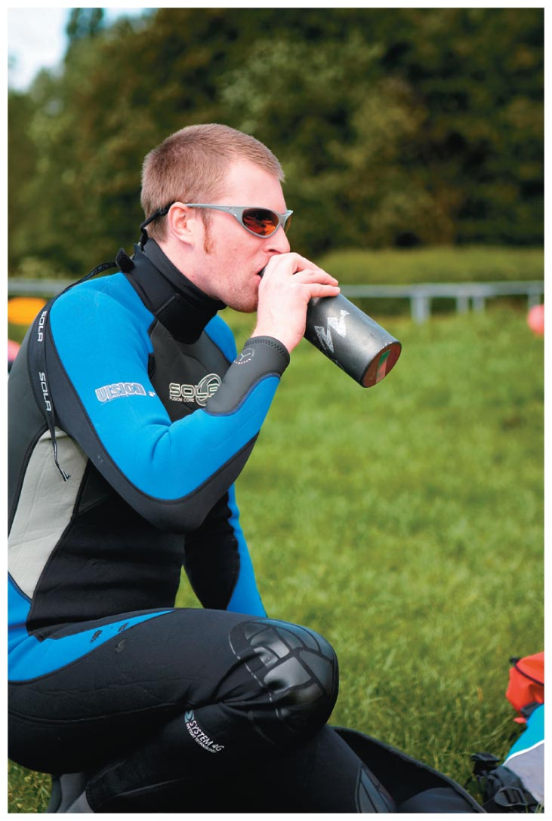
How Much Do I Need to Drink?
The American College of Sports Medicine and the National Athletic Trainers' Association recommend consuming 14 to 22 ounces of fluid several hours prior to exercise and about 6 to 12 ounces per 15 to 20 minutes during—assuming you are sweating.

Slide 40
See It! Video: Sports Drink Science: Is it Hype?
Discussion Questions
How does the marketing of products, including product placement, impact sales?
Discuss the problems with the science behind the sports drinks. Discuss whether or not it is ethical for companies to pay for research on their own products.
Identify claims sports drink companies have published that may bend the truth.
Why might sports drinks be unhealthy for your weekend warrior or average gym goer?

Slide 41
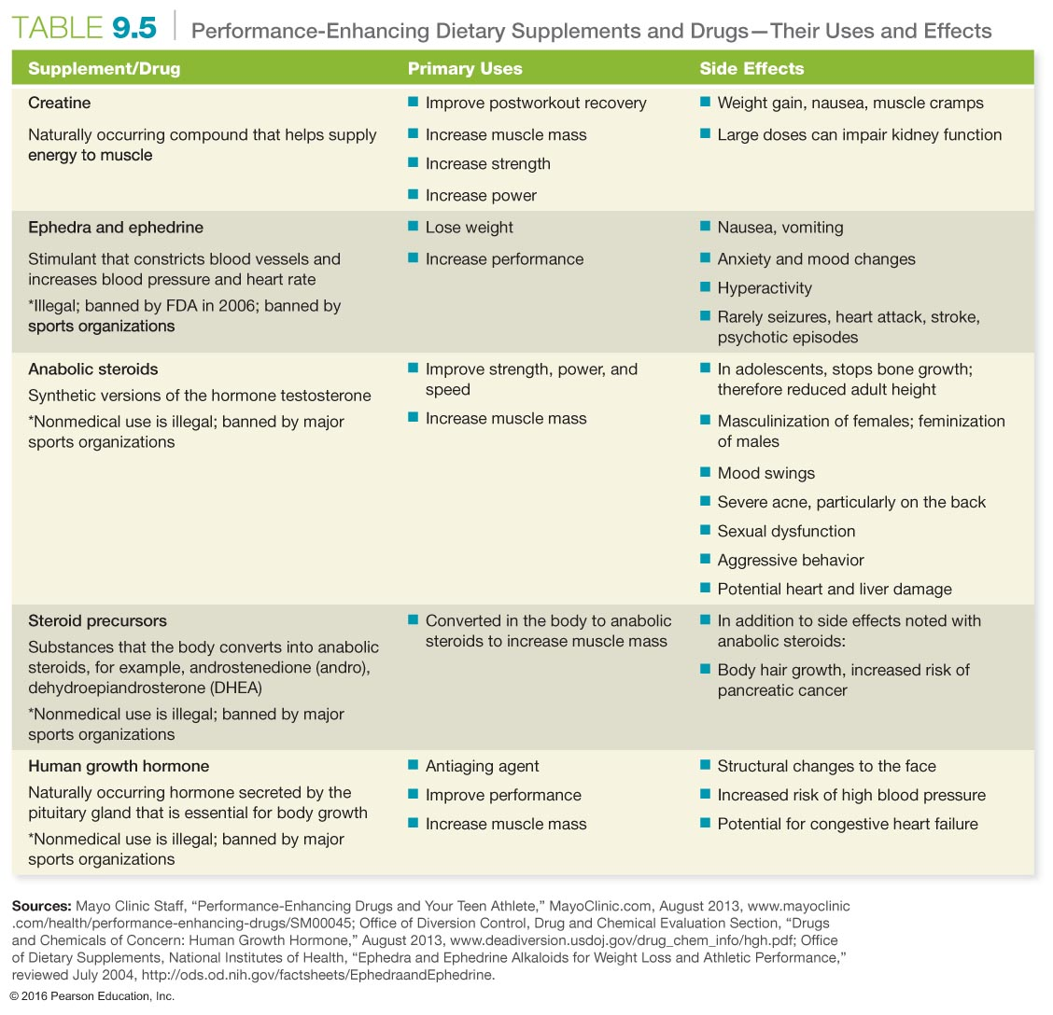

Slide 42
Preventing and Treating Common Exercise Injuries
Traumatic injuries occur suddenly, are violent, and typically occur by accident. They include broken bones, torn ligaments and muscles, contusions, and lacerations.
Some are unavoidable, like spraining an ankle, while others can be prevented through proper training, appropriate equipment and clothing, as well as common sense.

Slide 43
Common Overuse Injuries
Plantar fasciitis
Shin splints
Runner's knee

Slide 44
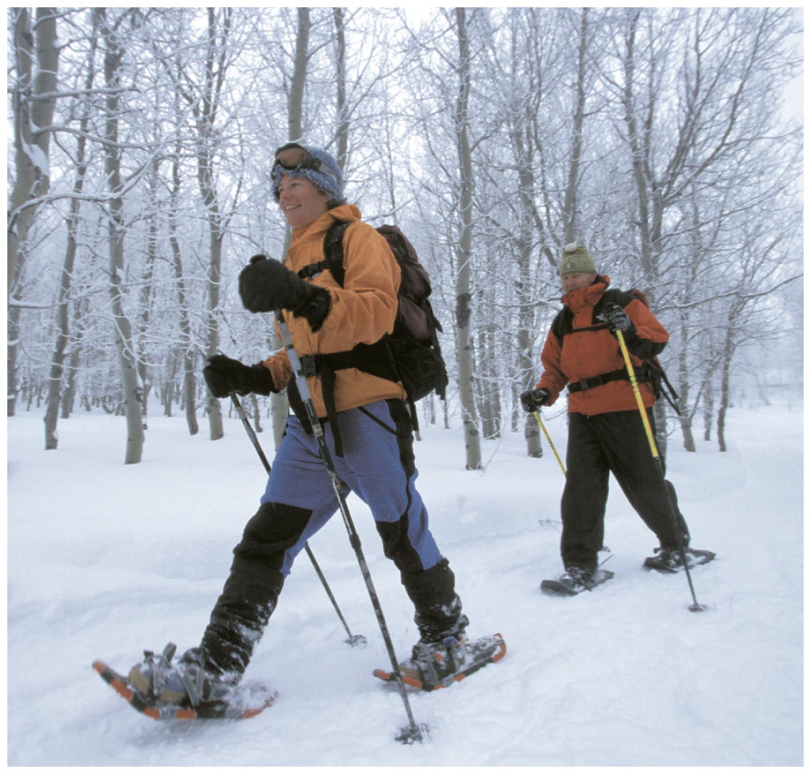
Preventing Injuries
Choose appropriate footwear.
Use appropriate protective equipment.
Be aware of the dangers of exercising in hot or humid weather: heat cramps, heat exhaustion, and heatstroke.
Cold or windy weather can lead to hypothermia, which can be fatal.

Slide 45
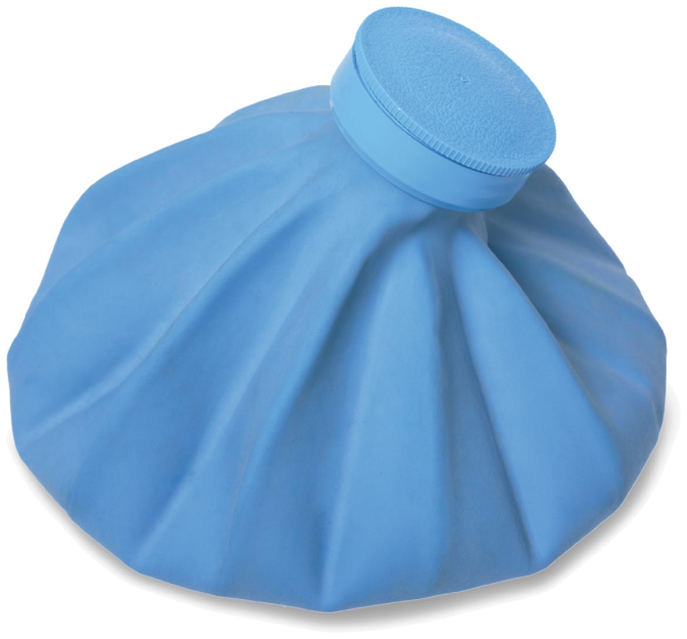
Treatment of Fitness-Related Injuries
RICE stands for
Rest
Ice
Compression
Elevation

Slide 46
Assessing Yourself—A Personal Inventory
Go online to MasteringHealth to take the "How Physically Fit Are You?" assessment.
Rate your personal fitness level using the numbers 1, 2, 4, and 5, where 1 represents being unfit and 5 represents being very fit.
If you are unfit, rate your motivational level for becoming fit, using the same scale, where 1 is not motivated and 5 represents being ready to start.
If you are very fit, rate your ability to complete a triathlon, where 1 is being unable to complete it and 5 represents completion.
Notes:
Please note that no number 3 is included. This encourages students to pick a side and not automatically choose the middle.

