Slide 1
Chapter 10: Drinking Alcohol Responsibly

Slide 2
Did you PREPARE and did you LEARN?
Explain the physiological and behavioral effects of alcohol, including absorption, metabolism, and blood alcohol concentration.
Identify short- and long-term effects of alcohol consumption.
Describe alcohol use patterns of college students, practical strategies for drinking responsibly, and ways to cope with campus and societal pressures to drink.
Describe the impact of drinking and driving on society.

Slide 3
Did you PREPARE and did you LEARN?
Compare the differences in alcohol consumption and abuse among various ethnic and racial minority groups.
Explain the risk factors associated with alcoholism, its symptoms, its costs to society, and its effects on family members.
Describe the various types of treatment programs for alcoholism and their effectiveness and explore the concepts of relapse and recovery.

Slide 4
Patterns of Consumption
Binge drinking: A pattern of drinking alcohol that brings BAC to 0.08 gram-percent or above; corresponds to consuming five or more drinks (adult male) or four or more drinks (adult female) in 2 hours.

Slide 5
Alcohol in the Body
Ethyl alcohol (ethanol): Process in which yeast organisms break down plant sugars to yield ethanol.
Fermentation: The process whereby yeast organisms break down plant sugars to yield ethanol.
Distillation: Process in which alcohol vapors are condensed and mixed with water to make hard liquor

Slide 6
The Chemistry and Potency of Alcohol
Proof: A measure of the percentage of alcohol in a beverage.
Standard drink: Amount of any beverage that contains about 14 grams of pure alcohol.

Slide 7
Absorption and Metabolism
About 20 percent of alcohol diffuses through the stomach lining into the bloodstream.
The other 80 percent passes through the lining of the upper third of the small intestine.
The concentration of the alcohol; quantity consumed; amount of food in stomach; pylorospasm (spasm of the pyloric valve in the digestive system); your metabolism, weight, and BMI; and your mood all affect the absorption of alcohol.

Slide 8
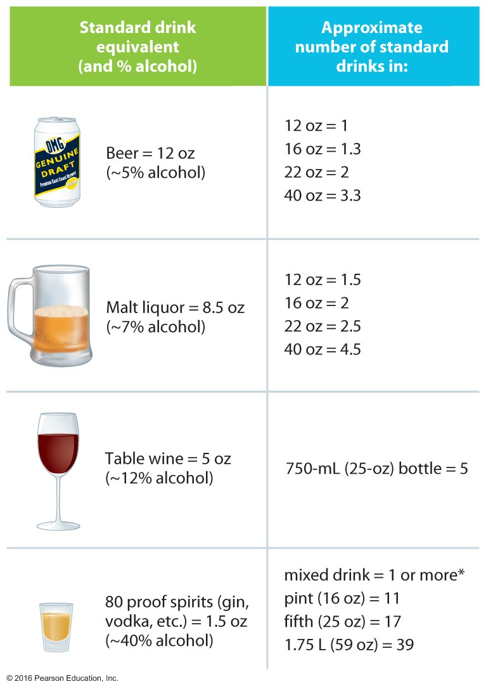
What Is a Standard Drink?

Slide 9
Absorption and Metabolism
Wine and beer are absorbed more slowly than distilled beverages.
Champagne and carbonated drinks are absorbed more rapidly.
The more alcohol you consume, the longer it takes to absorb it. Alcohol also irritates the digestive system.

Slide 10
Absorption and Metabolism
The pyloric valve controls the release of stomach contents into the intestine.
Carbonated beverages cause the valve to relax and empty the stomach contents more rapidly.
High intakes of alcohol cause pyloric spasms that prevent the stomach contents from emptying.
If the irritation continues, it can cause vomiting.

Slide 11
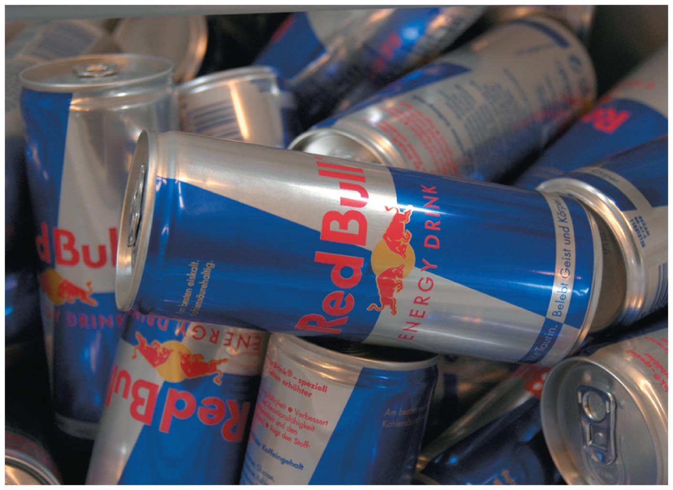
Alcohol and Energy Drinks: A Dangerous Mix
Students who report mixing alcohol with energy drinks tend to drink more—8.3 drinks vs. 6.1 drinks.
Those mixed alcohol with energy drinks (AMEDS) also report not noticing the signs of intoxication (dizziness, fatigue, headache, and trouble walking).
They are more likely to experience alcohol-related consequences, which include being taken advantage of, riding with a drunk driver, being hurt or injured, or needing medical treatment.
Notes:
The alcohol industry has used the popularity of energy drinks to promote its own products, introducing premixed alcohol and energy drink products such as Sparks, Rockstar 21, and Tilt.
In addition, alcohol companies promote mixing energy drinks with alcohol products on their edgy websites. Red Bull, for example, promotes a top drinks list suggesting "Jaegerbombs" and "Tucker Death mix".

Slide 12
Blood Alcohol Concentration
Blood alcohol concentration (BAC) is the ratio of alcohol to total blood volume.
Despite differences among individuals, alcohol produces some general behavioral effects depending on the person's BAC.
Heavier people have larger body surfaces through which to diffuse alcohol; therefore, they have lower concentrations of alcohol in their blood than do thin people after drinking the same amount.

Slide 13
Why Do People Feel the Effects of Alcohol Differently?
Many factors influence how rapidly a person's body absorbs alcohol and thus how quickly that person feels the effects of alcohol. For example, eating while drinking slows down the absorption of alcohol into your bloodstream.

Slide 14
Blood Alcohol Concentration and Gender
Because women tend to have more body fat and less water in their tissues than men of the same weight, they will become more intoxicated after drinking the same amount of alcohol.
Women have half as much alcohol dehydrogenase, the enzyme that breaks down alcohol in the stomach before it reaches the bloodstream and the brain, as men.
In learned behavioral tolerance, a person learns to modify his or her behavior in order to appear sober despite a high BAC.

Slide 15
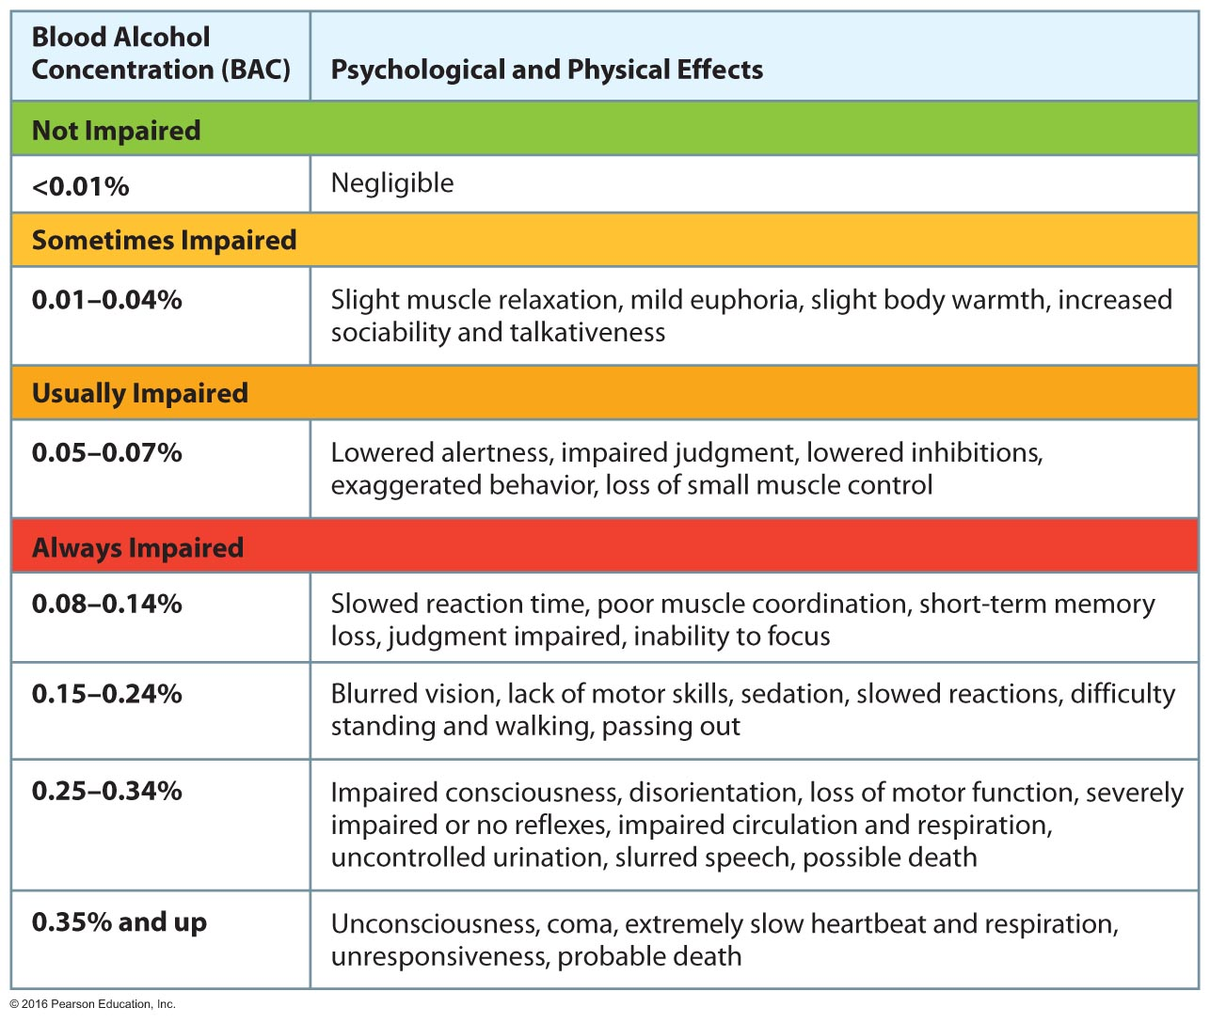
The Psychological and Physical Effects of Alcohol

Slide 16
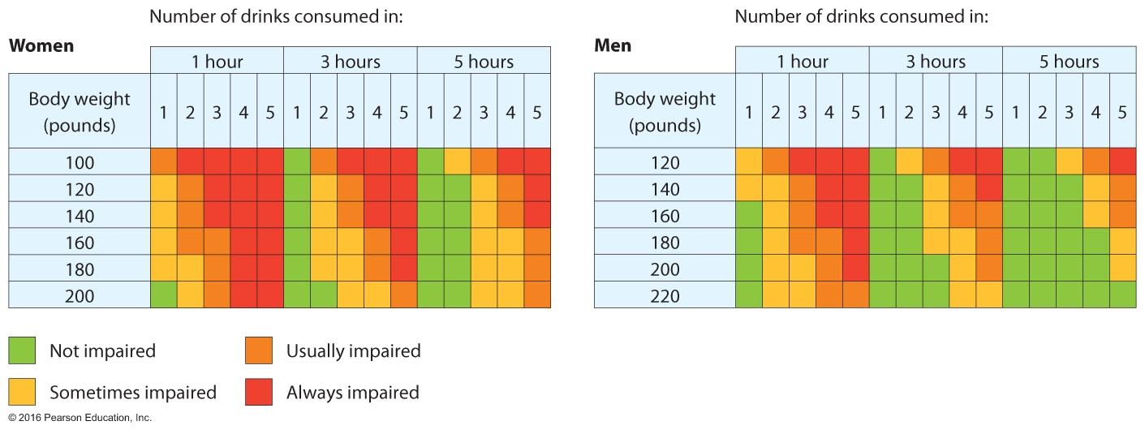
Approximate Blood Alcohol Concentration (BAC) and the Physiological and Behavioral Effects

Slide 17
Alcohol and Your Health
Short-term effects of alcohol
Drinking depresses the central nervous system (CNS).
Drinking leads to dehydration and headache. Drinkers may suffer symptoms that include the "morning-after" effects.
Alcohol irritates the gastrointestinal system.
Excessive drinking can lead to a hangover.
Congeners play a role in the development of hangovers.
Notes:
A depressed central nervous system decreases respiratory rate, pulse rate, and blood pressure. Vital functions eventually become noticeably affected. In extreme cases, coma and death result.
Alcohol may cause indigestion and heartburn if consumed on an empty stomach.

Slide 18
Effects of Alcohol on the Body and Health

Slide 19
Alcohol and Your Health
Short-term effects of alcohol
Alcohol use plays a significant role in the types of injuries people experience.
Alcohol influences one's ability to make good decisions about sex because it lowers inhibitions.
Alcohol is a key factor in many rapes and in domestic violence.
Alcohol contributes to weight gain; the freshman 15.
Alcohol, used either alone or in combination with other drugs, can lead to alcohol poisoning (also known as acute alcohol intoxication).

Slide 20
Is There Any Cure for a Hangover?
The only cure for a hangover is abstaining from excessive alcohol consumption.
Notes:
A hangover's symptoms include headache, muscle aches, upset stomach, anxiety, depression, diarrhea, and thirst. Congeners are metabolized after the ethanol is gone from the system, and their toxic by-products may contribute to the hangover.

Slide 21
Alcohol and Your Health
Long-term effects of alcohol
Even moderate drinking can have negative effects on the nervous system.
Alcohol affects the cardiovascular system.
Antithrombotic effect
One of the most common diseases related to alcohol abuse is liver disease.
Cirrhosis
Alcoholic hepatitis
Notes:
Chronic alcohol use is associated with diseases of the digestive and cardiovascular systems and some cancers.
Heavy social drinkers and alcoholics show evidence of brain damage.
Effects on the cardiovascular system depend on the amount of alcohol consumed.
Moderate doses may reduce the risk of heart disease.
Higher doses can elevate blood pressure.
Excessive consumption may lead to weakening of the heart muscle, or cardiac myopathy.
Alcohol in even small amounts alters liver function.
Continued use of alcohol leads to damage and eventual destruction of liver cells. Destroyed cells are replaced by fibrous scar tissue, a condition called cirrhosis.

Slide 22
Alcohol and Your Health
Long-term effects of alcohol
Alcohol is considered a carcinogen; that is, it can lead to cancer.
Alcohol abuse also leads to:
Inflammation of the pancreas
Interference with immunity
Affects sleep
Blocked absorption of calcium
Notes:
Excessive use of alcohol is associated with early death from cancer and other causes.
Alcohol can also inflame the pancreas, causing pancreatitis, and irritate the stomach lining. Violent vomiting can tear blood vessels in the wall of the esophagus.

Slide 23
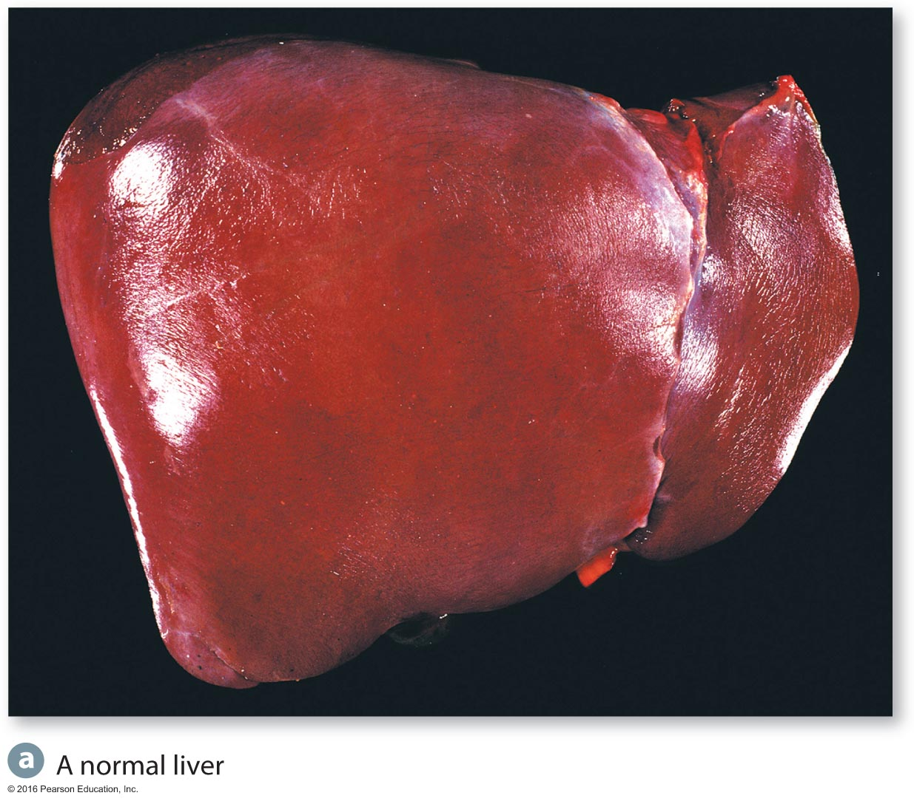
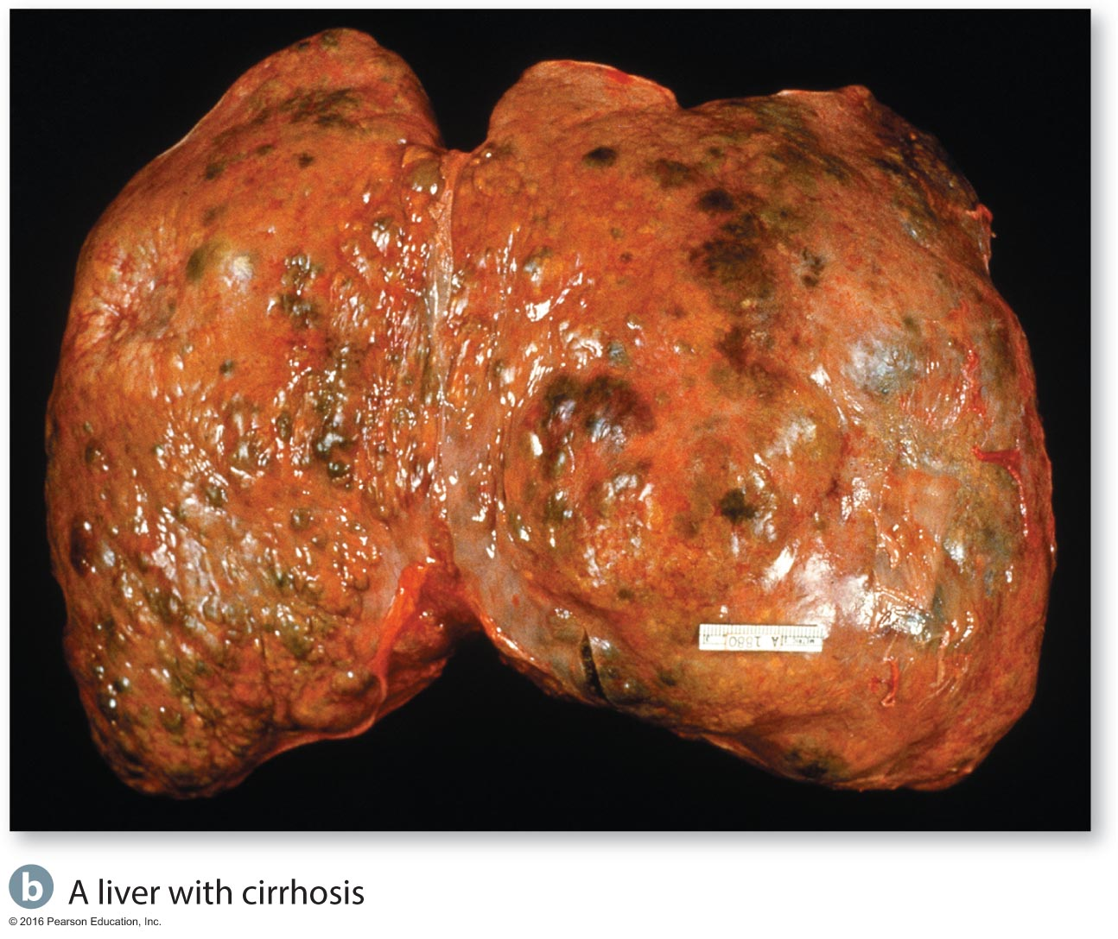
Comparison of a Healthy Liver with a Cirrhotic Liver

Slide 24
Alcohol and Pregnancy
Fetal alcohol syndrome (FAS) is associated with alcohol consumption during the first trimester, which may affect organ development; alcohol consumed during the last trimester may affect CNS development.
FAS, partial fetal alcohol syndrome (PFAS), and alcohol-related neurodevelopment disorder (ARND) are all classified as fetal alcohol spectrum disorders (FASDs). An estimated 40,000 infants in the United States are affected by FASDs each year.
Notes:
Alcohol consumed during pregnancy crosses the placenta and harms the fetus.
Moderate to heavy alcohol use can cause FAS.
Characteristics include physical abnormalities and mental impairment.
FAS is the most common preventable cause of mental retardation in the Western world.

Slide 25
Alcohol Use in College
Large numbers of college students report having consumed alcohol in the past 30 days.
About 40 percent of all college students engage in heavy episodic (binge) drinking.
A significant number of students experience negative consequences as a result of their alcohol consumption.
35 percent of students report having done something they regret after drinking.
Notes:
Survey students about their drinking behavior.
Binge drinking is consuming five or more drinks for men or four or more drinks for women within 2 hours. It brings the blood alcohol level (BAC) up to 0.08 percent.

Slide 26
College Students' Patterns of Alcohol Use in the Past 30 Days
Notes:
Ask students about social activities that include or do not include alcohol. List the options on the board.
Get students to think about how likely they would be to attend an event at which alcohol would be served and if so, whether they would avoid it or not.

Slide 27
High-Risk Drinking and College Students
According to a recent study, 1,825 college students die each year due to alcohol-related unintentional injuries.
Unintentional injuries are the leading cause of death among 18- to 24-year-olds, and alcohol is the leading contributor to those deaths.
Consumption of alcohol is the number one cause of preventable death among college students.
Notes:
Survey the class to determine how many people know someone who has suffered a negative consequence due to alcohol. List those consequences on the board and ask them to consider whether using alcohol provides so much pleasure that they are willing to risk these potential consequences.

Slide 28
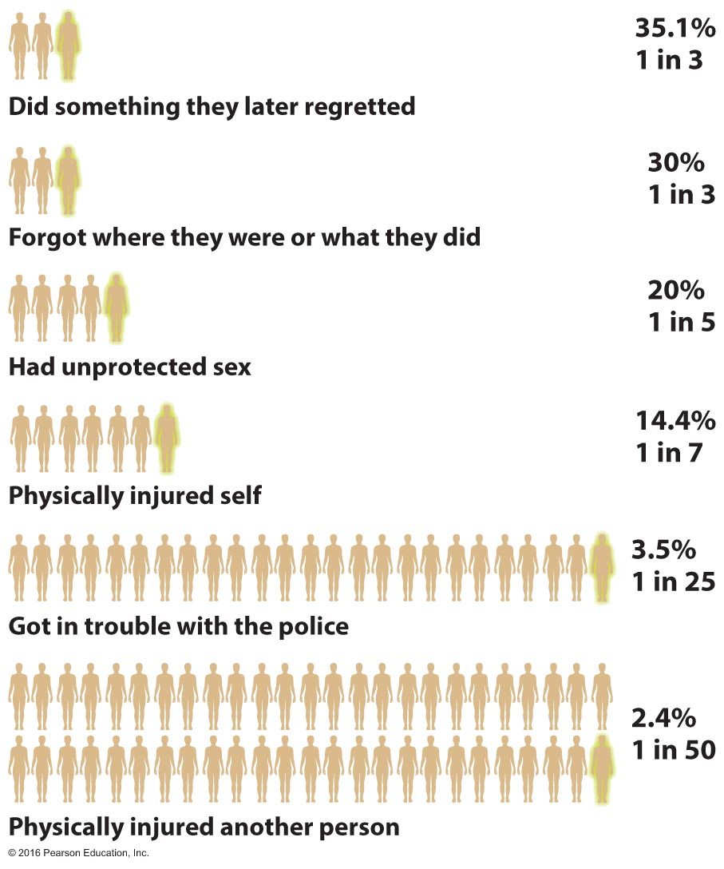
Prevalence of Negative Consequences of Drinking among College Students, Past Year

Slide 29
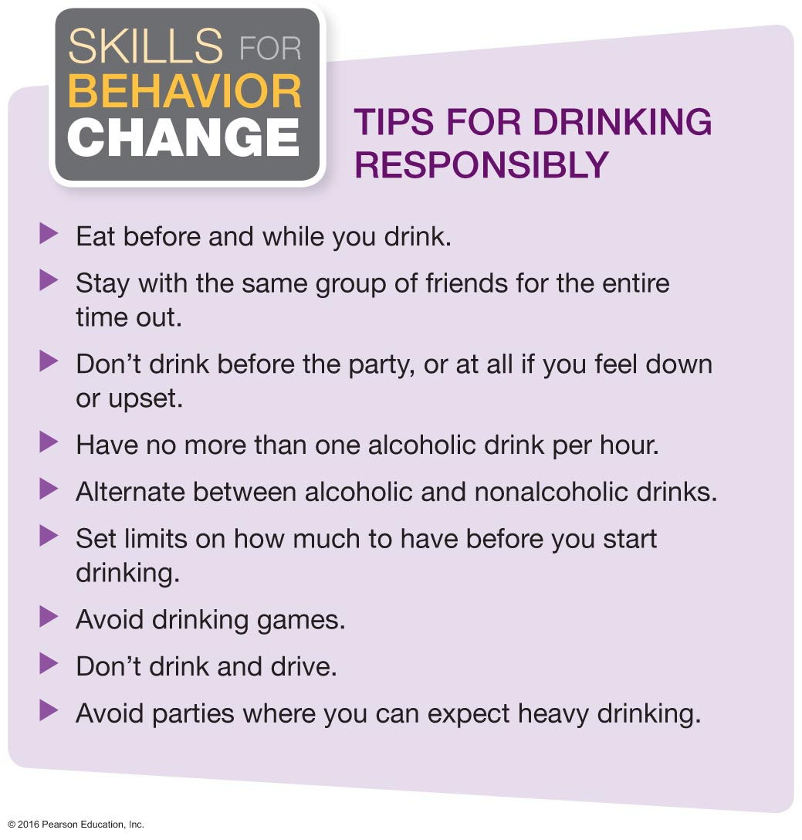
Tips for Drinking Responsibly

Slide 30
Who Drinks and Why Do College Students Drink So Much?
Most students are likely to drink in college, especially if drinking is approved of by parents and if they drank in high school.
Many college functions support the use of alcohol.
Alcohol advertising and promotion target students.
College students are vulnerable to peer influence.

Slide 31
Who Drinks and Why Do College Students Drink So Much?
Drink specials enable students to consume large amounts of alcohol cheaply.
College administrators often deny that alcohol problems exist on their campus.
Students believe that alcohol will make them feel better, less stressed, more sociable, and less self-conscious.
More than 80 percent of students drink alcohol to celebrate their twenty-first birthday, and they consume an average of nearly 13 drinks.

Slide 32
College Student Drinking Behavior and the Impact of Student Drinking
Pre-gaming is a strategy of drinking heavily at home before going out to an event or other location; it has become increasingly common on college campuses.
Recent studies confirm that drinkers and binge drinkers cause problems not only for themselves but also for those around them.
There is significant evidence that campus rape is linked to binge drinking as well as sleep disruptions, vandalism, negative academic consequences, etc.

Slide 33
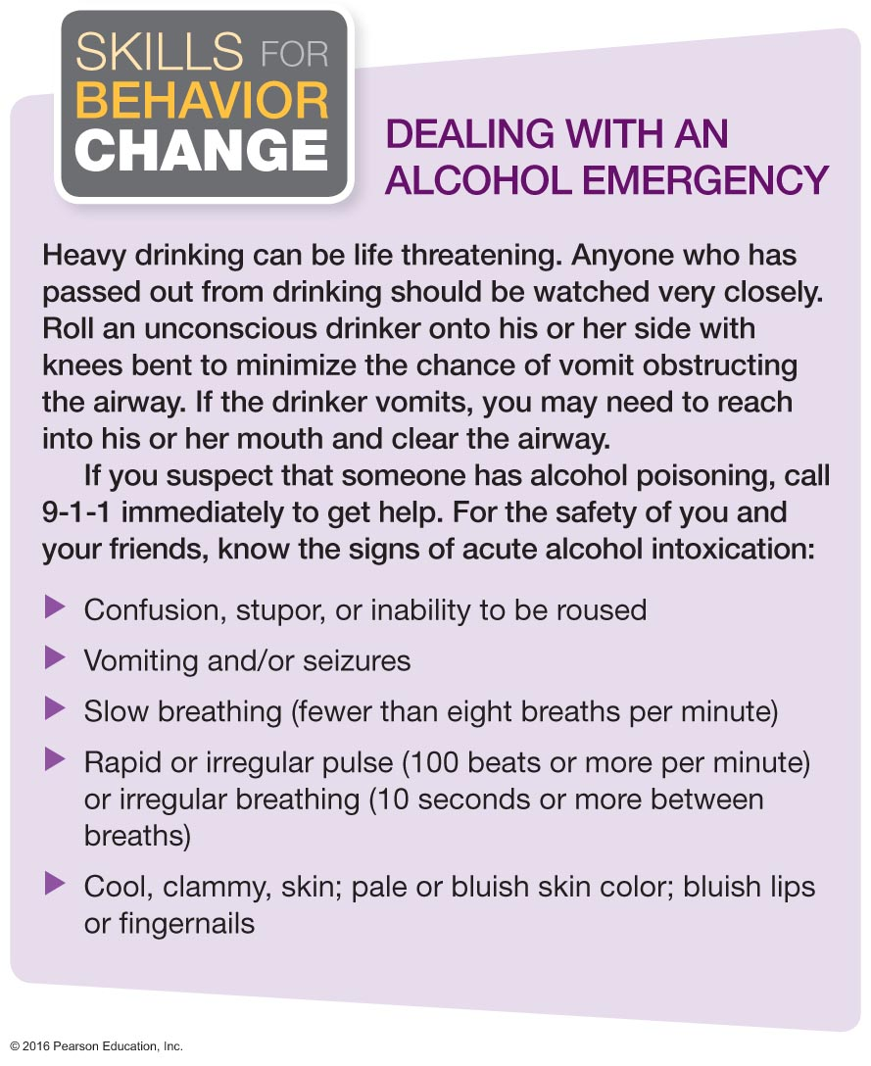
Dealing with an Alcohol Emergency
Notes:
If someone appears to be "too drunk," it is better to play it safe than sorry. Getting the person to an emergency room might be lifesaving.

Slide 34
Efforts to Reduce Student Drinking
Most fraternities have elected to have "dry" houses.
Programs that include cognitive behavior skills training and motivational interviewing have proven to be effective.
(BASICS) as an effective program for students who drink heavily and have experienced or are at risk for alcohol-related problems.
E-Interventions and web interventions also show promise
Schools are trying a "social norms" approach in an effort to reduce alcohol consumption.
Notes:
Find out what efforts your campus is making to reduce drinking or give it as an assignment to students.
Ask students to consider how alcohol consumption could be reduced on this college campus.

Slide 35
See It! Video: Sloppy Spring Breaker
Discussion Questions
Who should be held responsible in a potentially dangerous situation that involves a visually intoxicated woman and a male who attempts to take advantage of her? (i.e., the bartender, her friends, herself)?
Would you feel responsible for helping a visually intoxicated woman who is seemingly being taken advantage of by a male patron at the bar? How would you react in a similar situation to the ones in the video?
Discuss ground rules or ways to keep friends safe while on spring break if one of your friends gets intoxicated.

Slide 36
Drinking and Driving
Traffic accidents are the leading cause of accidental death for all age groups from 5 to 65 years old.
Approximately 1 of 3 crash deaths, or nearly 11,000 fatalities each year, are alcohol-related.
A recent survey showed that 23 percent of college students reported that they had driven under the influence of alcohol.
Notes:
Driving while intoxicated is a serious health and safety problem in the United States.
Driving while intoxicated has serious legal consequences.
Drivers should remain alert to signs that another driver is impaired and know how to drive defensively.
If you are away from your home and drinking, find alternative means of transportation or follow the practice of having a designated driver who has not consumed any alcohol.

Slide 37
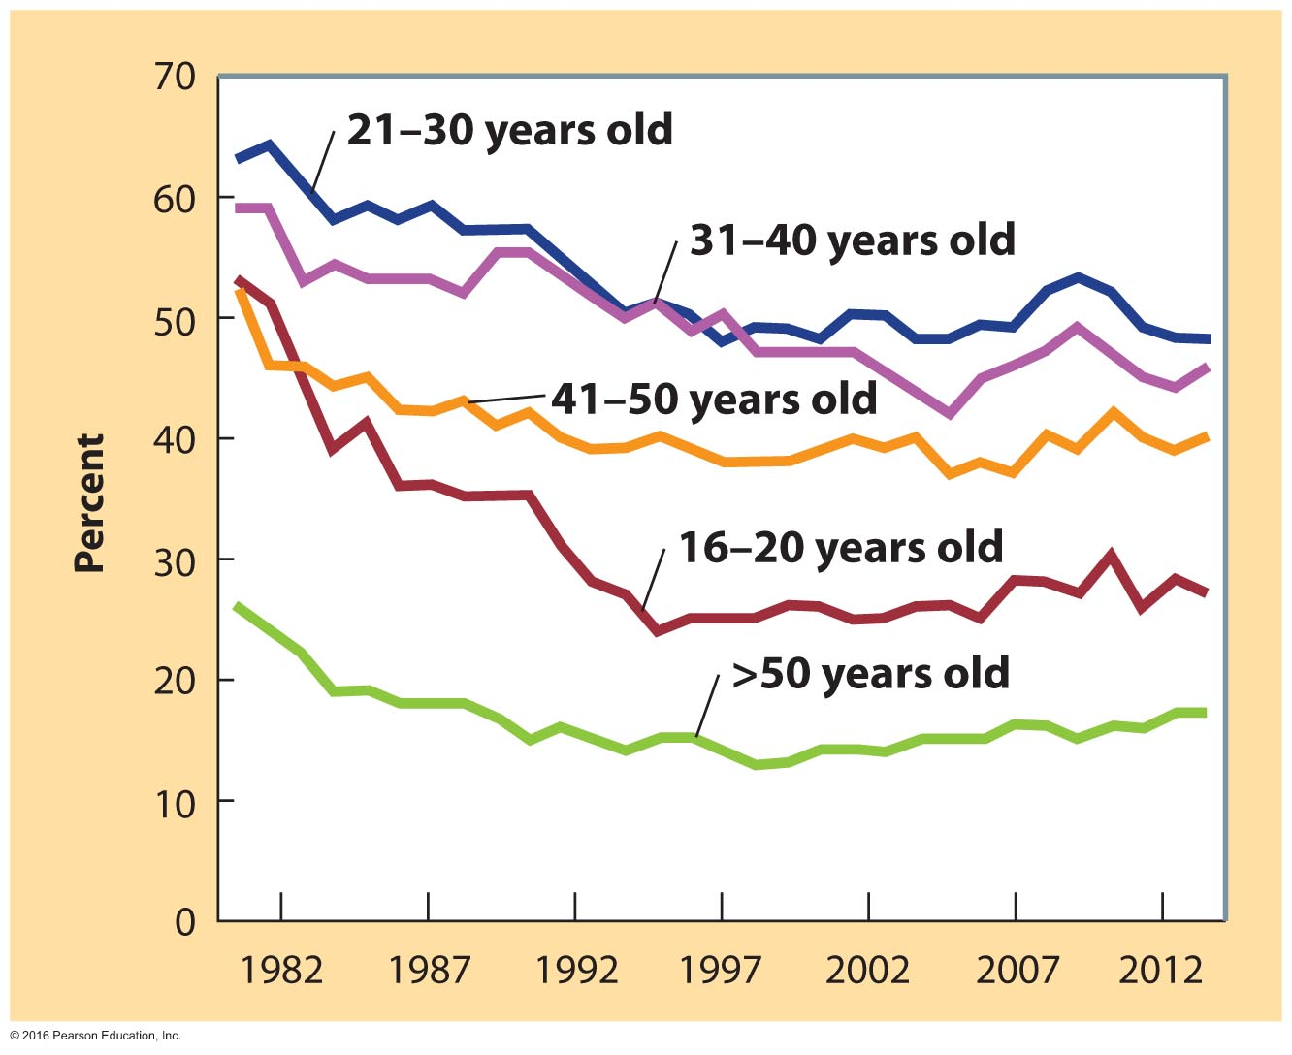
Percentage of Fatally Injured Drivers with BACs > 0.08 Percent, by Driver Age, 1982–2012

Slide 38
Ethnic Differences
Native American populations:
Their rates of alcoholism are two to three times higher than the national average.
African American populations:
Their rates of drinking are lower than those of white Americans, but those who do drink tend to drink heavily.
Latino populations:
The rates of alcohol abuse and alcoholism among men are high, though many Latinas abstain.
Asian American populations:
Their rates of alcoholism are lower than those of the other groups.
Notes:
Alcohol abuse is a very serious problem among American Indians and Alaskan natives. Treatment programs may be more effective if they incorporate tribal values, such as spirituality.
Alcohol abuse is a serious problem for African Americans, who experience higher rates of alcohol-related medical problems, crimes, and unintentional injuries. This is true despite the fact that, as a group, they use less alcohol than most other groups.
Drinking patterns among Latinos vary significantly, depending on their specific cultural background and how long they have lived in the United States. Considering the family as a unit is important in treatment, family solidarity and support are important aspects of Latino culture.
Asian Americans tend to have lower-than-average rates of alcohol abuse, although acculturation may weaken taboos that contribute to the lower rate.

Slide 39
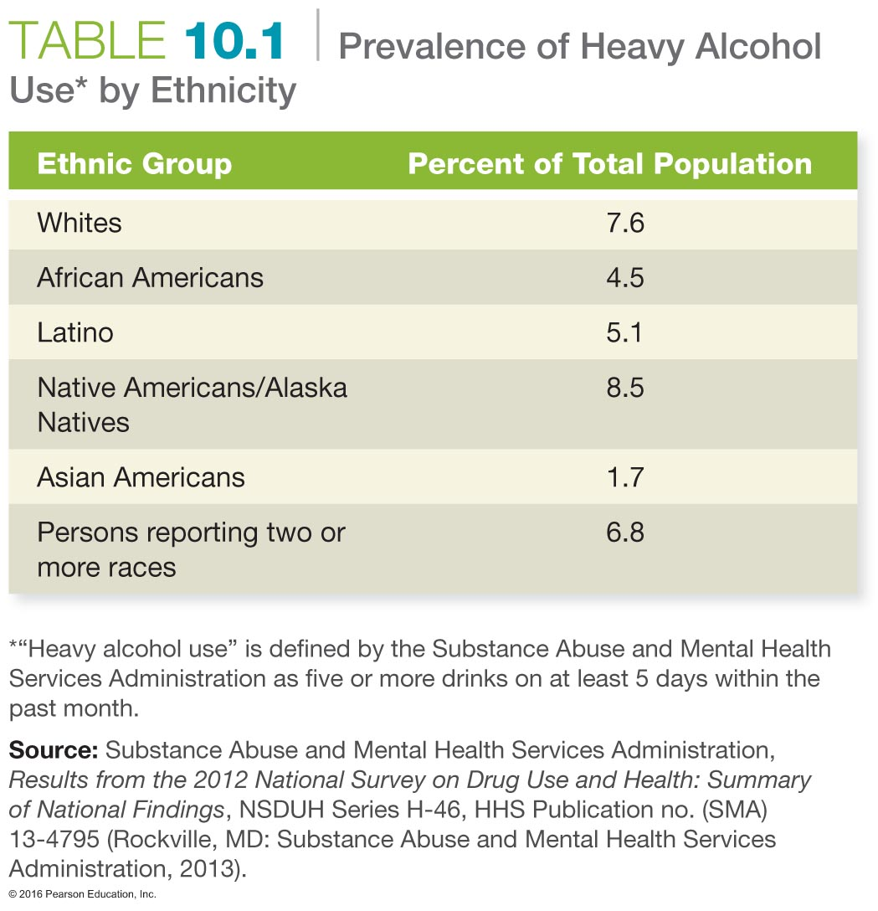

Slide 40
Abuse and Dependence
Alcohol abuse is drinking that interferes with work, school, social and family relationships, or entails violation of the law.
Alcoholism, or alcohol dependence, is the condition that results when personal and health problems related to alcohol use are severe and stopping alcohol use causes withdrawal symptoms.
Notes:
Alcohol abuse can be distinguished from alcohol dependence, or alcoholism.
Alcohol abuse is defined as recurrent alcohol use that has negative consequences, such as drinking in dangerous situations or drinking patterns that result in academic, professional, interpersonal, or legal difficulties.
Alcohol dependence, also called alcoholism, refers to more extensive problems, usually involving physical tolerance and withdrawal.
Signs of impending problems with alcohol include the following:
1. Drinking alone or secretively
2. Using alcohol deliberately and repeatedly to perform or get through difficult situations
3. Feeling uncomfortable on occasions when alcohol is not available
4. Escalating alcohol consumption beyond an already established drinking pattern
5. Consuming alcohol heavily in risky situations, such as before driving
6. Getting drunk regularly or more frequently than in the past
7. Drinking in the morning or at other unusual times

Slide 41
Identifying an Alcoholic
Alcoholics can be found at all socioeconomic levels and in all professions, ethnic groups, geographical locations, religions, and races.
Data indicates that about 15 percent of people in the United States are problem drinkers.
Recognizing and admitting the existence of an alcohol problem is often difficult.
Notes:
Psychological dependence and withdrawal symptoms must exist to qualify a person as an addict.

Slide 42
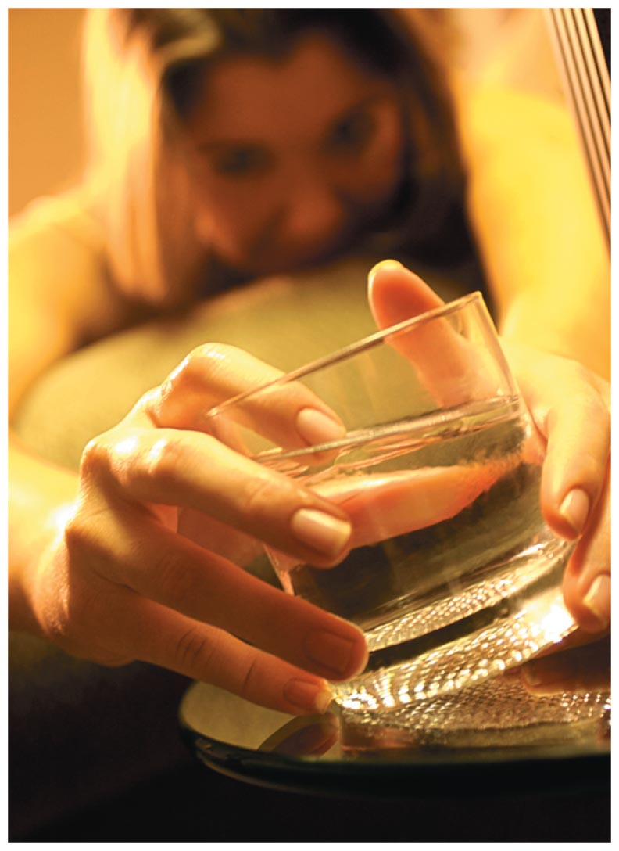
Alcohol and Prescription Drug Abuse
Recent studies have shown that men and women with alcohol use disorders are 18 times more likely to report nonmedical use of prescription drugs than people who do not drink at all.

Slide 43
The Causes of Alcohol Abuse and Alcoholism
Biological and family factors:
Alcoholism is 4 to 8 times more common among individuals who have a family history of alcoholism.
Social and cultural factors:
Social pressure
Family attitude toward drinking

Slide 44
Women and Alcoholism
The trend is for women, especially college-age women, to drink more heavily at a later age than males do.
Women become addicted faster with less alcohol.
Women alcoholics have greater risks for cirrhosis; excessive memory loss and shrinkage of the brain; heart disease; and cancers of the mouth, throat, esophagus, liver, and colon than do male alcoholics.
Notes:
Men who become alcoholics usually start drinking early in life and are identified as alcoholics by their thirties or forties.
Women at highest risk are those who are unmarried but living with a partner, are in their twenties or early thirties, or have a husband or partner who drinks heavily.

Slide 45
Effects of Alcoholism on Family and Friends
Alcohol abusers and alcoholics hurt more than just themselves.
Children in alcoholic dysfunctional families generally assume at least one of the following roles:
Family hero
Scapegoat
Lost child
Mascot
Notes:
Family hero: Tries to divert attention from the problem by being too good to be true
Scapegoat: Draws attention away from the family's primary problem through delinquency or misbehavior
Lost child: Becomes passive and quietly withdraws from upsetting situations
Mascot: Disrupts tense situations by providing comic relief

Slide 46
Costs to Society
Alcohol-related costs to society are estimated to be well over $223.5 billion annually when health insurance costs, criminal justice costs, treatment costs, and lost productivity are factored in.
Most people with alcohol problems are employed. It is estimated that alcohol problems contribute to 500 million lost workdays annually.
A recent study suggests that underage drinking costs society $62 billion annually or $2,070 per underage person.

Slide 47
Treatment and Recovery
Alcohol withdrawal can result in a severe syndrome known as delirium tremens (DTs), which is characterized by confusion, delusions, agitated behavior, and hallucinations.
Family members sometimes take action before the alcoholic does. Intervention is an effective method of helping an alcoholic to confront the disease.
Treatment programs:
Private treatment facilities
Family therapy, individual therapy, and group therapy
Pharmacological treatment
Support groups
Notes:
Most alcoholics require a treatment program, although as many as one third stop drinking on their own. No single treatment works for everyone.
Because many alcoholics have patterns that fluctuate, their alcoholism is probably a response to environmental factors such as stress and may be helped by treatment.

Slide 48
Treatment Programs
Pharmacological treatments:
Disulfiram (Antabuse)
Naltrexone
Acamprosate (Campral)
Support groups:
Alcoholics Anonymous (AA)
Al-Anon, which helps adult relatives and friends of an alcoholic
Alateen, designed, for teens living with alcoholic parents
Women for Sobriety
Secular Organizations for Sobriety (SOS)
Notes:
Alcoholics Anonymous (AA) uses a 12-step program that requires the recognition of one's powerlessness over alcohol and the need for help from a "higher power."
Secular Organizations for Sobriety help those alcoholics who are uncomfortable with the spiritual side of AA's program.
Pharmacological treatments include:
Disulfiram, which causes people to become violently ill when they drink
Naltrexone, which reduces the pleasant effects of alcohol
Acamprosate, approved in 2004, which helps people maintain alcohol abstinence after they have stopped drinking

Slide 49
Relapse
Over half of alcoholics relapse within the first 3 months of treatment.
Treating an addiction requires more than getting the addict to stop using a substance; it also requires getting the person to break a pattern of behavior that has dominated his or her life.
Many alcoholics refer to themselves as "recovering" throughout their lifetime rather than "cured."

Slide 50
Assessing Yourself—A Personal Inventory
Go online to MasteringHealth to take the "What's Your Risk of Alcohol Abuse?" assessment.
Do you ever make a rule to reduce or not drink and then break that rule?
Do you ever wish you could enjoy life as much without alcohol?
Consider your use of alcohol and rank it at either 1, 2, 4, or 5, where 5 indicates a potential alcoholism problem.
Are you ready to commit to a change?
Notes:
Note that there is no number 3 in the scale because this might indicate "fence sitting", or not wanting to make a decision. Before you introduce this chart, find out if there is an AA group on campus and when and where it meets.
Inform students about treatment and/or where they can find information about AA and Alanon in the white pages.

