Slide 1
Chapter 7: Nutrition: Eating for a Healthier You

Slide 2
Did you PREPARE and did you LEARN?
List the six classes of nutrients, and explain the primary functions of each and their roles in maintaining long-term health.
Discuss how to eat healthfully, including the MyPlate plan, the role of dietary supplements, how to read food labels, and the unique challenges that college students face.
Explain food safety concerns facing Americans and people in other regions of the world.

Slide 3
Assessing Eating Behaviors
Hunger is the physiological impulse to seek food, prompted by the lack or shortage of basic foods needed to provide the energy and nutrients that support health.
Appetite is the desire to eat; it normally accompanies hunger but is more psychological than physiological.

Slide 4
Assessing Eating Behaviors
Nutrients are the constituents of food that sustain humans physiologically: proteins, carbohydrates, fats, vitamins, minerals, and water.
Nutrition is the science that investigates the relationship between physiological function and the essential elements of the foods eaten.

Slide 5
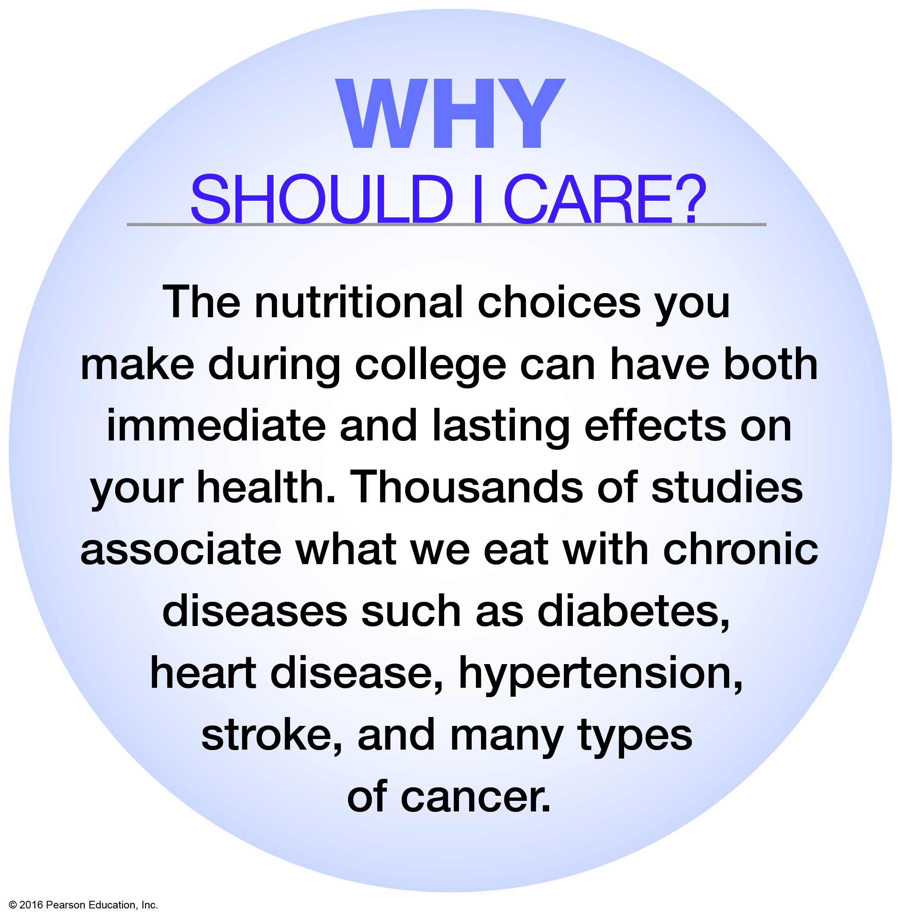
Why Should You Care?

Slide 6
Recommended Intakes for Nutrients
Recommended Dietary Allowances (RDAs)
US Recommended Dietary Allowances (USRDAs)
Adequate Intake (AI)
Tolerable Upper Intake Level (UL)
Acceptable Macronutrient Distribution Ranges (AMDRs)
Notes:
RDAs: The reference standard for intake levels necessary to meet the nutritional needs of 97 to 98 percent of healthy individuals.
AI: The recommended average daily nutrient intake by healthy people when there is not enough research to determine the full RDA.
UL: The highest amount of a nutrient an individual can consume daily without risking adverse health effects.
AMDR: The intakes of proteins, carbohydrate, and fats that provide adequate nutrition, and they are associated with a reduced risk for chronic disease.

Slide 7
Calories
A kilocalorie is a unit of measure to quantify the energy in food that the body can use.
Most nutrition labels use the word calorie to refer to kilocalories.
Energy is defined as the capacity to do work.
Energy-containing nutrients are proteins, carbohydrates, and fat.

Slide 8
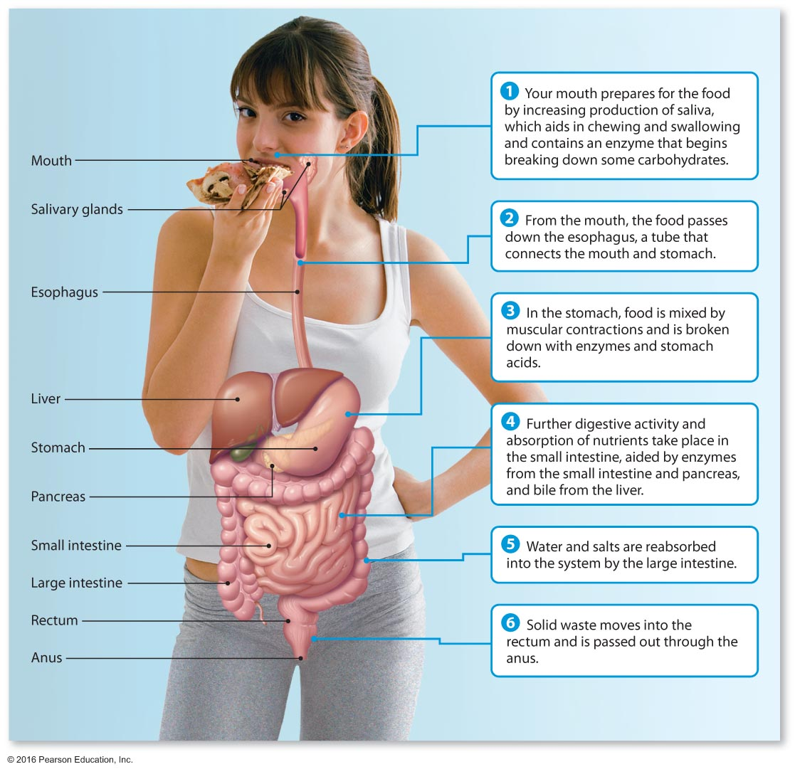
The Digestive Process

Slide 9
Water: A Crucial Nutrient
Humans can survive longer without food than without water.
Dehydration can cause serious problems within hours.
Too much water, or hyponatremia, can also pose a serious risk.
The body is made up of 50 to 70 percent water by weight.
Notes:
About 20 percent of our water needs are met through the food we eat. Fruits and vegetables are 80 to 95 percent water, meats are more than 50 percent water, and even dry bread contains about 35 percent water.
Some situations, as during hot weather, exercise, or when you are ill, require us to consume more water.

Slide 10
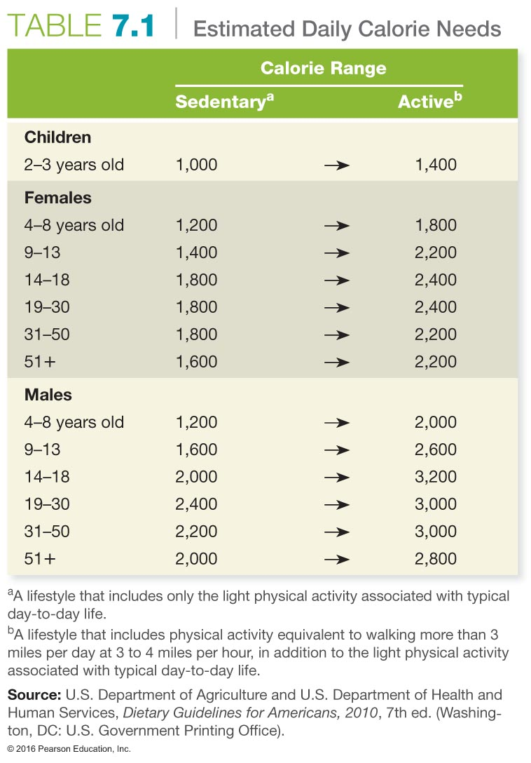
Notes:
1010

Slide 11
Proteins
Next to water, proteins are the most abundant substances in the body.
Proteins are major components of nearly every cell and are called body builders because of their role in developing and repairing bone, muscle, skin, and red blood cells.
They are also the key elements of antibodies.
Notes:
The average American consumes 100 grams of protein each day—twice the recommended daily amount.
Proteins are also key elements of enzymes that control the chemical activities of hormones by which our body functions are regulated. Antibodies are proteins that protect us from disease.
Ask students to list what protein-containing foods they ate yesterday Create lists on the board to show that protein is found not only in meats and other animal products, but also in many other foods

Slide 12
Proteins
Whenever you consume proteins, your body breaks them down into smaller molecules known as amino acids, the building blocks of protein.
Nine of the 20 different amino acids are termed essential amino acids, meaning that the body must obtain them from the diet; the other 11 can be produced by the body.
Notes:
1212
The body breaks down proteins into molecules called amino acids.

Slide 13
Proteins
Dietary protein that supplies all the essential amino acids is called complete (high-quality) protein.
Proteins from plant sources are often incomplete in that they may lack one or two of the essential amino acids. However, it is easy for those who do not eat meat to combine plant foods effectively and eat complementary sources of plant protein.

Slide 14
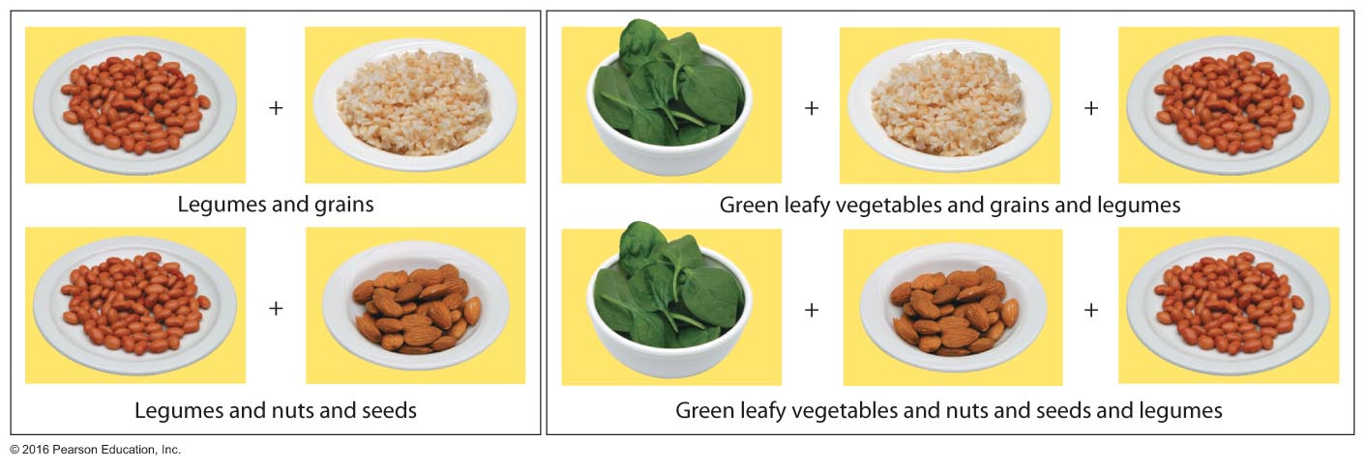
Complementary Proteins
Notes:
1414

Slide 15
Build a Pizza
Notes:
1515

Slide 16
Build a Salad
Notes:
1616

Slide 17
Carbohydrates
Carbohydrates supply us with the energy needed to sustain normal daily activity.
The body metabolizes carbohydrates more quickly and efficiently than it does proteins.
The two major types are simple carbohydrates and complex carbohydrates.
Notes:
Carbs are converted to glucose—the fuel for body cells. They play an important role in the functioning of internal organs, the nervous system, and muscles. They are the best fuel for endurance activities.

Slide 18
Simple Carbohydrates
Most Americans consume large amounts of simple carbohydrates in their diets.
Simple carbohydrates provide short-term energy; they are also known as simple sugars.
Examples of simple sugars are the monosaccharides glucose and fructose.

Slide 19
Simple Carbohydrates
Disaccharides are combinations of two monosaccharides; lactose and maltose are disaccharides.
Americans consume too many refined carbohydrates; these contain only sugars and starch, which have few health benefits.
Sugar is found in foods such as ketchup, barbeque sauce, and flavored coffee creamers.

Slide 20
See It! Video: Ditching Sugar
Discussion Questions
What can you do to avoid overconsumption of sugar?
Why is added sugar unhealthy? What diseases can occur due to consuming high amounts of added sugar?
What are some of the replacement (counterconditioning) tactics that can help cut back on our "want" of added sugar?

Slide 21
Complex Carbohydrates
Complex carbohydrates provide sustained energy.
Complex carbohydrates are polysaccharides, which are long chains of monosaccharides.
Like disaccharides, they must be broken down into simple sugars before the body can use them.
Starches, glycogen, and fiber are the main types of complex carbohydrates.

Slide 22
Complex Carbohydrates: Starches and Glycogen
Starches are an example of a complex carbohydrate group and come from many sources such as flour, pasta, rice, corn, and potatoes.
Polysaccharides can also be stored in the body's muscles and the liver as glycogen. When the body needs energy, it breaks glycogen down into glucose.

Slide 23
Build a Sandwich
Notes:
2323

Slide 24
Fiber
Fiber is the indigestible portion of plant foods that helps move foods through the digestive system, delays absorption of cholesterol and other nutrients, and softens stools by absorbing water. It is found in fruits, vegetables, nuts, and grains.
A more user-friendly classification of fiber types is either soluble or insoluble.
Soluble fibers can dissolve in water, form gel-like substances, and can be easily digested by bacteria in the colon.
Insoluble fibers typically do not dissolve in water and cannot be fermented by bacteria in the colon.
Notes:
2424
Fiber, sometimes referred to as "bulk" or "roughage," is the indigestible portion of plant foods that helps move foods through the digestive system, delays absorption of cholesterol and other nutrients, and softens stools by absorbing water.
Dietary fiber comprises the indigestible parts of plants—the leaves, stems, and seeds Functional fiber consists of indigestible forms of carbohydrates; it may come from plants or be manufactured in a laboratory Total fiber is the sum of dietary fiber and functional fiber in a person's diet
Soluble fibers are pectins, gums, and mucilages, which dissolve in water. They are easily digested in the colon. Food sources include citrus fruits, berries, oat bran, beans, and some vegetables.
Insoluble fibers such as lignins and cellulose do not dissolve in water and cannot be digested by bacteria. They are found in most fruits, vegetables, and whole grains (brown rice, wheat bran, and whole-grain breads and cereals).

Slide 25
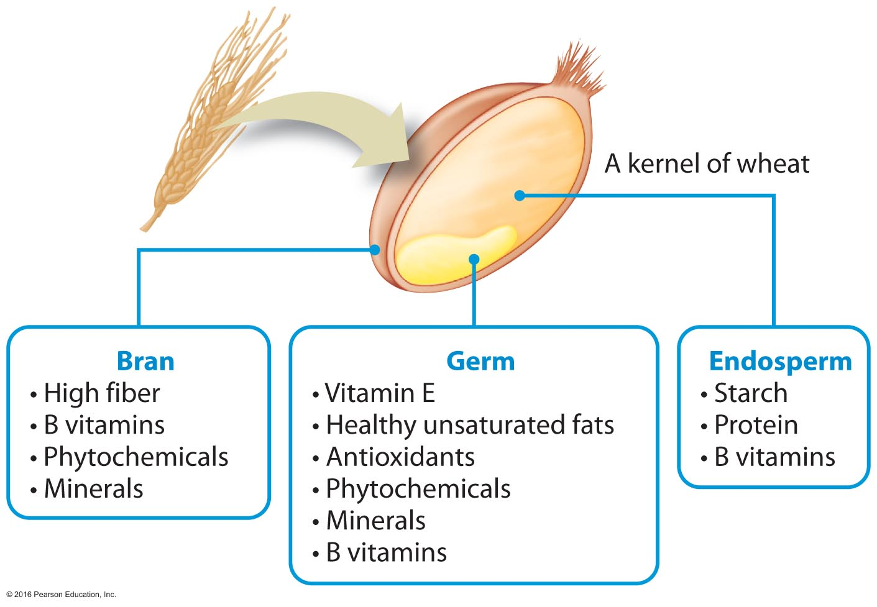
Anatomy of a Whole Grain

Slide 26
See It! Video: Grain Labels Do Not Reflect "Whole" Truth
Discussion Questions
How can we raise consumer awareness that there is a discrepancy between the marketing of grain products and the actual contents of grain products for consumption?
How can companies be held to a better standard to be more honest regarding the contents of products?
Provide an argument for the need for the FDA to define whole grains.

Slide 27
Fats
Fats are the most energy-dense source of calories in the diet.
Fats help maintain healthy skin and hair, insulate body organs, maintain body temperature, and promote healthy cell function.
Fats make foods taste better and carry fat-soluble vitamins A, D, E, and K to the cells.
Notes:
Fats also provide a concentrated form of energy in the absence of sufficient amounts of carbohydrates and make you feel full after eating.

Slide 28
Fats
Triglycerides are the most common form of fat circulating in the blood (95 percent of total body fat).
Cholesterol constitutes some of the remaining 5 percent of body fat, and it can accumulate as plaque on the inner walls of arteries, making it a major cause of atherosclerosis.
High-density lipoproteins (HDLs)
Low-density lipoproteins (LDLs)
Notes:
Fat functions to provide energy; absorb certain vitamins; cushion, insulate, and aid nerve conduction; and regulate body temperature.
HDLs are compounds that facilitate the transport of cholesterol in the blood to the liver for metabolism and elimination from the body. People with a high percentage of HDLs appear to be at lower risk for developing cholesterol-clogged arteries.
LDLs are compounds that facilitate the transport of cholesterol in the blood to the body's cells.

Slide 29
Types of Dietary Fats
Saturated fats are fats that are unable to hold any more hydrogen in their chemical structure. They are derived mostly from animal sources and are solid at room temperature
Unsaturated fats are fats that exclude hydrogen in their chemical structure. They are derived mostly from plants and are liquid at room temperature
Monounsaturated fatty acids (MUFAs)
Polyunsaturated fatty acids (PUFAs)
Linoleic acid is an omega-6 fatty acid.
Alpha-linolenic acid is an omega-3 fatty acid.
Notes:
Saturated fat increases LDL
Monounsaturated fat is liquid at room temperature Examples include olive, peanut, and canola oils
Polyunsaturated fat is also liquid at room temperature Examples include sunflower, corn, and soybean oils These fats help to lower total cholesterol
Omega-6 fatty acid reduces blood levels of total cholesterol and LDL (bad) cholesterol It is found in soybeans, peanuts, corn, and sunflower seeds
Omega-3 fatty acid lowers triglycerides, increases HDL, and acts as anticoagulant to prevent blood clotting It may lower blood pressure and is found in salmon, tuna, flax, canola oil, sardines, spinach, kale, green leafy vegetables, walnuts, and wheat germ

Slide 30
Avoiding Trans Fatty Acids
Trans fats (trans fatty acids) are fatty acids that are produced when polyunsaturated oils are hydrogenated to make them more solid.
Trans fats increase LDL cholesterol levels while decreasing HDL cholesterol levels.
Notes:
3030
A diet with just a 2 percent caloric intake of trans fats is associated with an increased risk of heart disease and heart attack.
Aim to eat fatty fish. Use soy, canola, and olive oils. Eat leafy greens, walnuts, and ground flaxseed.

Slide 31
New Fat Advice: Is More Fat Ever Better?
The bottom line for fat intake is that moderation is the key.
No more than 7 to 10 percent of your total calories should come from saturated fat, and no more than 35 percent should come from all forms of fat.
Switching to beneficial fats without increasing total fat intake is ideal.

Slide 32
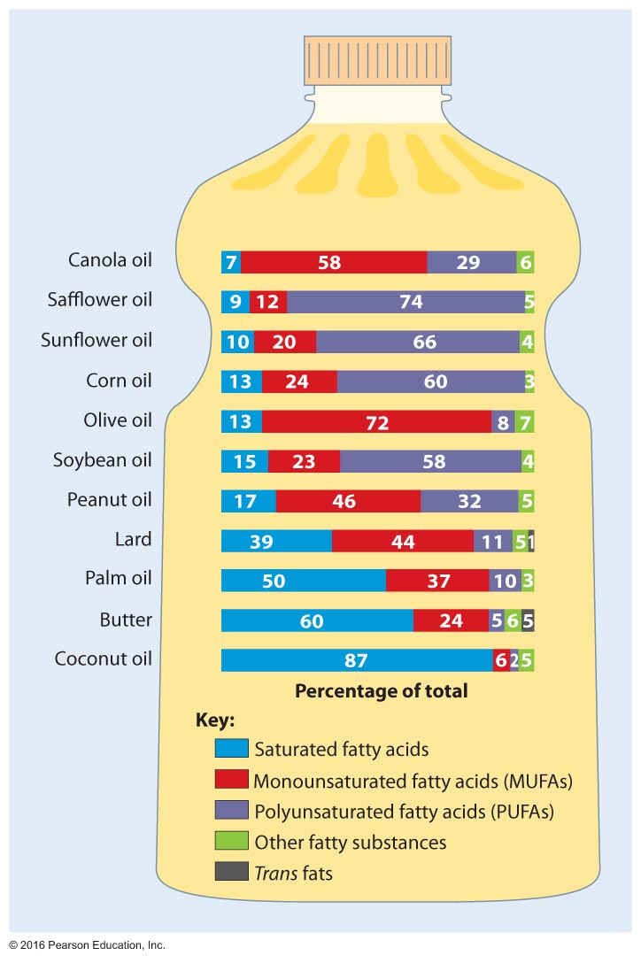
Percentages of Saturated, Polyunsaturated, Monounsaturated, and Trans Fats in Common Vegetable Oils

Slide 33
Build a Meal
Notes:
3333

Slide 34
Vitamins
Vitamins are essential organic compounds that promote growth and reproduction and help maintain life and health.
Vitamins can be either fat-soluble (vitamins A, D, E, and K) or water-soluble (B-complex vitamins and vitamin C).
Vitamins help to maintain nerves and skin, produce blood cells, build bones and teeth, heal wounds, and convert food energy to body energy.

Slide 35
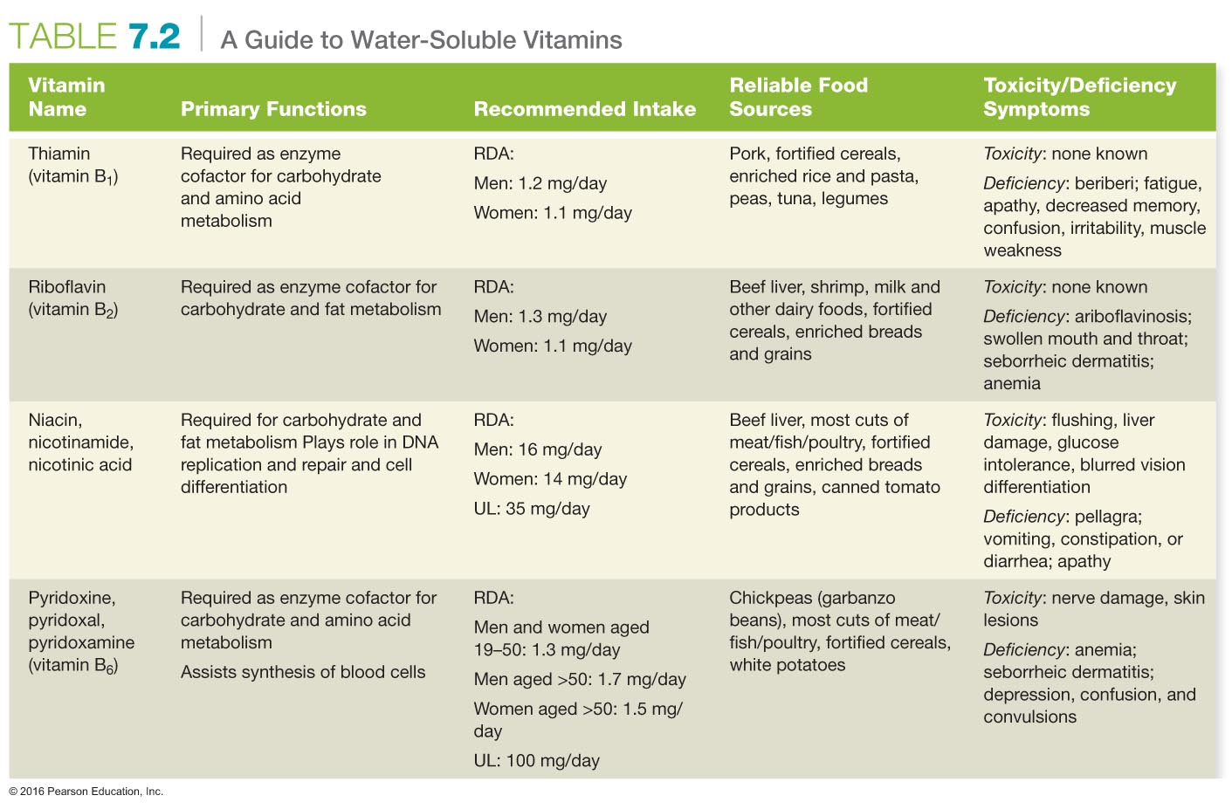

Slide 37
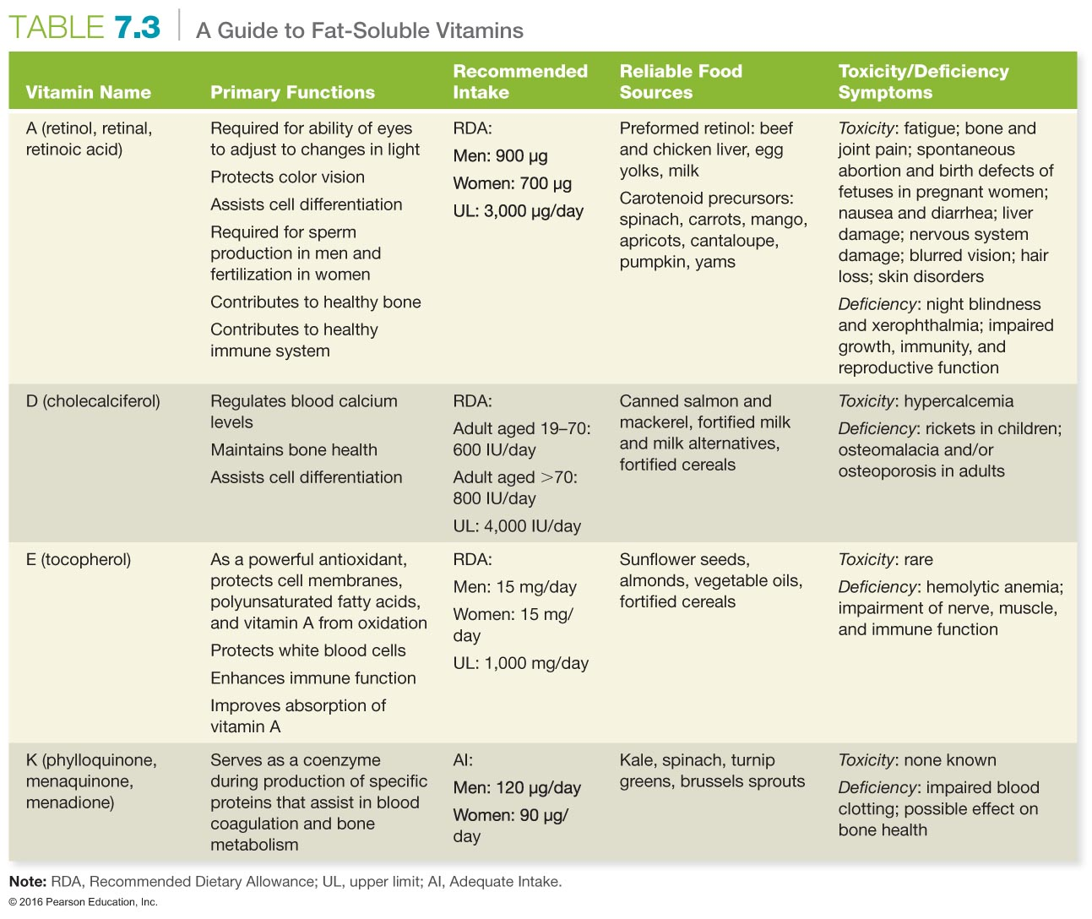

Slide 38
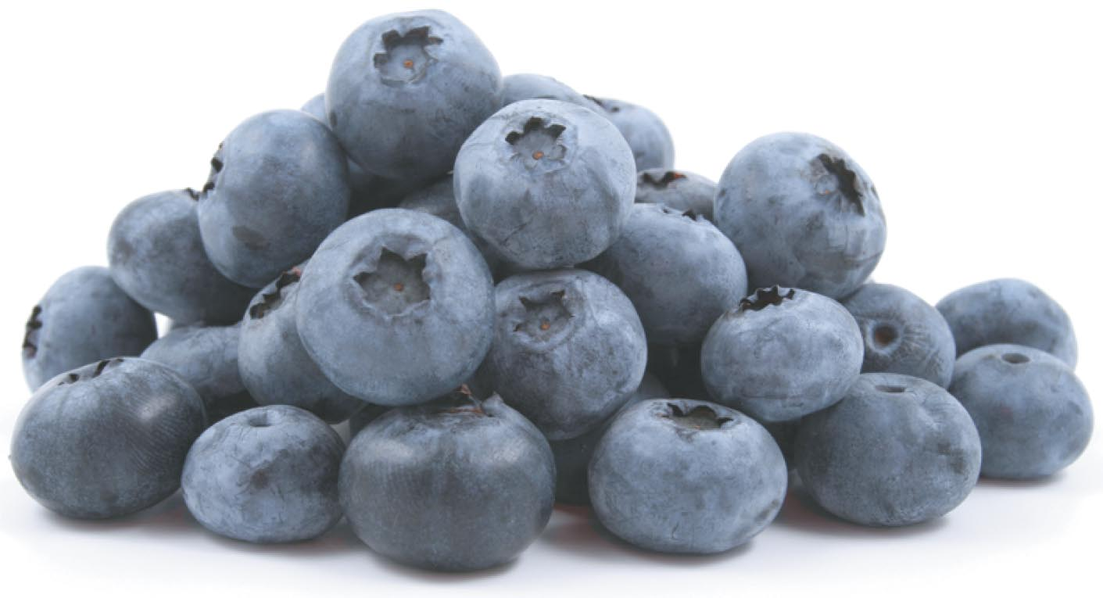
Antioxidants
Beneficial foods are termed functional foods.
Some of the most popular functional foods today are items containing antioxidants or other phytochemicals.
Antioxidants are believed to protect against oxidative stress and tissue damage at the cellular level.
Carotenoids are fat-soluble plant pigments with antioxidant properties
Notes:
3838
Ensuring a daily intake of antioxidants through proper diet can decrease the formation of free radicals.
Antioxidants include vitamins A (beta-carotene), C, and E.

Slide 39
Folate
Folate is the form of vitamin B that is needed for DNA production in body cells.
Folate is important during fetal development because deficiencies during pregnancy can result in spina bifida, a birth defect.
Folate has been widely studied for its potential to decrease blood levels of homocysteine and to protect against cardiovascular disease.
Notes:
3939

Slide 40
Minerals
Minerals are inorganic, indestructible elements that aid physiological processes.
Macrominerals are minerals that the body needs in fairly large amounts.
Trace minerals are minerals that the body needs in very small amounts.
Notes:
4040

Slide 41
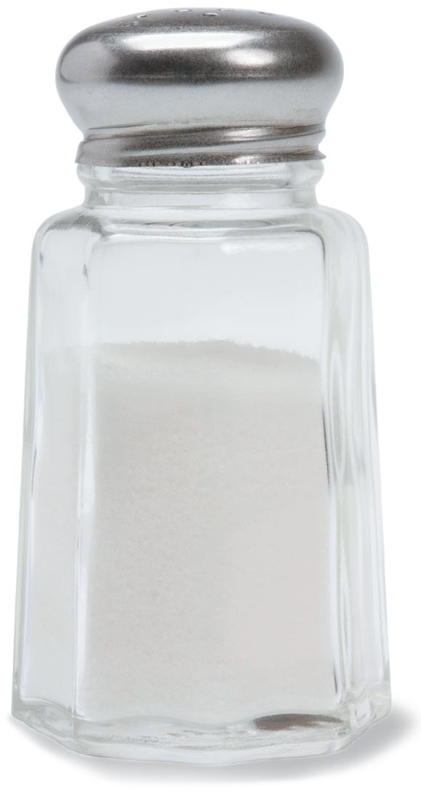
Sodium
Notes:
Sodium is necessary for the regulation of blood and body fluids, transmission of nerve impulses, heart activity, and certain metabolic functions. It enhances flavors, balances the bitterness of certain foods, acts as a preservative, and tenderizes meats, so it's often present in high quantities in many of the foods we eat.
A common misconception is that table salt and sodium are the same. However, table salt accounts for only 15 percent of sodium intake. Most of the sodium in our diet comes from highly processed foods that are infused with sodium to enhance flavor and preservation. Pickles, fast foods, salty snack foods, processed cheeses, canned soups and frozen dinners, many breads and bakery products, and smoked meats and sausages often contain several hundred milligrams of sodium per serving. Many health professionals believe there is evidence that Americans need to reduce sodium.
The Institute of Medicine, the American Heart Association, the FDA, and the US Department of Agriculture (USDA) are among the professional and governmental organizations recommending that healthy people consume fewer than 2,300 milligrams of sodium each day. What does that really mean? For most of us, less than 1 teaspoon of table salt per day is all we need! The latest National Health and Nutrition Examination Survey (NHANES) estimates that the average American over 2 years of age consumes 3,436 milligrams per day.

Slide 42
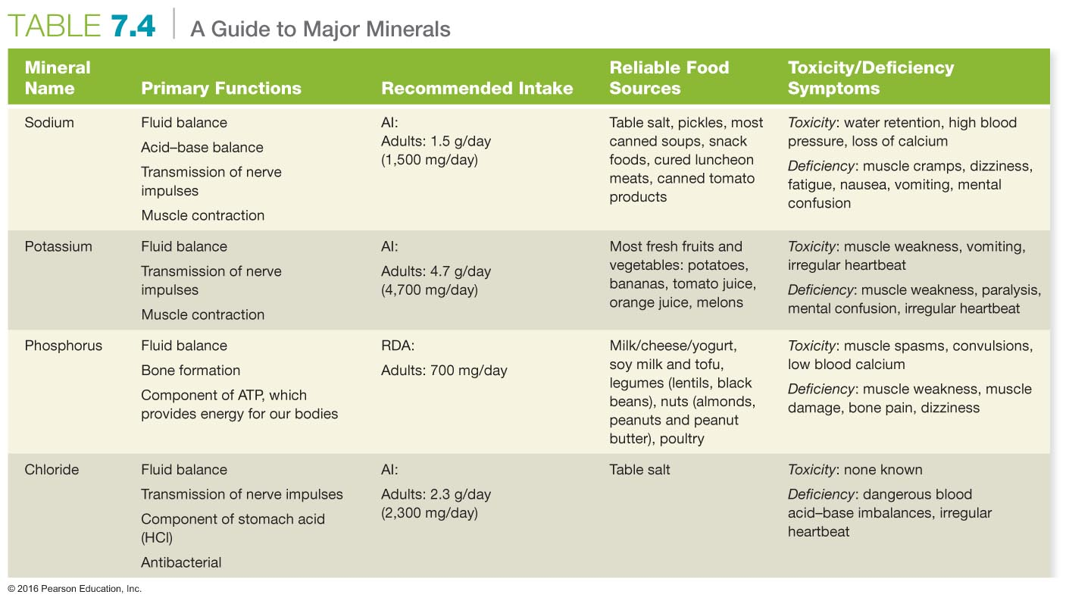

Slide 43
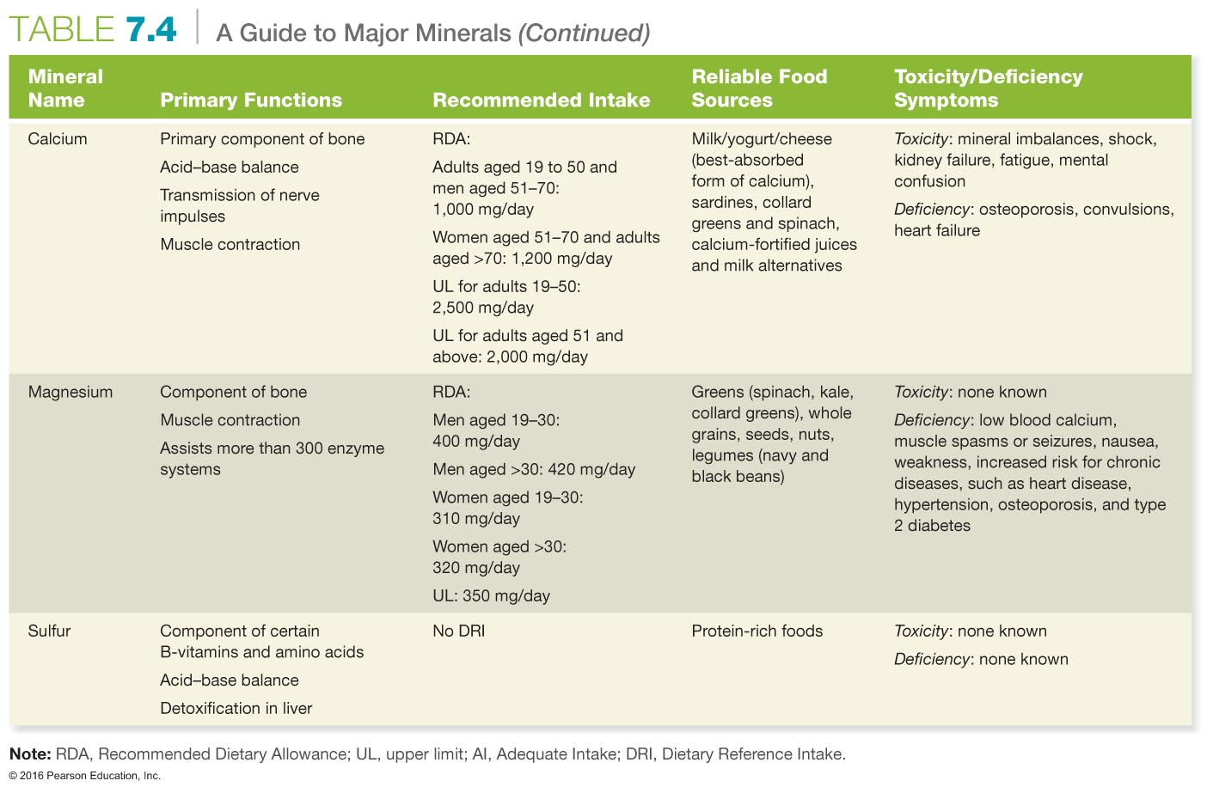

Slide 44
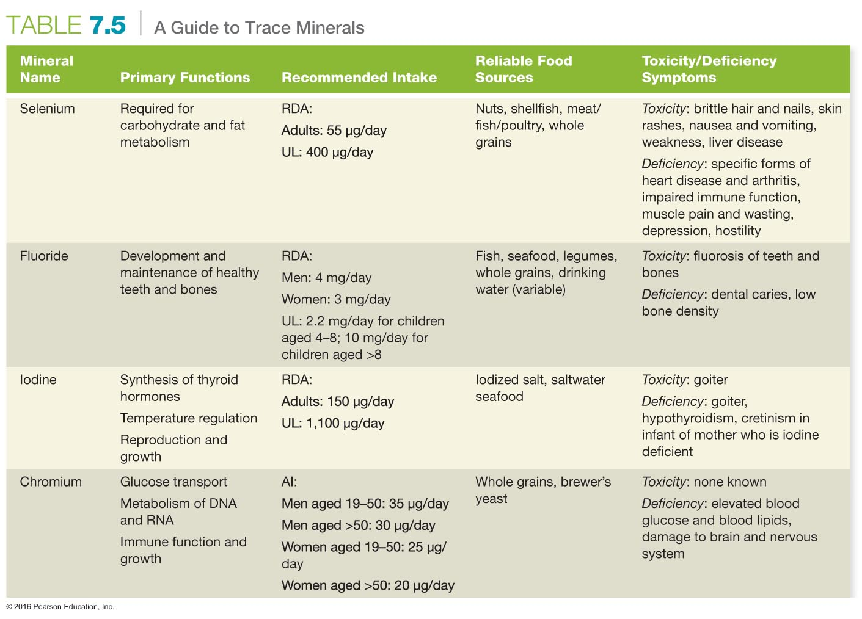

Slide 45
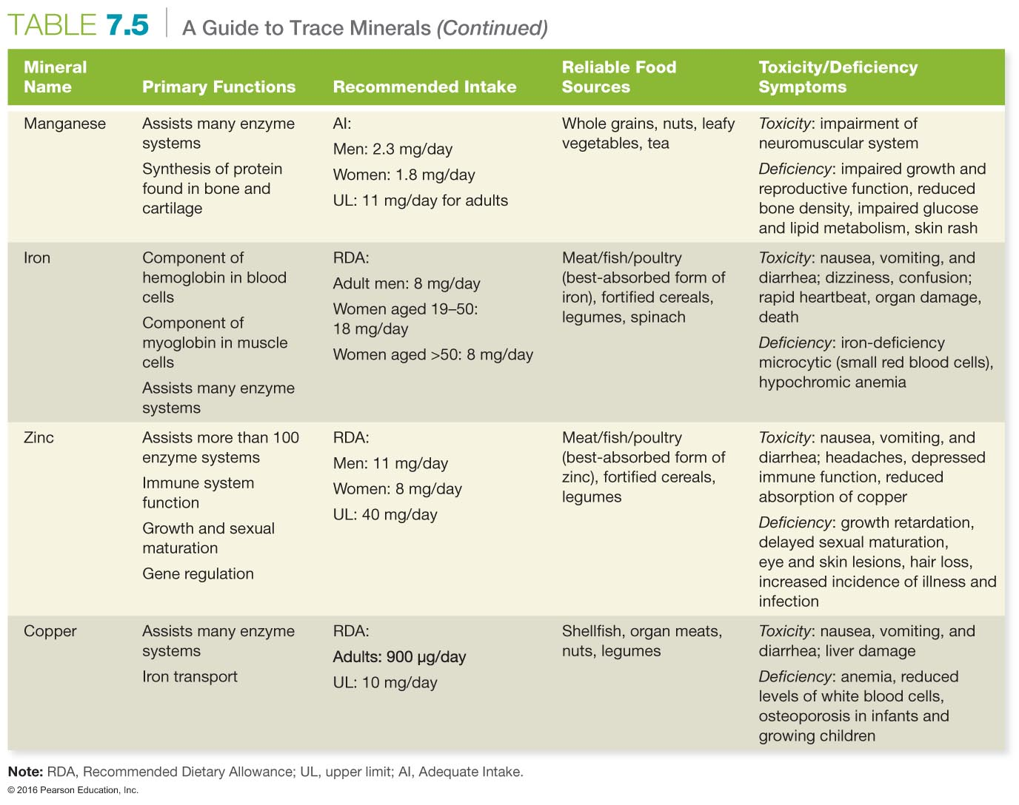

Slide 46
Calcium and Iron
Calcium plays a vital role in building strong bones and teeth and aiding muscle contraction, blood clotting, nerve impulse transmission, regulation of the heartbeat, and maintaining the fluid balance within cells.
Iron is necessary for the production of hemoglobin. Iron deficiency leads to anemia, which is a condition resulting from the body's inability to produce hemoglobin.
Notes:
Iron overload, or iron toxicity due to ingesting too many iron-containing supplements, is the leading cause of accidental poisoning in small children in the United States. Symptoms of toxicity include nausea, vomiting, diarrhea, rapid heartbeat, weak pulse, dizziness, shock, and confusion.

Slide 47
How Can I Eat More Healthfully?
A healthful diet provides the combination of energy and nutrients needed to sustain proper functioning.
A healthful diet should be:
Adequate
Moderate
Balanced
Varied
Nutrient dense

Slide 48
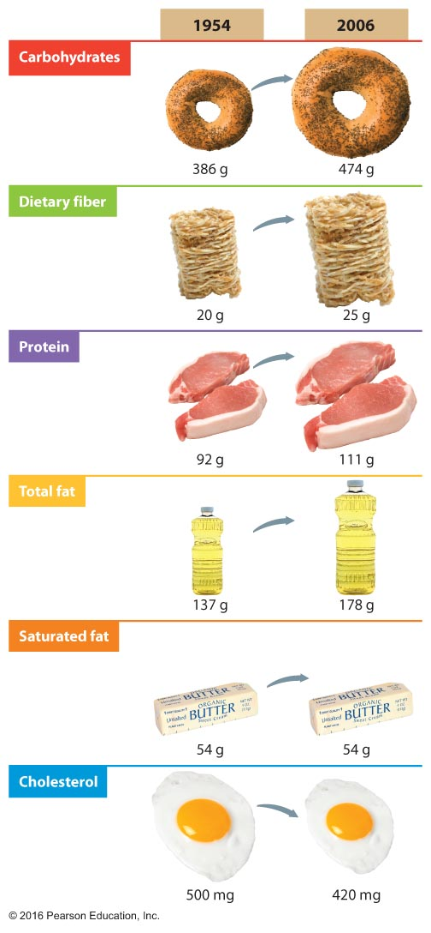
Trends in Per Capita Nutrient Consumption

Slide 49
Use the MyPlate Food Guidance System
MyPlate encourages consumers to eat for health with three general areas of recommendation:
Balance calories:
Enjoy your food, but eat less
Avoid oversized portions
Increase foods:
Fill half your plate with fruits and vegetables
Make at least half your grains whole
Switch to fat-free or 1 percent milk
Reduce foods:
Compare sodium in foods such as soup, bread, and frozen meals
Drink water instead of sugary drinks
Notes:
What is the difference between a serving and a portion? A serving is the recommended amount you should consume, whereas a portion is the amount you choose to eat at any one time.

Slide 50
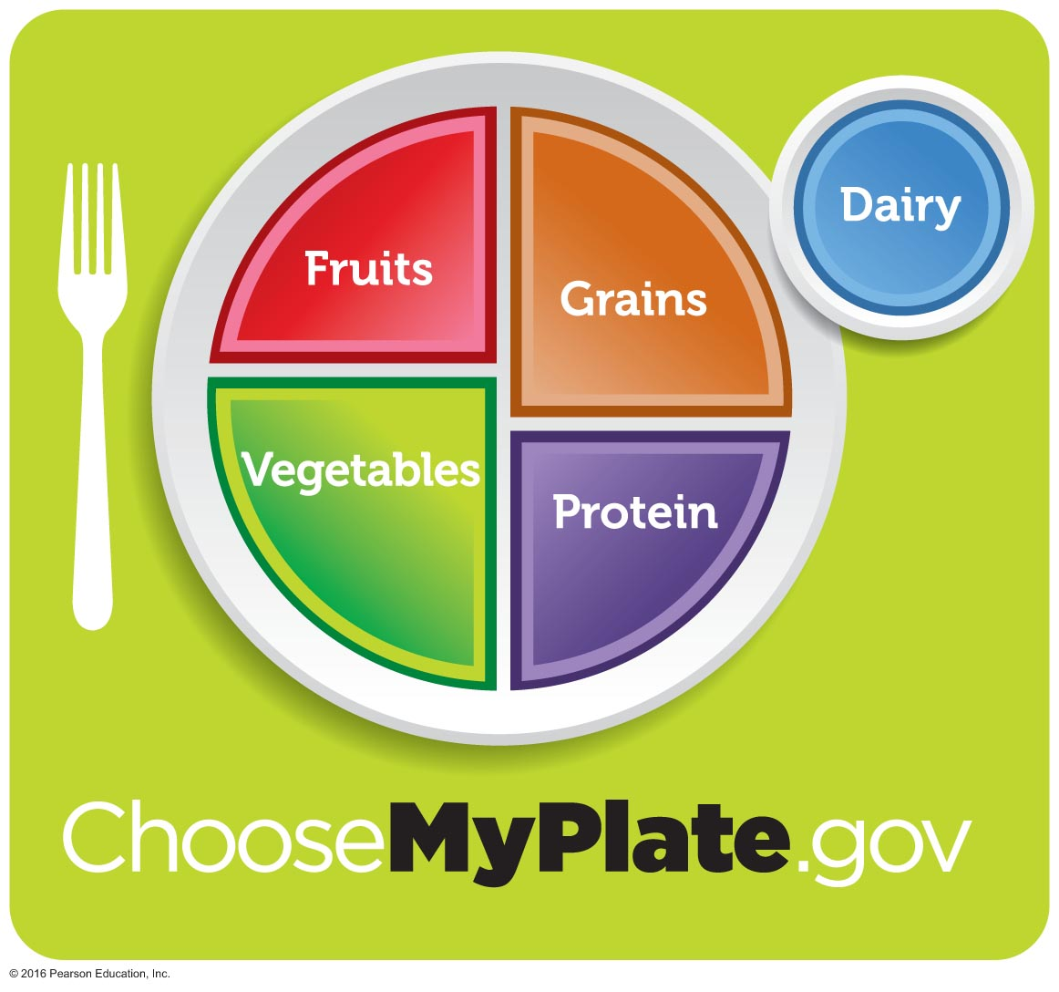
MyPlate Plan
Notes:
5050
A good homework assignment might be to have students record and analyze their diet over 3 days

Slide 51
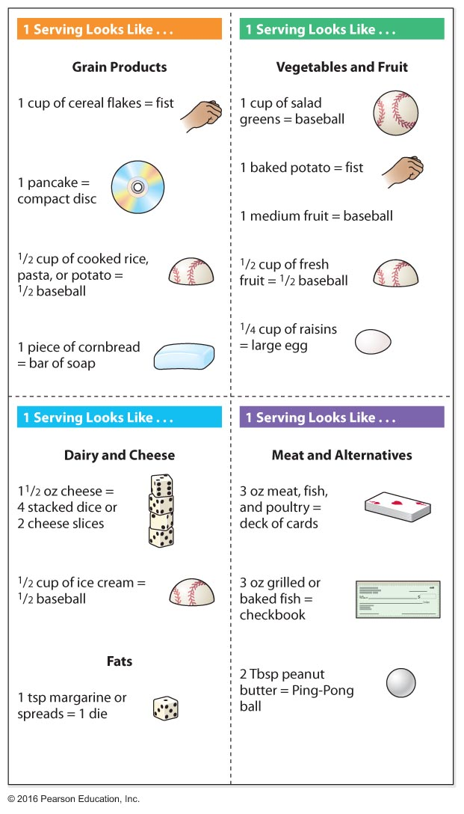
Serving-Size Chart

Slide 52
Read Food Labels
The FDA and the USDA developed the percent daily values (%DVs) list that you see on food and supplement labels. The %DV is calculated based on a 2,000 calorie per day diet.
The FDA allows five types of health-related claims on the packages of foods and dietary supplements:
Nutrient content claims
Structure and function claims
Dietary guidance claims
Qualified health claims
Health claims

Slide 53
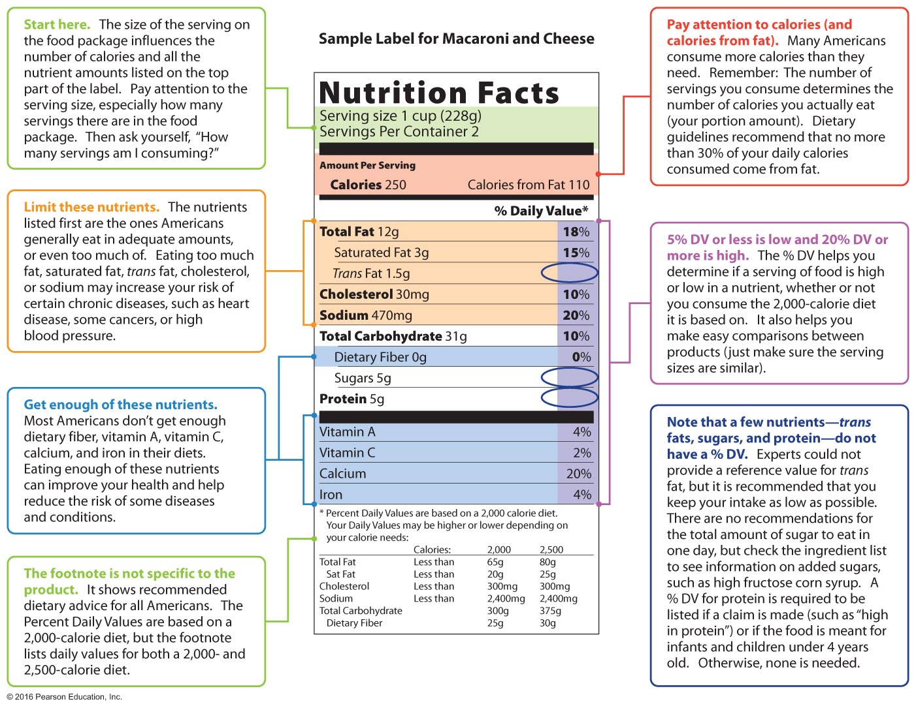
Reading a Food Label

Slide 54
Vegetarianism: A Healthy Diet?
A vegetarian is a person who follows a diet that excludes some or all animal products.
Generally, people who eat a balanced vegetarian diet weigh less and have healthier cholesterol levels, fewer irregular bowel movements, and a lower risk of heart disease than do non-vegetarians.

Slide 55
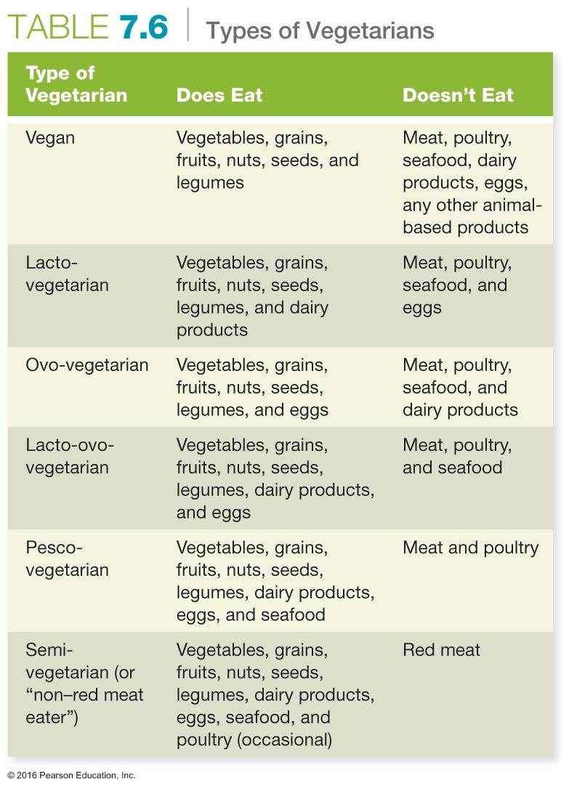

Slide 56
See It! Video: Menu Calorie Counts
Discussion Questions
Is the new federal law, which requires posting calorie counts for foods, beneficial or detrimental for restaurant goers?
In what ways is the calorie count advertised misleading for customers?
Caloric needs are based on several factors. Does the average person have the knowledge to accurately assess caloric intake needs? What more can be done to educate the public regarding caloric needs?
What practical methods can the consumer employ to decrease calorie intake at restaurants?
Notes:
56

Slide 57
Supplements: Research on the Daily Dose
Dietary supplements are products—usually vitamins and minerals—taken by mouth and intended to supplement existing diets.
It is important to note that dietary supplements are not regulated by the FDA, like other food and drug products.

Slide 58
Eating Well in College
If you must eat fast food, try to follow these tips to get more nutritional bang for your buck:
Order salads, but be careful about what you add to them.
Try baked fries.
Avoid giant sizes and refrain from ordering "extra."
Limit beverages and foods that are high in added sugars.
At least once per week, order a vegetable-based product instead of meat when you're eating fast food.

Slide 59
Eating Well in College
In the dining hall, try these ideas:
Choose lean meats, grilled chicken, or vegetable dishes.
Avoid fried foods.
Load up on leafy greens at the salad bar.
Get creative with your meals: have a baked potato with salsa instead of sour cream.
Avoid large portions and going back for seconds.
Pass up high-calorie, low-nutrient foods such as sugary desserts.
Choose fruit or low-fat yogurt to satisfy your sweet tooth.

Slide 60
Choosing Organic or Locally Grown Foods
Organic foods and beverages are developed, grown, or raised without the use of synthetic pesticides, chemicals, or hormones.
It is almost impossible to assess the health impact of organic versus non-organic foods.
A locavore is someone who eats only food grown close to home.
Notes:
6060
Although organic foods may not have shown an advantage in human health, there may be advantages to the environment in favoring them as less pesticides, chemicals, and hormones enter the soil and water when foods are produced organically.

Slide 61
See It! Video: Organic Produce
Discussion Questions
Many Americans may be confused about the nutritional value of organic foods and the benefits of eating organic. How can we get the word out about the nutritional value of organic and conventional foods?
What is the justification for the higher cost of organic foods? Describe reasons you think organic food is or is not worth the higher price tag.
Describe the benefits to eating organic foods.
Notes:
61

Slide 62
Food Safety: A Growing Concern
Foodborne pathogens sicken more than 48 million people; they cause 128,000 hospitalizations and 3,000 deaths in the United States annually.
Most foodborne illnesses are caused by common bacteria and viruses.
Signs of illness vary but may include diarrhea, nausea, cramping, and vomiting.
Notes:
6262
Ask students about ways they can improve food safety in the home and create a list on the board.

Slide 63
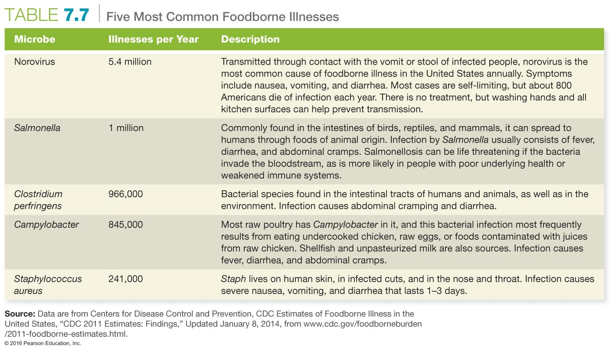

Slide 64
The USDA's Fight BAC!

Slide 65
Food Irradiation
Food irradiation involves treating foods with waves of energy that damage microorganisms.
The process lengthens shelf life and prevents the spread of deadly microorganisms.
Notes:
6565

Slide 66
Food Sensitivities
A food allergy is an overreaction by the body to normally harmless proteins, which are perceived as allergens. In response, the body produces antibodies, triggering allergic symptoms.
In contrast, a food intolerance happens when people who lack the digestive chemicals needed to break down certain substances eat those substances and suffer adverse effects.
Notes:
6666
About 33 percent of people think they have a food allergy, but only 4 to 8 percent of children and 2 percent of adults actually do.
Ask students to identify the foods that cause the most food allergies. (Answers include peanuts, milk, eggs, other nuts, fish and shellfish, soy products, and wheat).

Slide 67
Genetically Modified Food Crops
Additives are substances added to food to reduce the risk of foodborne illness, prevent spoilage, and enhance the way foods look and taste.
Genetically modified foods are foods derived from organisms whose DNA has been altered by using genetic-engineering techniques.
Notes:
Antimicrobial agents: Examples include salt, sugar, and nitrates; these make foods less hospitable to microbes.
Antioxidants: Preservatives of color and flavor and vitamins C and E are examples.
Artificial colors: Nutrient additives, flavor enhancers, and fortifying agents such as folic acid and flavorings such as MSG.
Sulfites: These preserve vegetable color.
The use of GM organisms and foods has sparked much controversy among diverse groups.

Slide 68
Assessing Yourself—A Personal Inventory
Go online to MasteringHealth to take the "How Healthy Are Your Eating Habits?" assessment.
Consider what you ate this past weekend and rank it on a scale of 1 to 10, where 10 indicates that the foods you ate were healthy.
What changes are you prepared to make to improve your nutritional habits?
Do you think your health would be improved if you made these changes?
Notes:
Have students work in groups to discuss answers to these questions.

