Slide 1
Chapter 11: Ending Tobacco Use

Slide 2
Did you PREPARE and did you LEARN?
Describe the rate of tobacco use in the United States, and explain the social and political issues involved in tobacco use.
Discuss the use of tobacco by college students, and identify some of the reasons college students smoke.
Describe how the chemicals in tobacco products affect the body.
Explain the health risks of smoking and using smokeless tobacco.

Slide 3
Did you PREPARE and did you LEARN?
Explain the dangers created by environmental tobacco smoke.
Discuss prevention policies enacted by the U.S. government to curb tobacco use.
Describe the various quitting strategies, including those aimed at ending the body's addiction to nicotine.

Slide 4
United States Tobacco Use
About 70 million Americans age 12 and older report using tobacco products at least once a month.
In 2012, 20.5 percent of men and 15.8 percent of women were current smokers.
Every day, 1,000 people under age 18 become daily smokers.
More than 20 percent of Americans are former smokers.
Notes:
Some 30 percent of all cancer deaths have smoking as a primary causal factor.

Slide 5
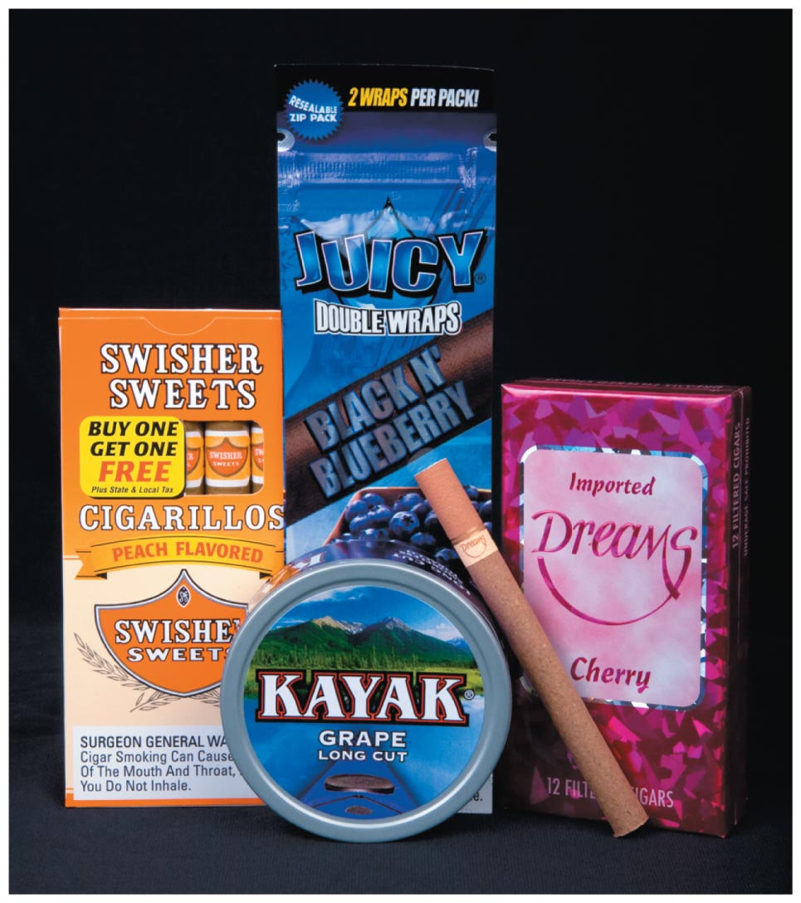
Advertising
An estimated 24 million per day is spent on advertising and promoting tobacco products.
Tobacco companies target children and teenagers with tobacco products that have candy, fruit, or alcohol flavorings.
Advertisements in woman's magazines imply that smoking is the key to financial success, independence, and social acceptance.
Notes:
Certain brands are designed to appeal to men, women, or particular ethnic groups.

Slide 6
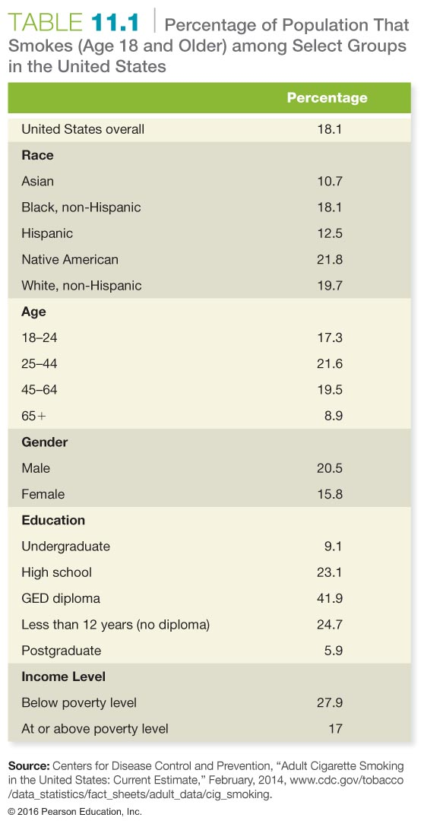

Slide 7
Financial Costs to Society
Annual costs attributed to smoking in the U.S. are between $289 and $333 billion.
Economic burden is $132–$176 billion in direct medical expenditures and $156 billion in lost productivity
Smoking-related health costs and productivity losses are $18.20 per pack of cigarettes sold.
These costs far exceed the tax revenue from cigarette sales.

Slide 8
Women and Smoking: Catching Up to the Men
Less educated women are more likely to smoke, and more affluent women are less likely to smoke.
An estimated 174,000 women die each year of tobacco-related diseases.
Women who die of a smoking-related disease lose, on average, 14.5 years of potential life.

Slide 9
College Students and Tobacco Use
Despite heavy promotion by the tobacco industry, U.S. college students are smoking less.
College students say they smoke to relax, to reduce stress, or to control weight gain.
Students who smoke regularly do want to quit.
Notes:
Studies have consistently shown a link between smoking, depression, and low life satisfaction.
Students who have reported being depressed in the previous year are much more likely to smoke than those who were not.
Other research finds that students diagnosed or treated for depression are 7.5 times more likely to use tobacco than students who were never diagnosed or treated for depression.

Slide 10
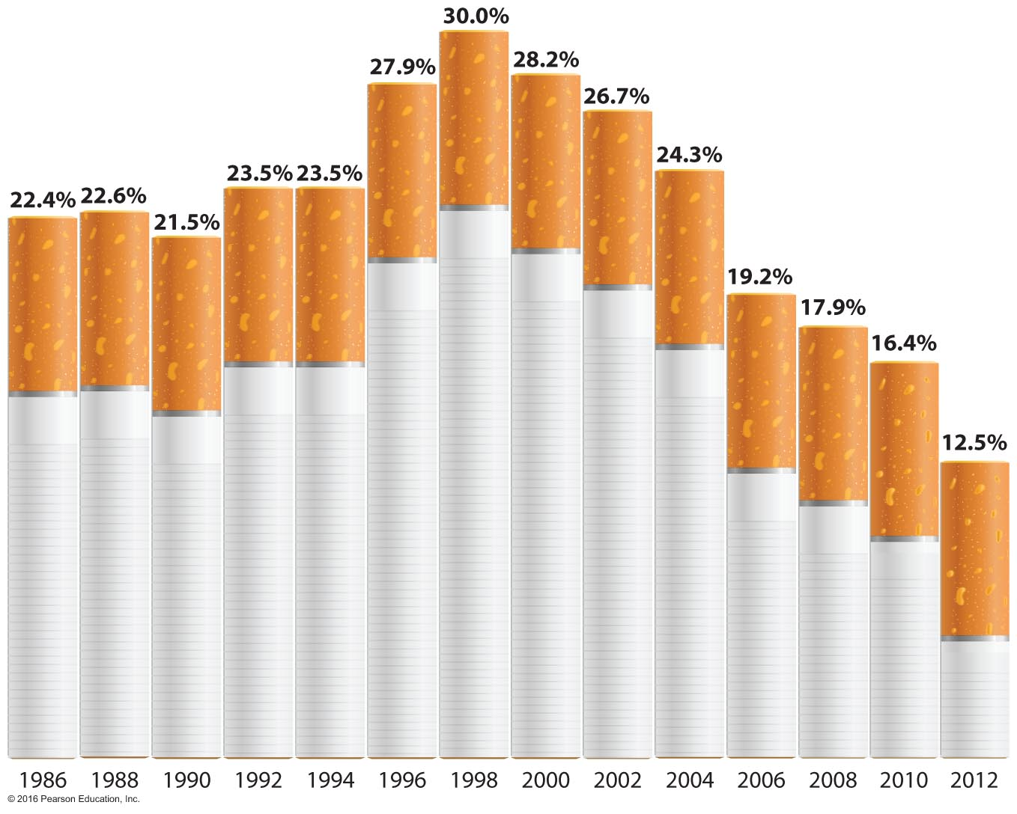
Trends in Prevalence of Cigarette Smoking in the Past Month among College Students

Slide 11
See It! Video: Do Nicotine Patches and Gum Work?
Discussion Questions
What impacts have state and national laws had on rates of smoking?
How involved should the state be in regulating smoking and/or making it difficult for people to smoke?
New York is discussing increasing the age for people to purchase cigarettes to 21. Discuss reasons to support the increase in age, and discuss reasons why the state should not increase the age to 21.

Slide 12
Social Smoking
Many college students identify themselves as "social smokers"—those who smoke when they are with people rather than when they are alone.
Social smoking in college or only at other social occasions can lead to a complete dependence on nicotine and thus to all the same health risks as smoking regularly.

Slide 13
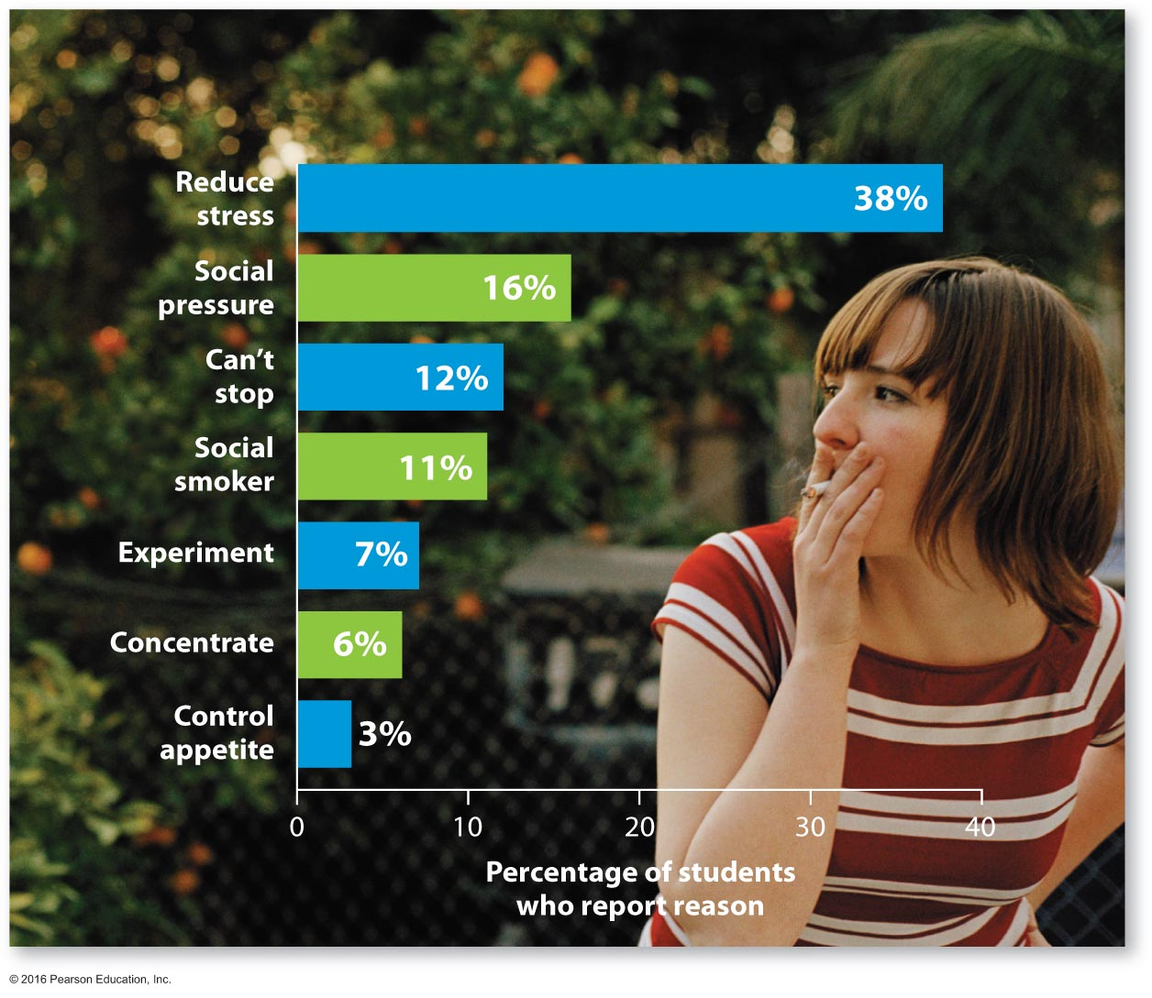
Reasons Why College Students Smoke

Slide 14
Effects of Tobacco
Nicotine is a chemical stimulant and is highly addictive.
Cigarette smoke is a complex mix of chemicals and gases produced by burning tobacco and its additives.
Tar is condensed particulate matter from smoke that accumulates in the lungs.
Notes:
Tobacco smoke contains hundreds of damaging chemical substances. Smoke from an unfiltered cigarette contains 5 billion particles per cubic millimeter, or 50,000 times more than in an equal amount of polluted urban air. When condensed, these particles form a sticky mass called tar.

Slide 15
Effects of Tobacco
Phenols are chemical irritants in smoke that may combine with other chemicals to contribute to the development of lung cancer.
The cleansing function of the lungs' cilia is impaired by nicotine.
Carbon monoxide is a gas found in cigarette smoke; it binds at oxygen receptor sites in the blood.

Slide 16
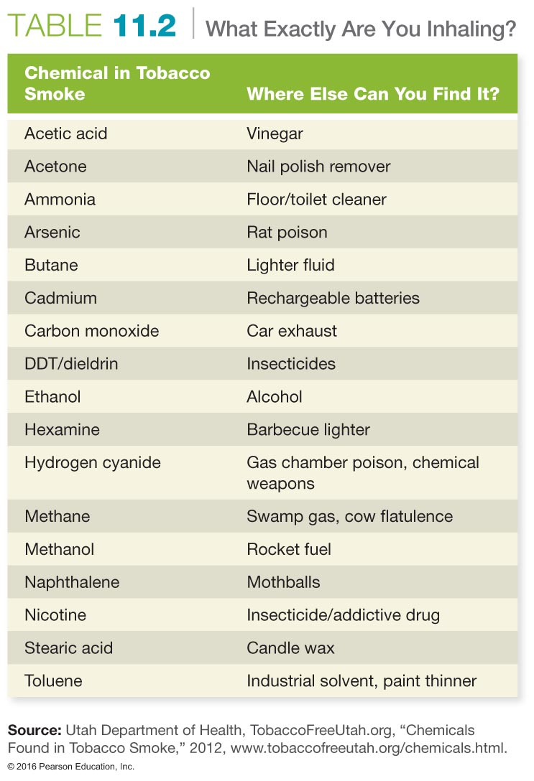

Slide 17
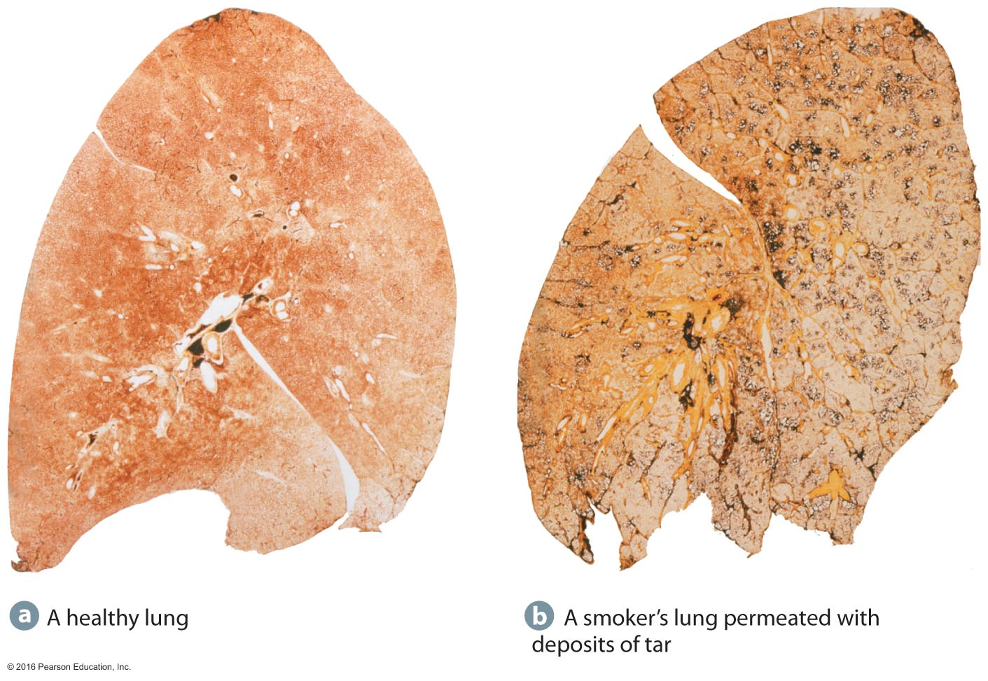
Lung Damage from Chemicals in Tobacco Smoke

Slide 18
Tobacco Addiction
Nicotine addiction: Tolerance to nicotine develops almost immediately and causes nicotine poisoning.
Behavioral dependence: Psychological dependence results in comfort.
Weight control: Nicotine is an appetite depressant and elevates metabolism.
Notes:
Ask the class how many have ever tried a cigarette, and ask those that have tried but don't smoke why they did not continue.

Slide 19
Tobacco Products
Filtered and nonfiltered cigarettes are the most common forms of tobacco available today.
Clove cigarettes are about 40 percent ground cloves, 60 percent tobacco.
Menthol cigarettes have higher carbon monoxide concentrations than do regular cigarettes.
Cigars contain 23 poisons and 43 carcinogens.

Slide 20
Tobacco Products
Pipes and hookahs are promoted as safe alternatives to cigarettes.
They are not safer.
They are particularly popular among college students.
Hookah smoking carries the same risk as smoking cigarettes and also the risk of transmitting infectious diseases.
Notes:
Hookahs are marketed as a safe alternative to cigarettes because they reduce your risks from hazardous chemicals by filtering the smoke through water before you inhale. In fact, water pipes may cool the smoke; however, they do not eliminate or filter out harmful substances such as nicotine, carbon monoxide, or tar. In addition to the health risks associated with all tobacco products, unique risks associated with hookah use include hygiene and sanitation concerns from sharing the pipe and the possibility of infectious disease transmission.

Slide 21
Tobacco Products
Bidis are small hand-rolled, flavored cigarettes that produce three times more carbon monoxide and nicotine and five times more tar than conventional cigarettes.
Smokeless tobacco:
Chewing tobacco
Dipping tobacco
Snuff

Slide 22
Is Chewing Tobacco as Harmful as Cigarette Smoking?
This young cancer survivor began using smokeless tobacco at age 13; by age 17 he was diagnosed with squamous cell carcinoma and has undergone surgery to remove neck muscles, lymph nodes, and his tongue to beat his cancer.

Slide 23
Health Hazards of Tobacco Products
Cancer
Cardiovascular disease
Platelet adhesiveness
Stroke
Respiratory disorders
Chronic bronchitis
Emphysema
Sexual dysfunction
Gum disease
Notes:
Other health hazards associated with smoking include ulcers, erectile dysfunction, reproductive health problems, dental diseases, diminished physical senses, and injuries. Smoking also increases the risk of gastrointestinal reflux, which causes heartburn and can, if severe, increase the risk of esophageal cancer.

Slide 24
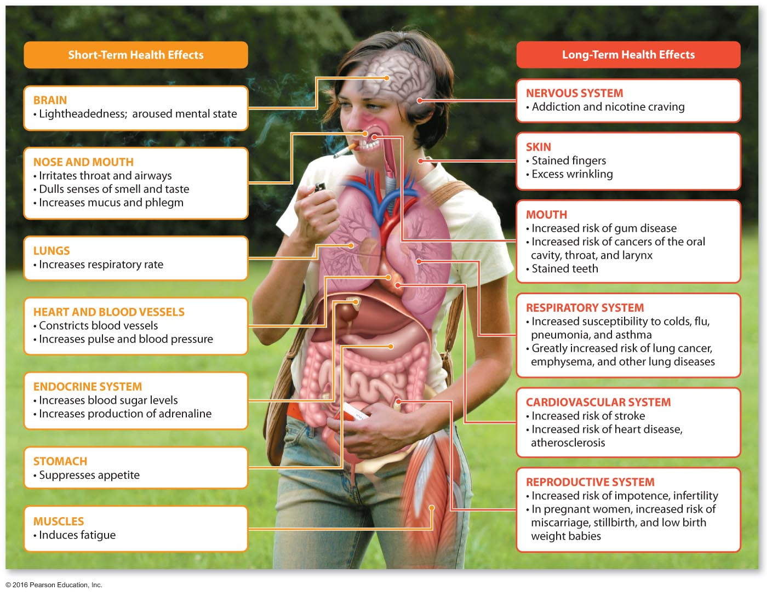
Effects of Smoking on the Body and Health
Notes:
Male and female smokers experience a greater rate of acute and chronic diseases.

Slide 25
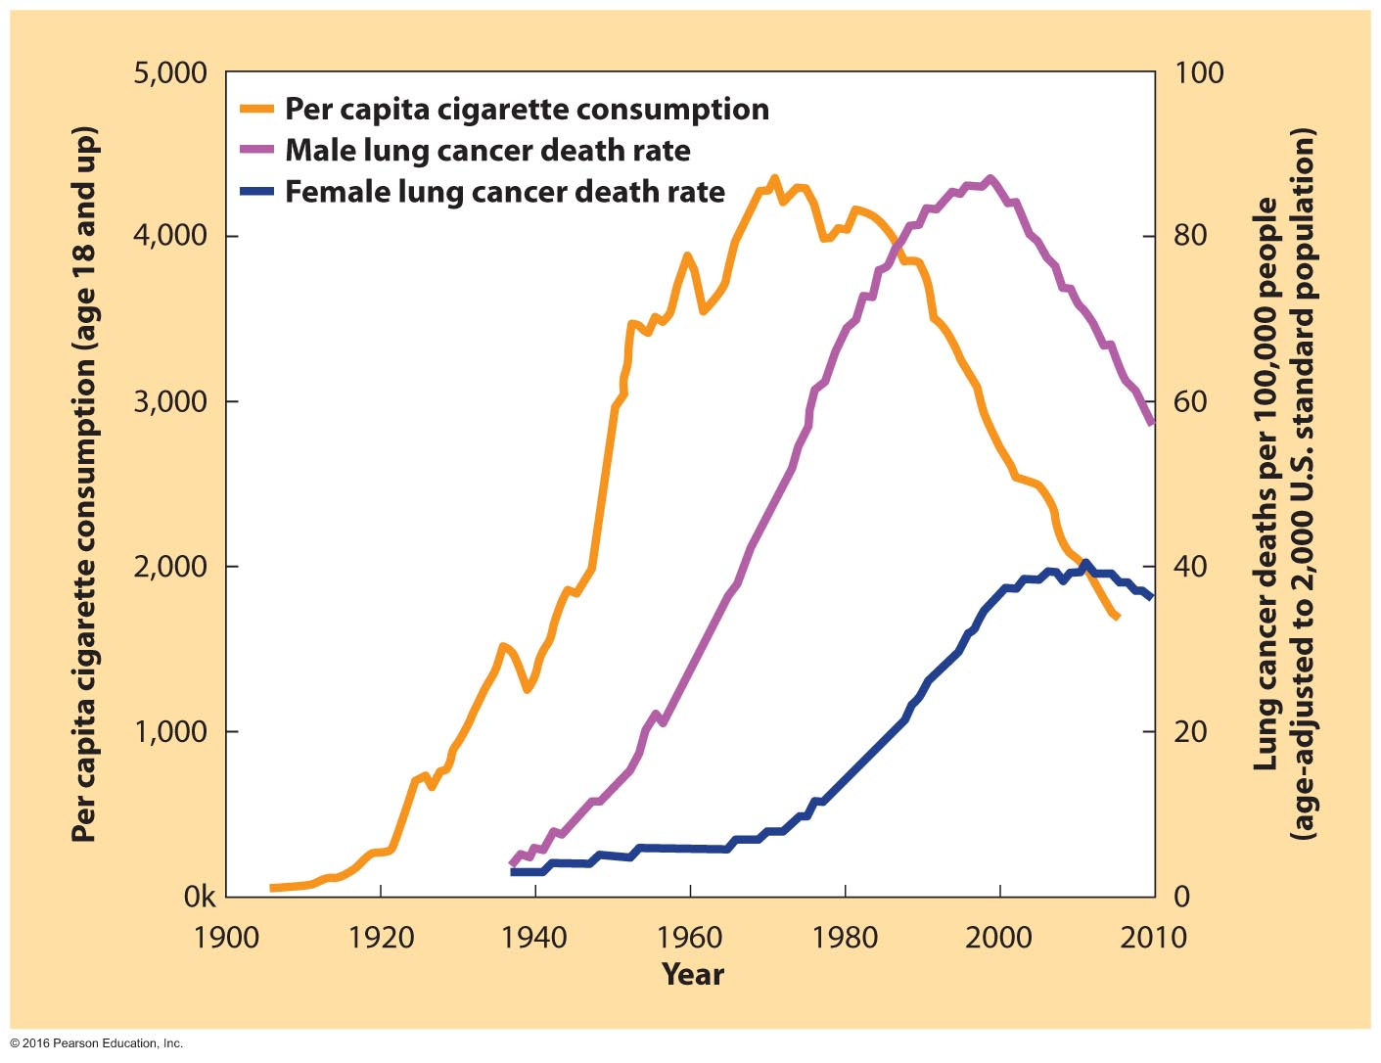
Correlation between Tobacco Consumption and Lung Cancer Deaths in the United States

Slide 26
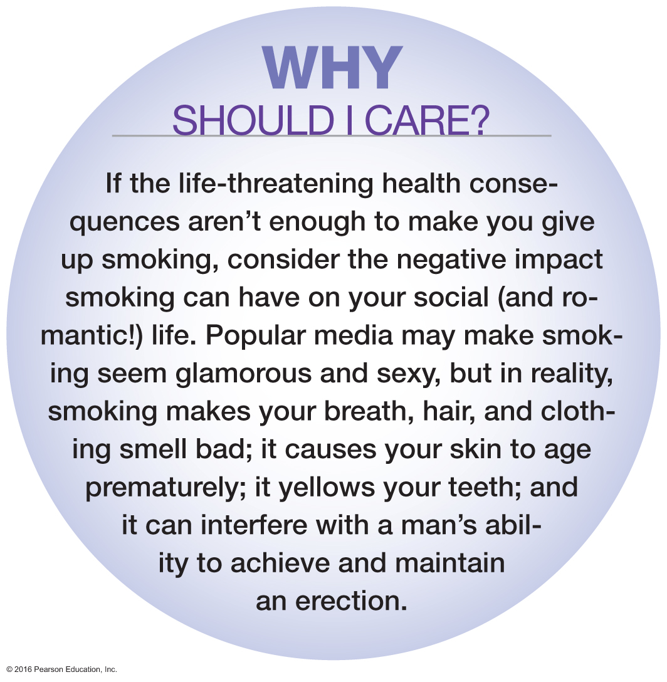
Why Should You Care?

Slide 27
Tobacco-Related Cancers
Lung cancer is directly linked to cigarette smoking.
It is the cause of cancer deaths in the United States.
It may take 10 to 30 years to develop.
Leukoplakia is a condition characterized by white patches inside the mouth due to chewing tobacco.
Tobacco is linked to other cancers.
Pancreatic
Kidney
Bladder
Larynx
Notes:
Lung cancer: Benzo[a]pyrene, a chemical found in tobacco smoke, causes mutations in lung cells that are identical to those found in many patients with lung cancer.
The risk increases proportionally to the number of cigarettes smoked daily, the number of years a person has smoked, and the age at which the person started to smoke.
Smoking as little as one cigar per day can double the risk of several cancers—of the oral cavity, esophagus, larynx, and lungs.
After 1 year without smoking, the risk of lung cancer falls substantially; after 10 years, the risk of lung cancer among ex-smokers is 50 percent that of continuing smokers.

Slide 28
Cardiovascular Disease
Over one third of all tobacco-related deaths occur from heart disease.
Smokers are 2 to 4 times as likely to suffer strokes.
The risk of dying from a heart attack falls by half after 1 year without smoking.

Slide 29
Respiratory Disorders
Chronic obstructive pulmonary disease:
Chronic bronchitis
Chronic emphysema
There is no known cure for emphysema, and the damage is irreversible. Approximately 80 percent of all cases of emphysema are related to cigarette smoking.

Slide 30
Sexual Dysfunction and Fertility Problems
Smoking can cause male impotence.
Smokers are two times more likely to suffer from some form of impotence, which may indicate oncoming cardiovascular disease.
Female smokers have an increased risk of infertility, ectopic pregnancy, spontaneous abortion, and stillbirth.
Their babies are at risk for sudden infant death syndrome (SIDS), cleft palate, or cleft lip.
Notes:
Smoking during pregnancy:
Leads to approximately 30 percent of premature births
Increases the risk of low birth weight, which in turn increases the risk of illness and death for the baby

Slide 31
Environmental Tobacco Smoke
Mainstream smoke is the smoke that is drawn through tobacco while inhaling.
Sidestream, or secondhand, smoke is that which is emitted from the burning end of a cigarette or exhaled by a smoker.
Involuntary or passive smokers breathe smoke from someone else's smoking product.
More than 53 percent of U.S. children age 3 to 11 years—or 22 million children—are exposed to ETS.
Notes:
Children exposed to ETS have an increased risk of lower respiratory tract infections. They are also at higher risk for other respiratory problems such as coughing, wheezing, asthma, chest colds, and decreased lung function.

Slide 32
Risks from Environmental Tobacco Smoke
Sidestream smoke contains more carcinogenic substances than mainstream smoke.
It contains 2 times more tar and nicotine, 5 times more carbon monoxide, 50 times more ammonia.
ETS is responsible for 3,400 lung cancer deaths, 46,000 coronary and heart deaths, and higher risk of deaths in newborns (SIDS).
Notes:
Nonsmokers exposed to secondhand smoke are 20 to 30 percent more likely to have coronary heart disease than those who are not exposed to smoke.

Slide 33
Tobacco Use Prevention Policies
It has been more than 40 years since the government began warning that tobacco use was hazardous to health.
Master Settlement Agreement (MSA) of 1998
Tobacco industry to pay states $206 billion over 25 years
Various measures to support antismoking education and advertising to be taken
Notes:
Under the 1998 MSA, tobacco companies are:
Required to pay approximately $206 billion over 25 years nationwide
Forbidden to use billboard advertising
Forbidden to use cartoon characters in advertising
Forbidden to market cigarettes to children
Forbidden to misrepresent the health effects of cigarettes

Slide 34
Will Quitting Reverse the Damage That Has Already Been Done?
Tobacco causes serious injury to your heart and lungs, but when you quit, your body immediately starts to recover and repair the damage. Over time, the body's repair processes reduce a former smoker's risk of heart disease and cancer; after 10 years, lung cancer risk is comparable to those of nonsmokers, and after 15 years, heart disease risk is the same.

Slide 35
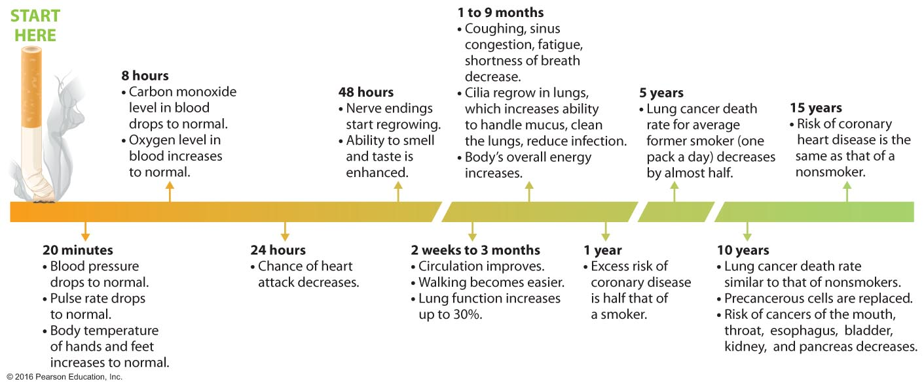
When Smokers Quit

Slide 36
Benefits of Quitting
According to the American Cancer Society, many tissues damaged by smoking can repair themselves.
As soon as smokers stop, the body begins the repair process. Within 8 hours, carbon monoxide and oxygen levels return to normal, and "smoker's breath" disappears.
After 1 year of not smoking, the risks for lung cancer and stroke decrease.

Slide 37
Breaking the Nicotine Addiction
The road to quitting may include antismoking therapy.
Operant conditioning pairs smoking with an external stimulus. When the stimulus is removed, the hope is that smoking will cease.
Self-control therapy aims at identifying the situations associated with smoking and then teaching skills needed to resist smoking.
Notes:
Example to share:
Pavlov's dogs received operant conditioning. That is, every time they were fed, a bell was rung, and the food caused them to salivate. The dogs were trained to associate the bell with food. Eventually just ringing the bell caused salivation.
Side note – in this experiment, the dogs were in a food-restricted state before the experiment and during the experiment.

Slide 38
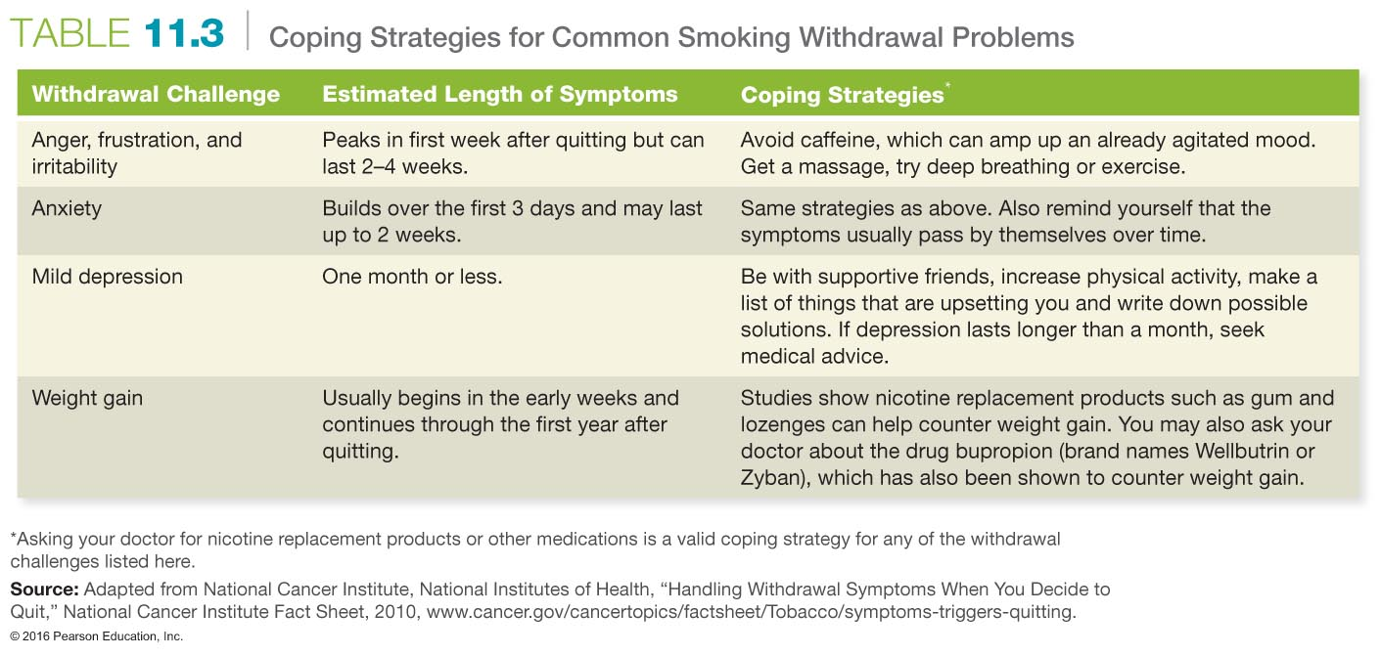

Slide 39
Quitting
Breaking the nicotine addiction:
Withdrawal
Nicotine replacement products:
Nicotine gum
Nicotine patch
Nasal spray
Nicotine inhaler
Buproprion (Zyban)
Notes:
Quitting tobacco use:
A recent survey showed 70 percent of tobacco users want to quit and 44 percent of those will make an attempt this year.
No single method for breaking this addiction works for everyone.

Slide 42
Assessing Yourself—A Personal Inventory
Go online to MasteringHealth to take the "Tobacco: Are Your Habits Placing You at Risk?" assessment.
If you are a smoker, list the health hazards that you risk because of smoking and the benefits you would gain from quitting. Which list is longer, and is it worth it to continue smoking?
If you are a nonsmoker, are you doing everything you can to promote a nonsmoking environment?

